Slide 1

Security of mortgage lending and structures of mortgage funding
Europe and Brazil
32nd IUHF World Congress 2024
19 September 2024
Berlin, Germany
Dr. Claudia Magalhães Eloy, Editor of the Latin America and Caribbean Housing Yearbook
Dr. Tim Lassen, Member of Management Board, Department Head „Cover Assets“

Slide 2
AGENDA – Europe Brazil
A. Reliablility of Mortgage Finance
Round Table SRIP
Mortgage as Credit Collateral
Land Register
Foreclosure
Insolvency
B. Specific Legislation on Covered Bonds
Round Table Covered Bond Legislation (RTCBL)
Introduction to CBs - A traditional concept with a global footprint
Up to date Covered Bond Law
Valuation and LTV
Independent and Specific Public Supervision
Insolvency Procedures over CB Issuer
Investment Rules
C. Reconstruction in Germany post 1945
Public Guarantees for Housing Finance
Tax Privilege for Housing Covered Bonds
A. Reliablility of Mortgage Finance
The creation of the Fiduciary Lien
The substitution of traditional mortgages “hipoteca”
RT SRIP - a brief comparison
  Mortgage as Credit Collateral
  Land Register
  Foreclosure
  Insolvency
B. Specific Legislation on Covered Bonds
Regulatory process (2015 to 2024)
Regulation
  Issuers and issuance limits
  Characteristics
  Fiduciary Regime and Agent
  Cover Pool
  Assets’ eligibility and LTV
C. Funding for Mortgages/Real Estate
The traditional deposits system
The introduction of CBs (& other securities)
The development of CBs
Current funding and mortgage portfolios

Slide 3
A. Reliability of
Mortgage Finance

Slide 4
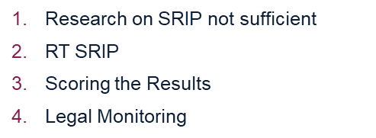
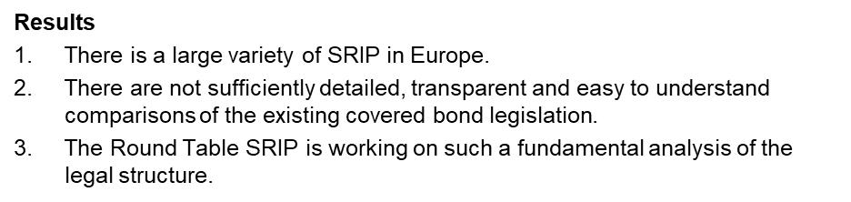
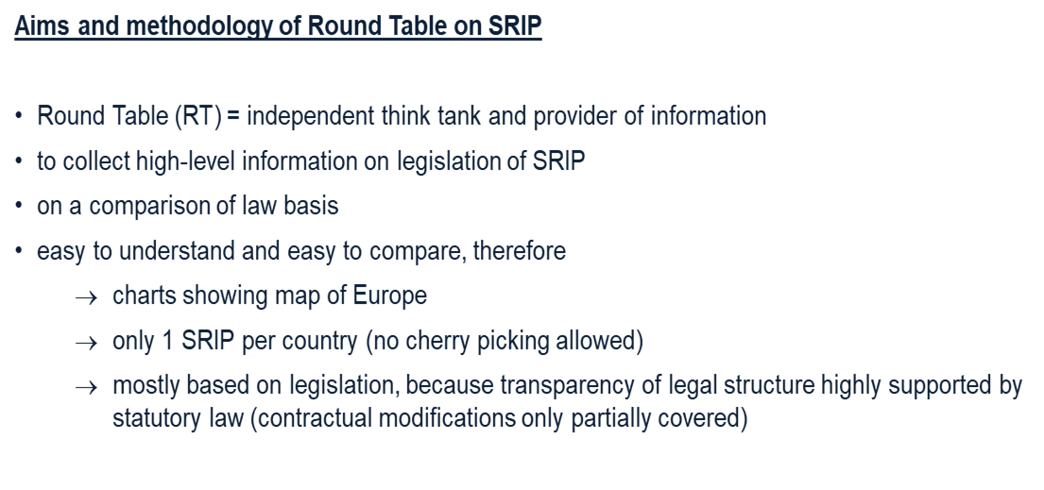
A. Reliability of Mortgage Finance - Europe
1. Round Table Security Rights Over Immovable Property (RT SRIP)

Slide 5
A. Reliability of Mortgage Finance - Europe
1. Round Table Security Rights Over Immovable Property (RT SRIP)
Scoring the results
The Round Table SRIP developed the idea to assess the results of legal facts.
Discussion showed:
Assessment depends on perspective:
Bank – enforcement
Bank – usability (flexibility)
Owner
Legislator
Perspective of the legislator regards also interests of third parties. Interest = well-understood interest
Support of Legislation
Support of scholars in the comparison of law
Internal Rating (Basel II, CRD)
      LGD-Grading
      Compensation for non-existing data on
      recovery rates in real estate finance in most countries

Slide 6
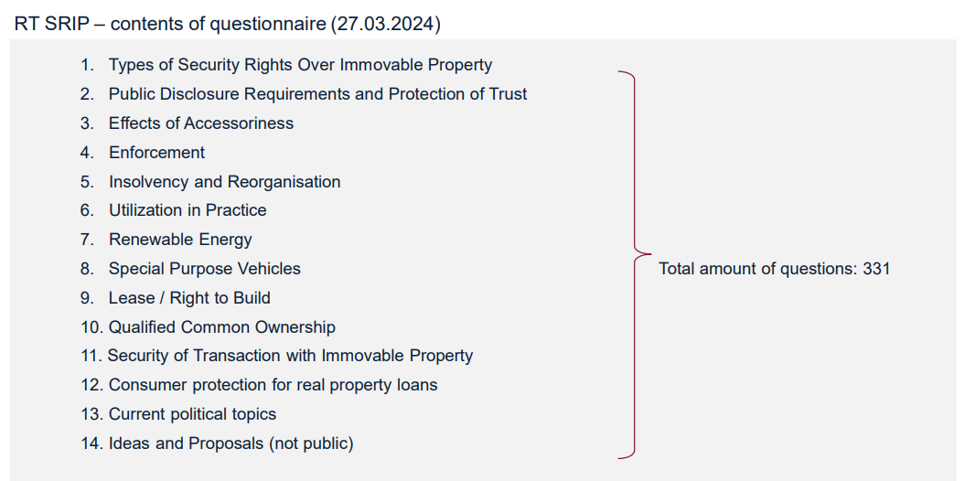
A. Reliability of Mortgage Finance - Europe
1. Round Table Security Rights Over Immovable Property (RT SRIP)

Slide 7
A. Reliability of Mortgage Finance – Brazil
Until mid 90s the only type of SRIP was the traditional mortgage – Hipoteca
Problems – riskier and time consuming for creditors:
Must be created by means of a public deed
Debts/Claims with priviledge – fiscal, labour and social security judicial lien early foreclosure
Personal guarantees of debtors (surety, endorsement) judicial lien early foreclosure
Property could be sold by owner
Creditors subject to the debtor’s insolvency proceedings (as secured creditors up to the limit of the value of the collateral; as unsecured creditors for the portion of the credit in excess of such value)
Enforcement – lenghty judicial action (specific Law)
The need to strenghen creditor rights led to the creation of the
Fiduciary Lien - Law (9,514/1997) – more robust SRIP, faster foreclosure
→ temporarily transfers ownership of the collateral to the creditor, the debtor keeps possession.

Slide 8




A. Reliability of Mortgage Finance – Brazil
Fiduciary lien of real estate:
contract
borrower
creditor
registry
Possession
Indirect proprietorship
“expectancy”
Fiduciary ownership*
Direct proprietorship
*Brazilian Civil Code of 2002: FO can be created only over non-fungible movable goods and can benefit any creditor, either domestic or foreign

Slide 9
A. Reliability of Mortgage Finance – Brazil
Fiduciary lien of real estate*
can be carried out by means of a private instrument with the effects of a public deed
the borrower/security provider cannot sell, mortgage or pledge the property, since no longer has full ownership of the asset and thus lacks capacity to encumber it
the property/SRIP is protected (“armored”) against other/privileged claims and insolvency
provides a much faster/simpler foreclosure process
The Brazilian Legal System:
Civil Law
catch all clauses are not allowed: security binds specific assets to a certain debt; both the debt and the assets must be perfectly described in the contract
secured obligation and collateral must be described in a specific way to meet the legal requirements for the validity of the security
*The fiduciary transfer security was created by Law 4,728/1965
Note: The bankruptcy law (Law 11,101/2005) significantly strengthened the rights of secured creditors by giving them a higher priority when it comes to accessing the assets of the bankrupt firm (https://www.bcb.gov.br/pec/wps/ingl/wps404.pdf)

Slide 10
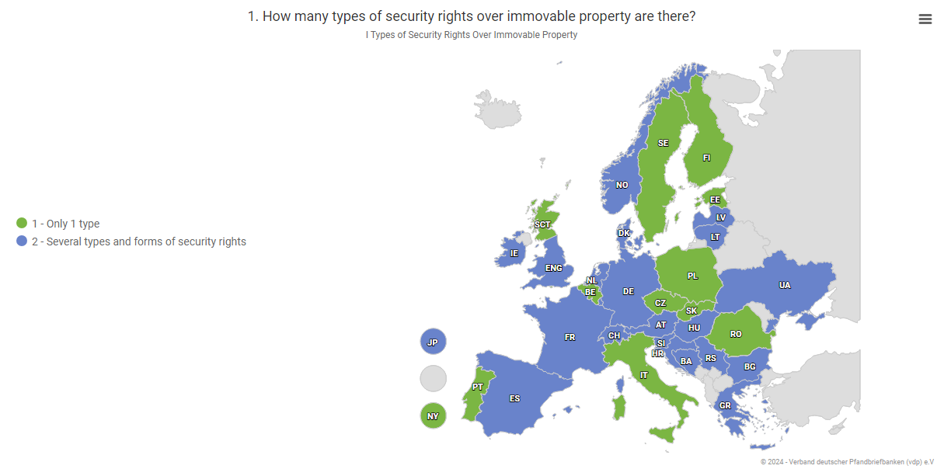
A. Reliability of Mortgage Finance - Europe
2. Mortgage as Credit Collateral

Slide 11
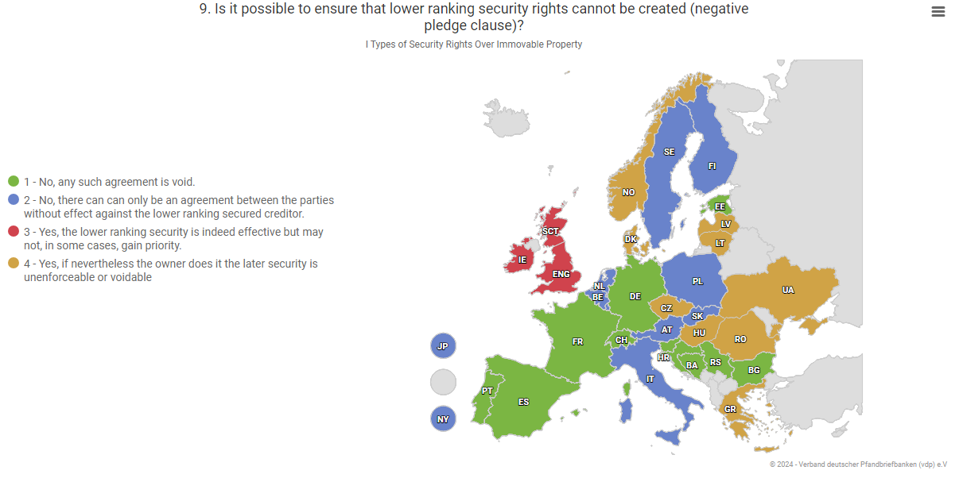
A. Reliability of Mortgage Finance - Europe
2. Mortgage as Credit Collateral

Slide 12
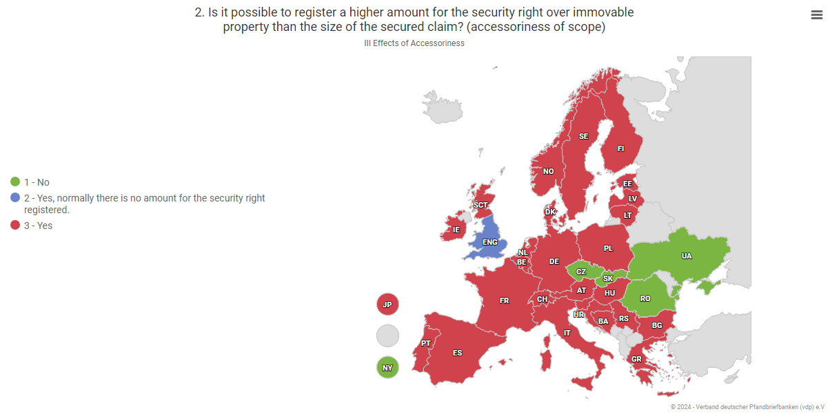
A. Reliability of Mortgage Finance - Europe
2. Mortgage as Credit Collateral

Slide 13
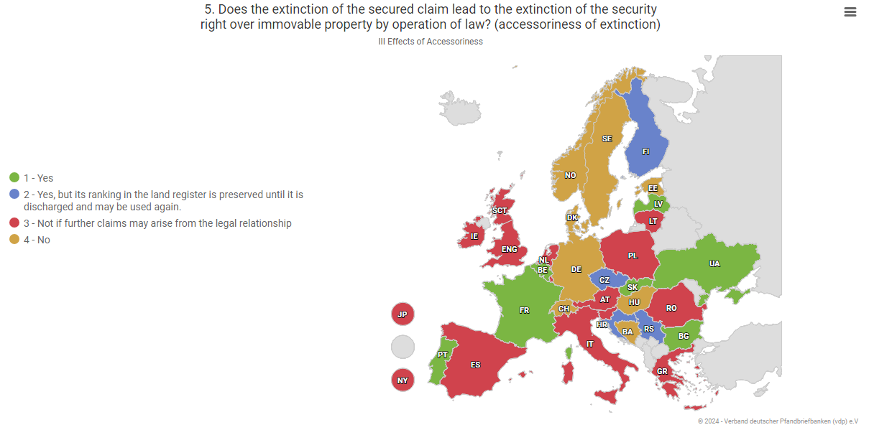
A. Reliability of Mortgage Finance - Europe
2. Mortgage as Credit Collateral

Slide 14
A. Reliability of Mortgage Finance – Brazil
3.1 “Mortgage” as credit collateral
  Types of SRIP: “hipoteca” (subject to judicial liens of privileged claims) and fiduciary lien
  Lower ranking SRIP: possible with any type
      Under the FL, they cannot prevent the planned utilization of an established security right
      “superveniente” – efficacy after the extinction of the 1st “fiduciary property”
      extended (same creditor)
  A higher amount of SRIP than the size of the secured claim can be registered
      After foreclosure/enforcement – positive balance is paid back to the borrower
      The security provider is not responsible for the part of the debt that exceeds the amount obtained with the collateral sale.
  The extinction of the security claim abolishes the SRIP (by notary act)
      lower ranking rights (if there are any) ascend

Slide 15
A. Reliability of Mortgage Finance - Europe
3. Land Register
Reliability and effectiveness of real estate register systems.
Security of real estate transactions in general.
Protection of trust in the correctness and completeness of the registration.
Europe-wide trend towards increasing the importance of registration has been observed for many years. Promoted not least by the digitization of registers.
Protection of holders of security rights over real property in particular.

Slide 16
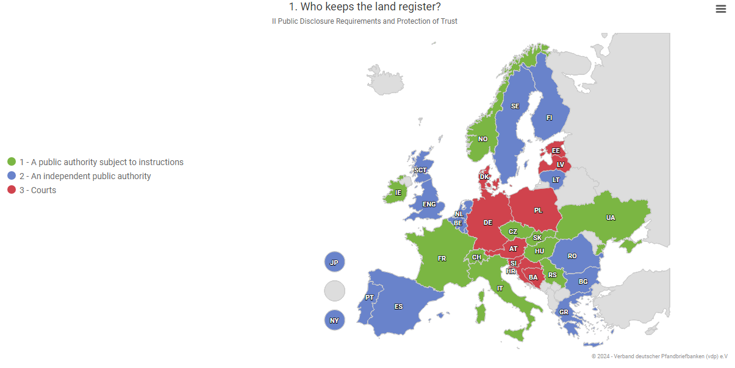
A. Reliability of Mortgage Finance - Europe
3. Land Register

Slide 17
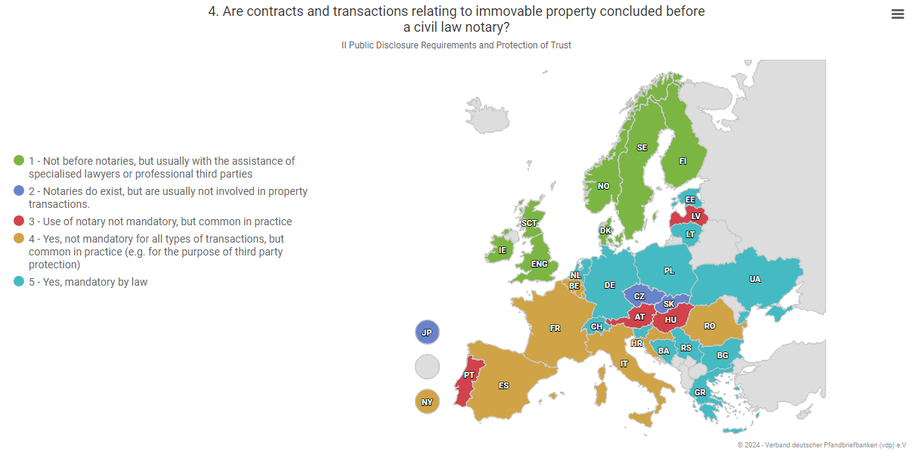
A. Reliability of Mortgage Finance - Europe
3. Land Register

Slide 18
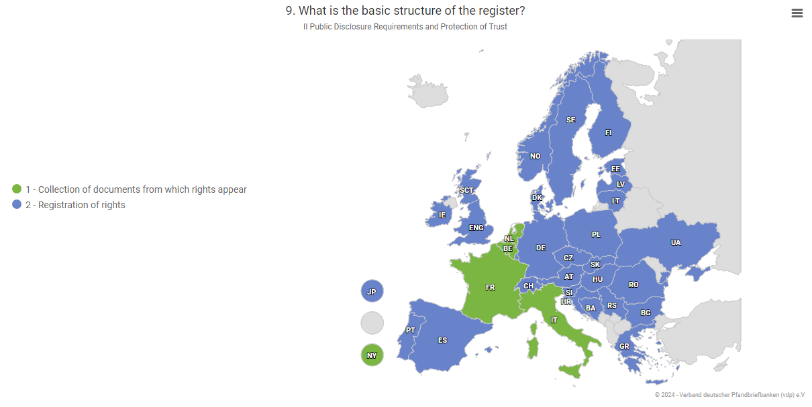
A. Reliability of Mortgage Finance - Europe
3. Land Register

Slide 19
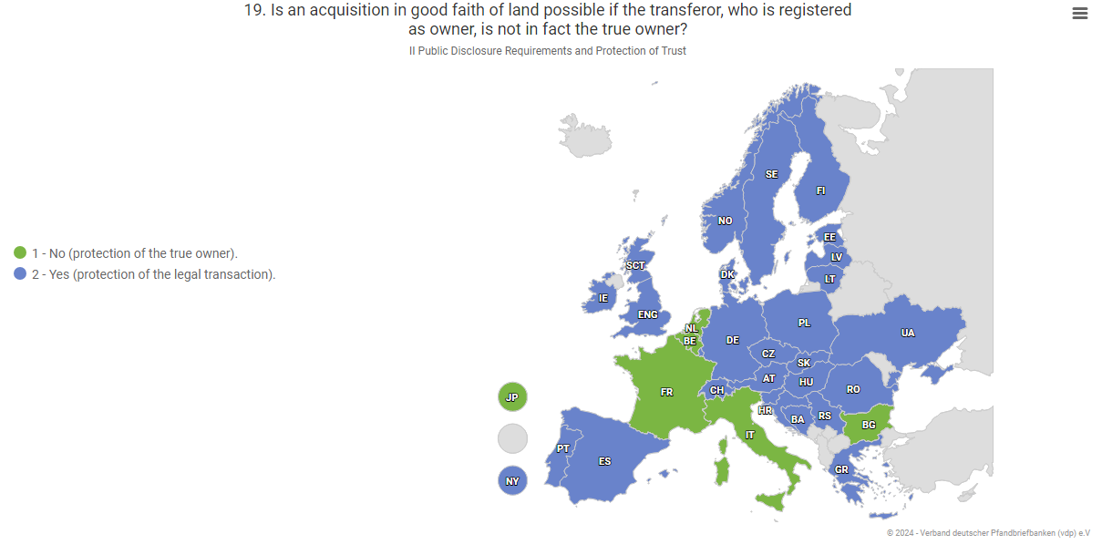
A. Reliability of Mortgage Finance - Europe
3. Land Register

Slide 20
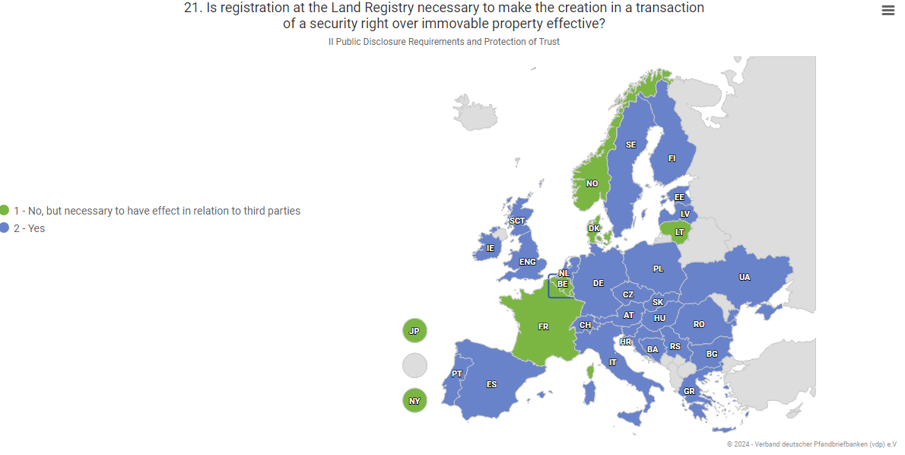
A. Reliability of Mortgage Finance - Europe
3. Land Register

Slide 21
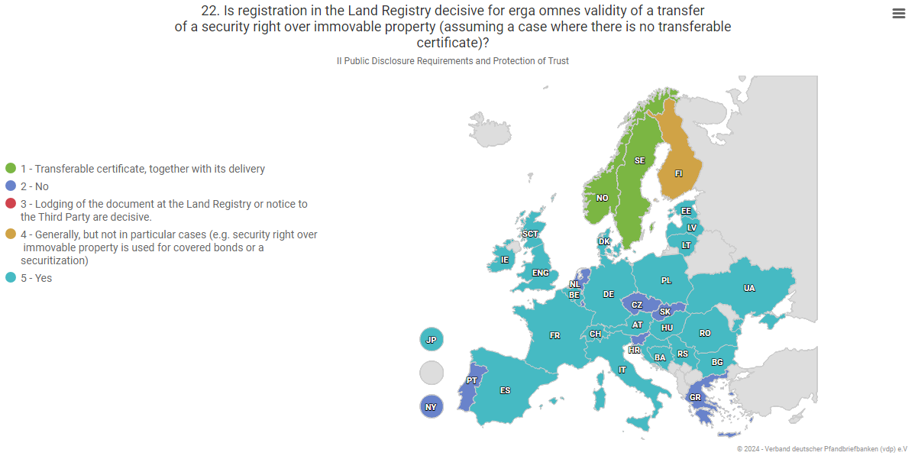
A. Reliability of Mortgage Finance - Europe
3. Land Register

Slide 22
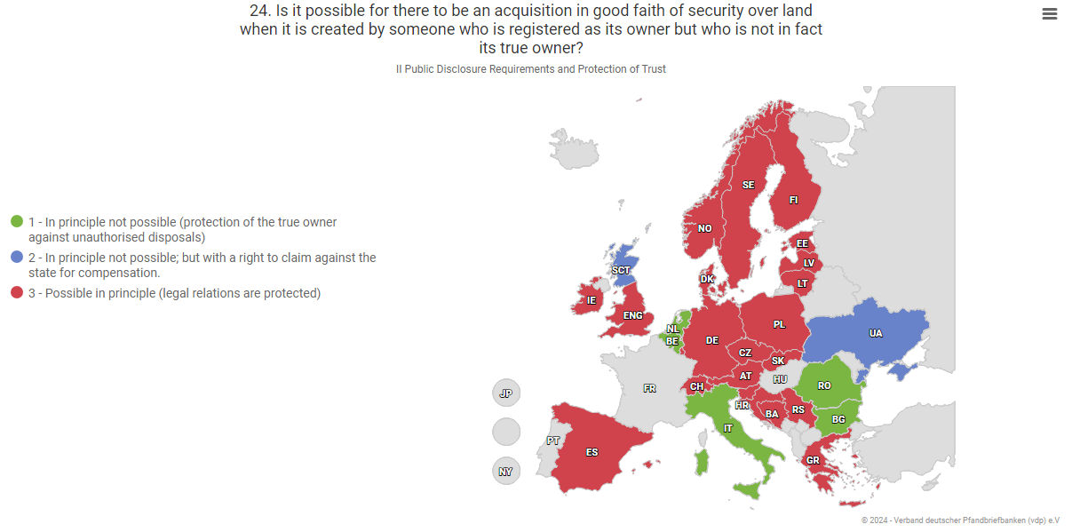
A. Reliability of Mortgage Finance - Europe
3. Land Register

Slide 23
A. Reliability of Mortgage Finance – Brazil
Land Register
  A public authority subject to regulation* keeps the land register
  Contracts and transactions relating to IP must be concluded before a civil law notary
  If registration of a SRIP is applied for with all necessary doc, registration takes 12 days
  The basic structure of the register is the registration of rights
  An acquisition in good faith of land, when the transferor who is registered as owner is not in fact the true owner is possible: protection of the legal transaction
  Registration at the Land Registry is necessary to make the creation in a transaction of a SRIP effective: the right is constituted by the registry
Reliability and effectiveness of real estate register systems.
*Brazilian National Council of Justice (“CNJ”)

Slide 24
A. Reliability of Mortgage Finance – Brazil
Land Register …
  Registration in the Land Registry is decisive for erga omnes validity of a transfer of a SRIP: existence, validity and efficacy
  It is possible, in principle, for there to be an acquisition in good faith of security over land when it is created by someone who is registered as its owner but who is not in fact its true owner: legal relations (and the good faith of the purchaser) are protected
  It is sufficient for the acquirer of security over land to check that the owner who is creating the secutiry is registered. Lawyers may perform extra due diligence
  Digitalising of land registers has begun
  There is no blockchain based land registry system
  Buildings are part of the land, yet new rights have been created (surface right, slab right)

Slide 25
A. Reliability of Mortgage Finance - Europe
Foreclosure
In the event of enforcement, it becomes clear whether the security right over real property delivers what it promises: to be a credit security right that helps the creditor if the debtor is no longer able or willing to service the secured claim.
Conversely, the debtor or owner needs protection against unjustified enforcement if a secured claim does not exist or no longer exists.
Protection of the owner if enforcement could have serious consequences (consumer protection).
Efficiency and greater security for creditors on the one hand and protection of the owner on the other.
- Rights of the owner
- Rights of subordinated creditors
- Options before the realization date
- Cancellation of rights
- Realization at the request of subordinated creditors
- Valuation of the property
- Protection against dissipation
- Claims not evident from the land register that are serviced primarily from the proceeds
- Servicing of interest and costs from the proceeds of the forced sale

Slide 26
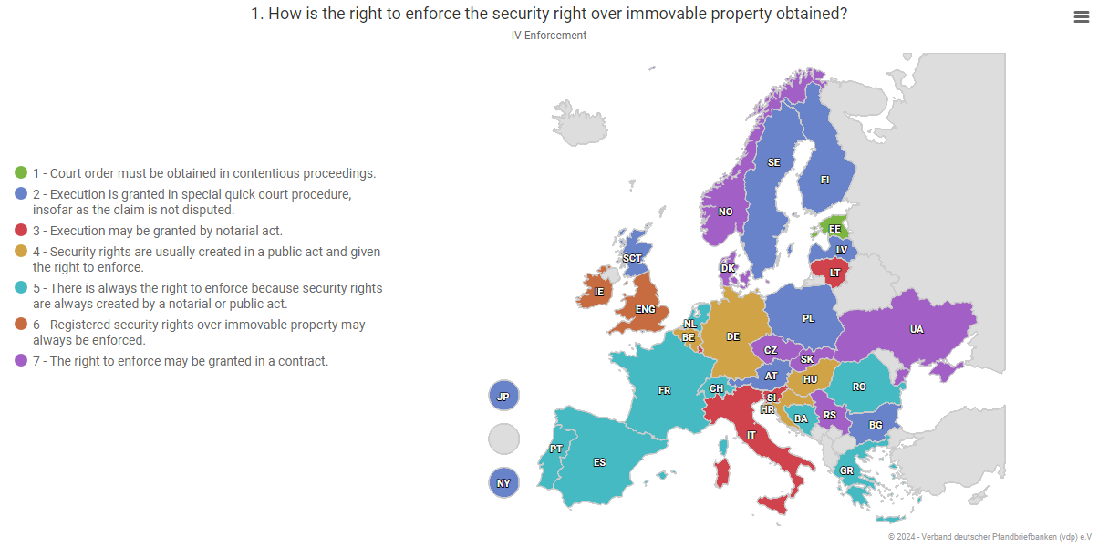
A. Reliability of Mortgage Finance - Europe
Foreclosure

Slide 27
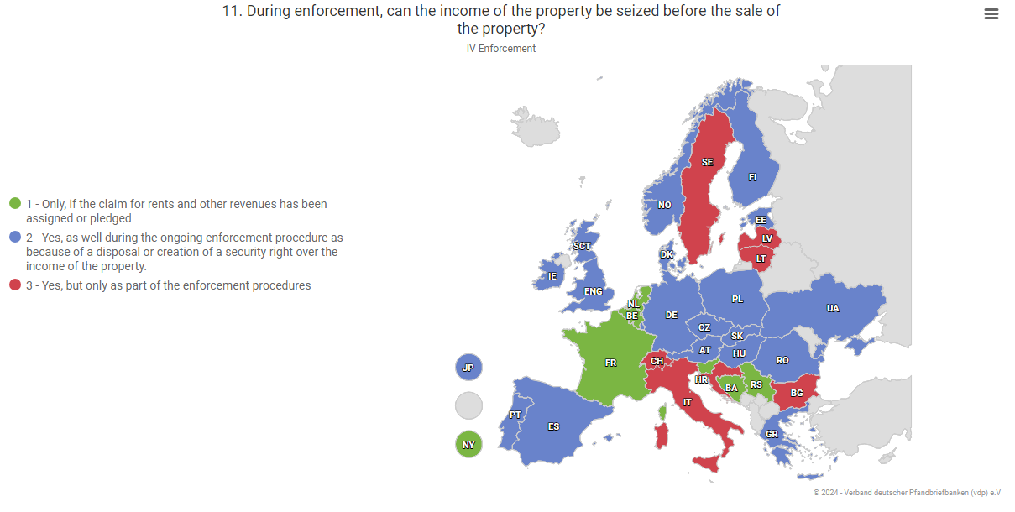
A. Reliability of Mortgage Finance - Europe
Foreclosure

Slide 28
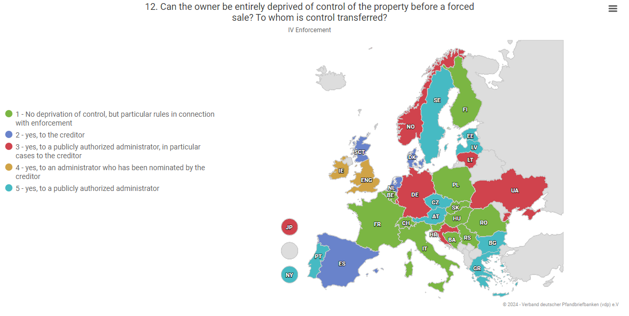
A. Reliability of Mortgage Finance - Europe
Foreclosure

Slide 29
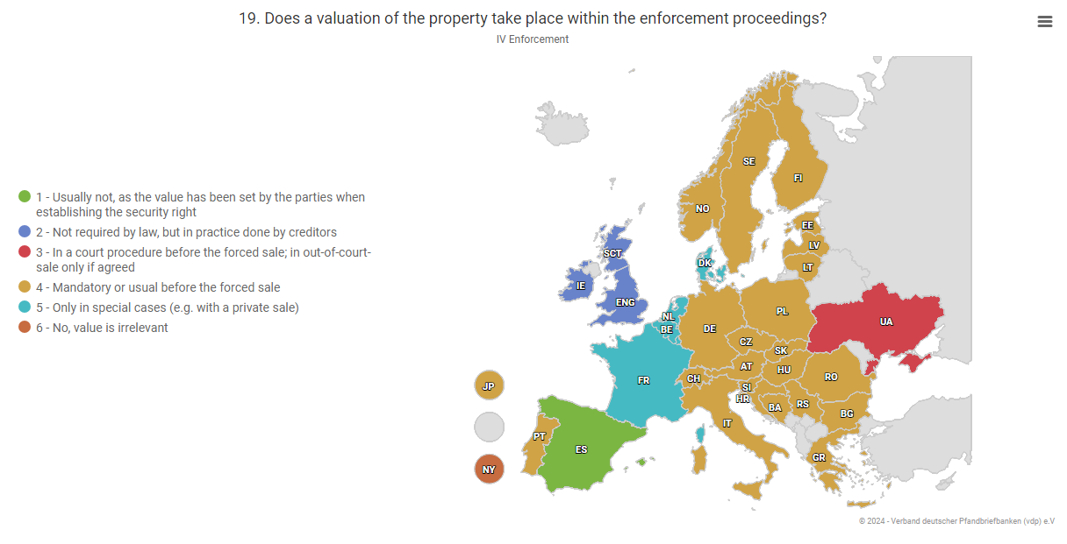
A. Reliability of Mortgage Finance - Europe
Foreclosure

Slide 30
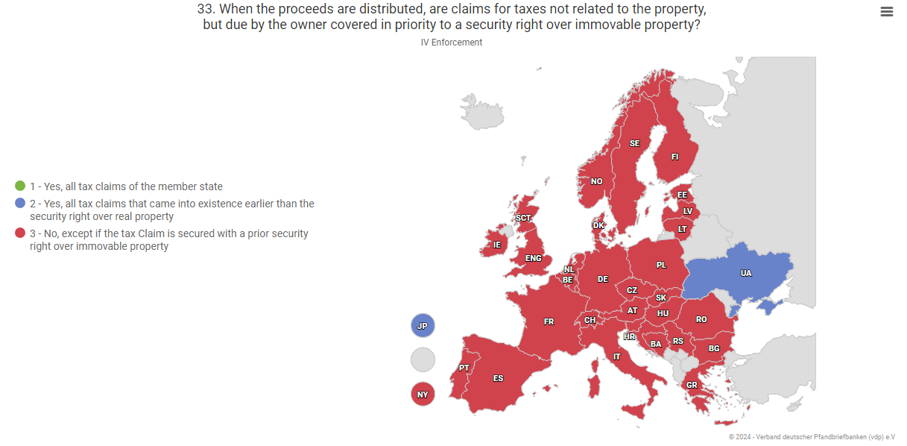
A. Reliability of Mortgage Finance - Europe
Foreclosure

Slide 31
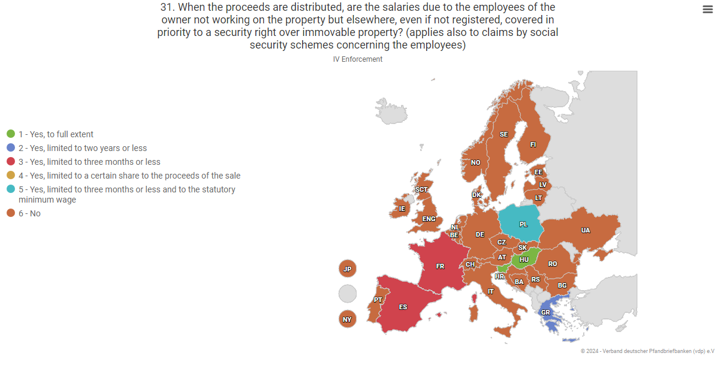
A. Reliability of Mortgage Finance - Europe
Foreclosure

Slide 32
A. Reliability of Mortgage Finance – Brazil
Foreclosure
  The right to enforce the SRIP is obtained by a notary act
  During enforcement, the income of the property can be seized before its sale
  In the FL the borrower is deprived of control of the property before a forced sale
      The control is transferred to the creditor/holder of the right
  A mandatory valuation of the property takes place within the enforcement proceedings
      It establishes the “vile value” (floor price for 2nd auction)
  When the proceeds are distributed, which claims due by the owner/borrower are covered in priority to a SRIP?
      Hipoteca: fiscal, labour and social security
      FL: none (borrower has expectancy of ownership; the “owner” is now the creditor)

Slide 33
A. Reliability of Mortgage Finance - Europe
Insolvency
Employees
Competing insolvency creditors
Secured creditors
Parties entitled to separate satisfaction
Many conflicting interests:
May different assets
Debtors
Etc.

Slide 34
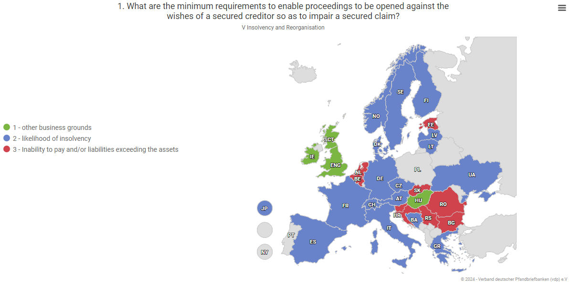
A. Reliability of Mortgage Finance - Europe
Insolvency

Slide 35
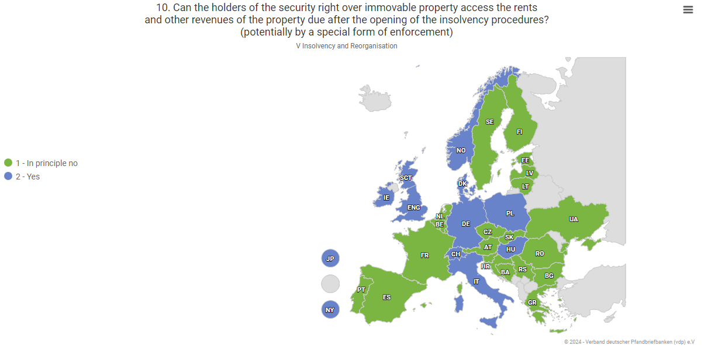
A. Reliability of Mortgage Finance - Europe
Insolvency

Slide 36
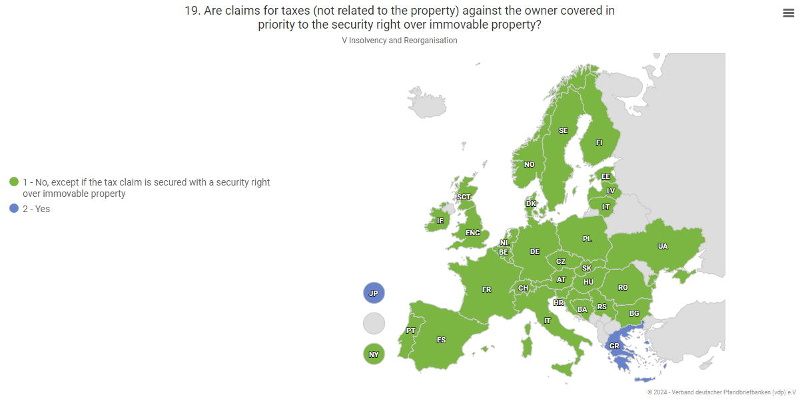
A. Reliability of Mortgage Finance - Europe
Insolvency

Slide 37
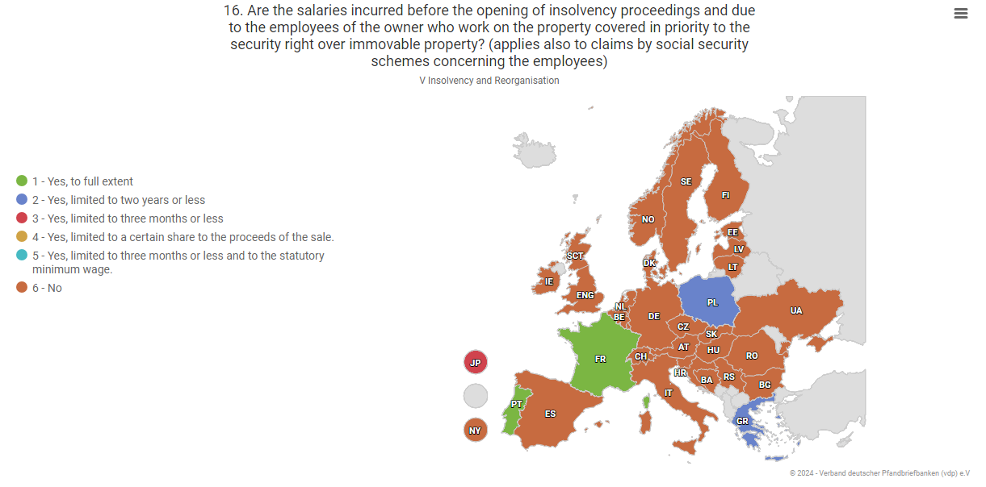
A. Reliability of Mortgage Finance - Europe
Insolvency

Slide 38
Insolvency
  what are the minimum requirements to enable proceedings to be opened against the wishes of a secured creditor so as to impair a secured claim?
    under the FL, the secured claim is protected
    the collateral does not constitute part of the debtor’s or creditor’s bankrupt estate
    the insolvency of the lender/creditor does not affect the expectancy rights of the borrower (as long as payments towards the bankrupt estate are maintained)
  the holders of the SRIP can access the rents and other revenues of the property due after the opening of the insolvency procedures
    Legally possible but not used in practice
  under the FL, even during insolvency procedures of the creditor, no privileged claims can be covered in priority to the SRIP since the property is transferred to the FA/investors
A. Reliability of Mortgage Finance – Brazil

Slide 39
www.vdpmortgage.com
The database for international comparison of security rights over immovable property:

Slide 40
B. Specific Legislation on Covered Bonds

Slide 41
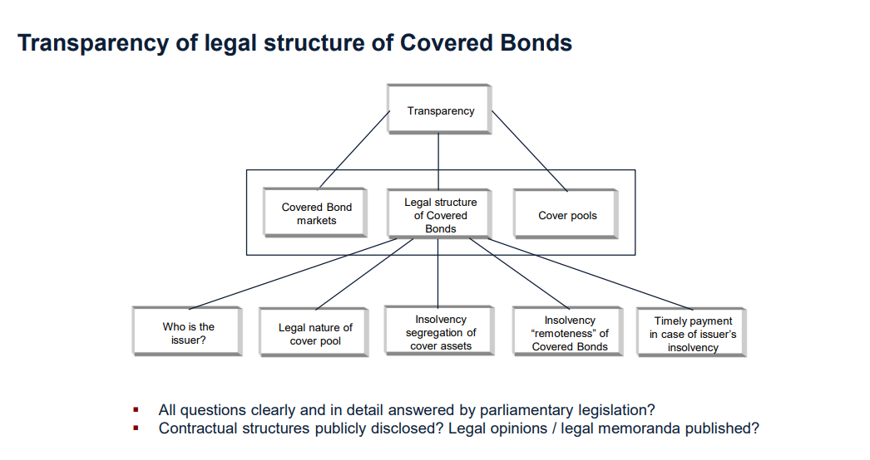
B. Specific Legislation on Covered Bonds - Europe
1. Round Table Covered Bond Legislation (RTCBL)

Slide 42
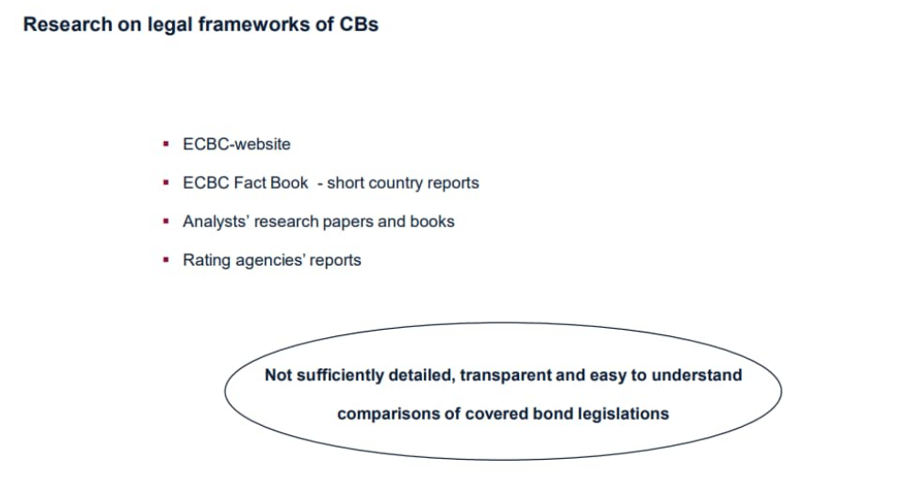
B. Specific Legislation on Covered Bonds - Europe
1. Round Table Covered Bond Legislation (RTCBL)

Slide 43
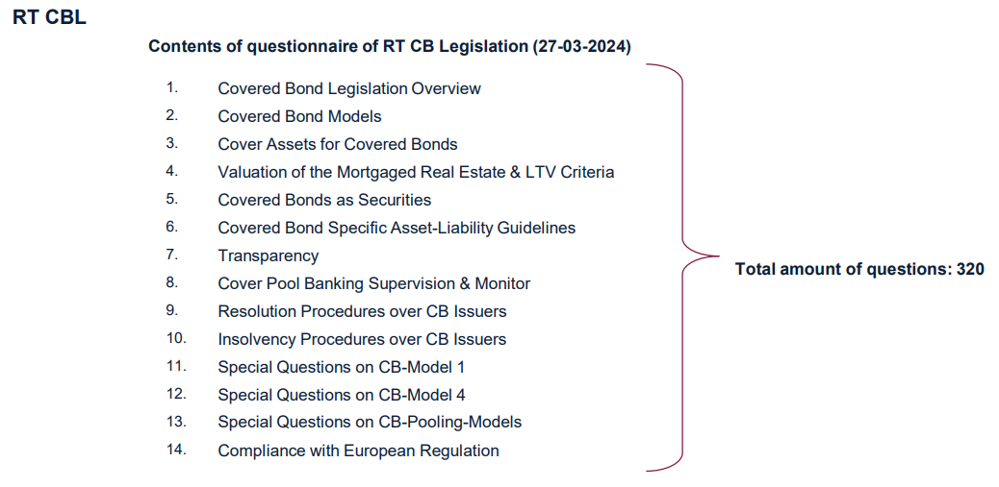
B. Specific Legislation on Covered Bonds - Europe
1. Round Table Covered Bond Legislation (RTCBL)

Slide 44
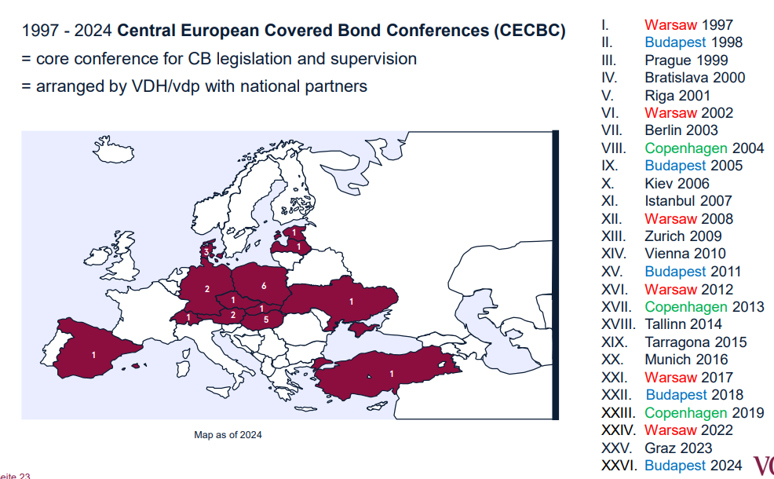
B. Specific Legislation on Covered Bonds - Europe
1. Round Table Covered Bond Legislation (RTCBL)

Slide 45

B. Specific Legislation on Covered Bonds - Europe
2. Introduction to Covered Bonds - A traditional concept with a global footprint
Invented in 1769 in Prussia by edict of Frederick the Great in 1769.
Real Pan-European instrument since Denmark and France developed product further in 18th and 19th century.
In 1900 German Mortgage Bank Act entered into force.
Covered Bond Directive in 2019 milestone in harmonization.

Slide 46
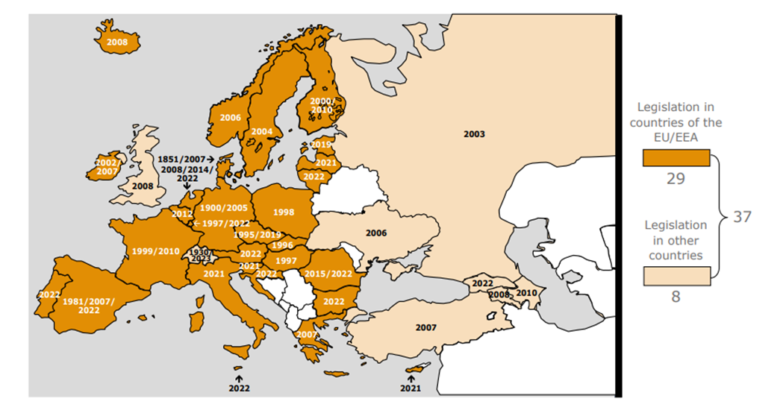
2. Introduction to covered bonds - A traditional concept with a global footprint
B. Specific Legislation on Covered Bonds - Europe
Covered Bond Legislation in Europe as of July 2023

Slide 47
B. Specific Legislation on Covered Bonds - Europe
3. Up to date Covered Bond Law
What is a Covered Bond?
Directive (EU) 2019/2162 of the European Parliament and of the Council of 27 November 2019
on the issue of covered bonds and covered bond public supervision (CBD)
Art. 1 CBD – Investor Protection rules
Requirements for
Issuing
Covered Bonds
Structural Features
of
Covered Bonds
Covered Bond
Public
Supervision
Publication Requirements
for Issuing
Covered Bonds

Slide 48
B. Specific Legislation on Covered Bonds - Europe
3. Up to date Covered Bond Law
Requirements for Issuing Covered Bonds (art. 2 CBD)
Covered Bond is:
Debt
obligation
Art. 3 (1) CBD
Issued by
a credit institution
Art. 3 (7) CBD
CRR (Regulation
575/2013)
In accordance with
the provisions of
national law,
transposing mandatory
CBD-Rules
Art. 3 (2) CBD
Secured by
cover assets /
cover pool
Art. 3 (3); (4)
To which CB-investors
have direct recours
as preferred creditors
Art. 3 (1) CBD

Slide 49
B. Specific Legislation on Covered Bonds - Europe
3. Up to date Covered Bond Law
Structural Features (art. 4 to 17 CBD)
Dual recourse
and
bankruptcy
remoteness
Cover pool and Coverage
Eligible assets
Coverage and liquidity
Art. 4, 5 CBD
Eligible
cover assets
Art. 6 CBD;
129 CRR
Composition
of cover pools
Art. 10 CBD
Derivatives
Art. 11 CBD
Coverage
requirments
Art. 15 CBD
Liquidity
buffer
Art. 16 CBD
Extendable
maturity
Art. 17 CBD
Segregation of
cover assets
Art. 12 CBD
Cover pool
monitor
Art. 13 CBD
Investor
information
Art. 14 CBD

Slide 50
B. Specific Legislation on Covered Bonds - Europe
3. Up to date Covered Bond Law
Covered Bond Public Supervision (art. 18 to 26 CBD)
Supervision
ensuring
compliance with / enformcement of
requirements to issue of CB
Art. 3 (18); 18 CBD
Permission
for CB-programmes
Art. 19 CBD
CB public supervision in
insolvency / resolution
Art. 20 CBD

Slide 51
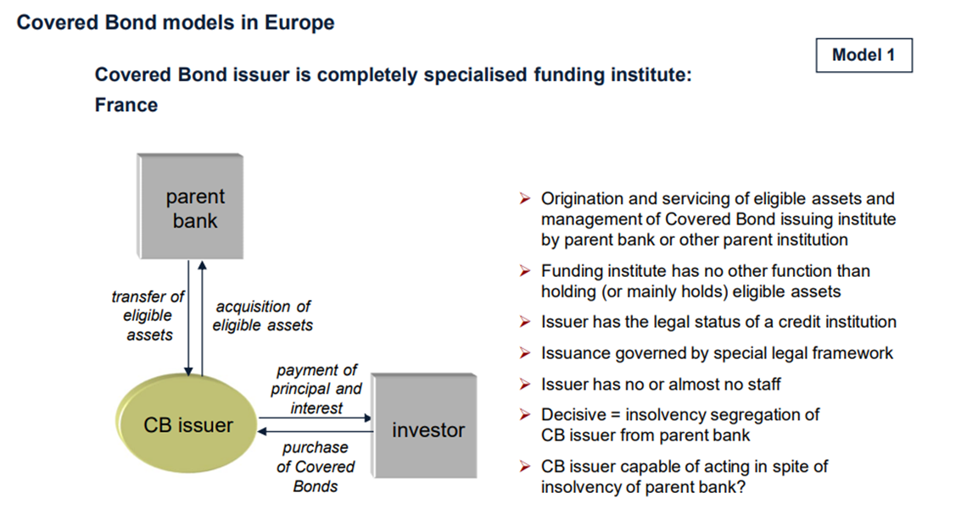
B. Specific Legislation on Covered Bonds - Europe
3. Up to date Covered Bond Law

Slide 52
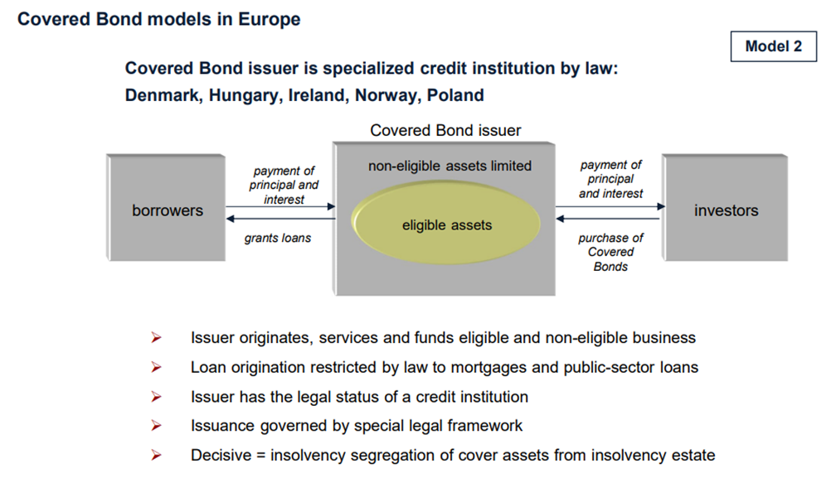
B. Specific Legislation on Covered Bonds - Europe
3. Up to date Covered Bond Law

Slide 53
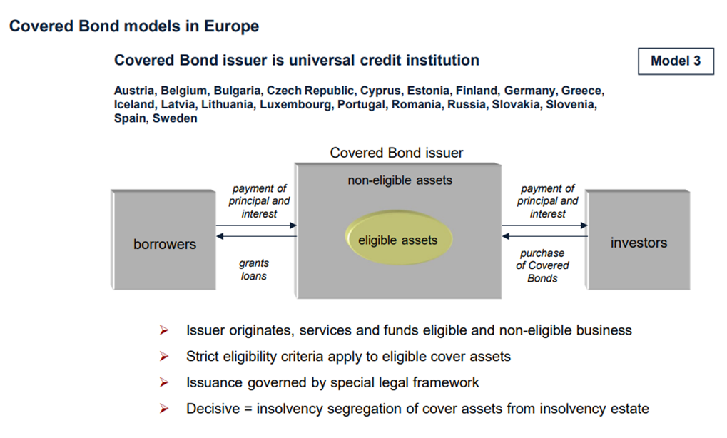
B. Specific Legislation on Covered Bonds - Europe
3. Up to date Covered Bond Law

Slide 54
B. Specific Legislation on Covered Bonds - Europe
3. Up to date Covered Bond Law

Slide 55
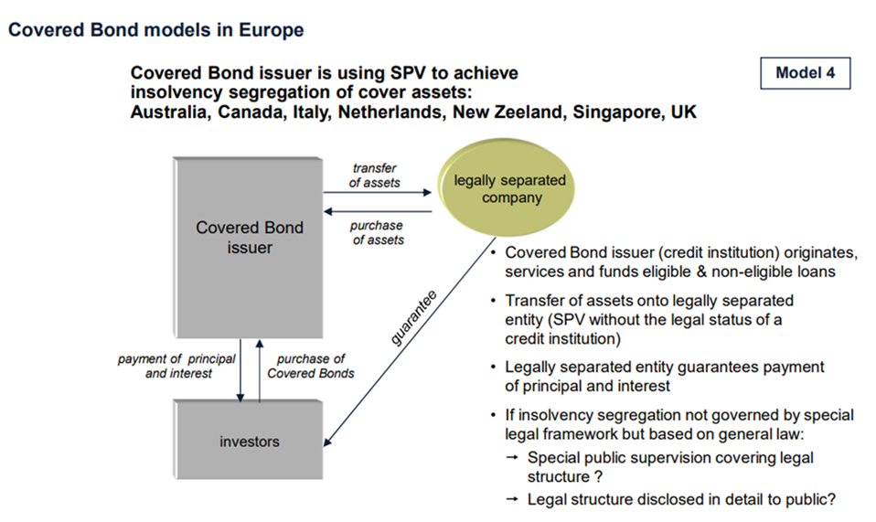
B. Specific Legislation on Covered Bonds - Europe
3. Up to date Covered Bond Law

Slide 56
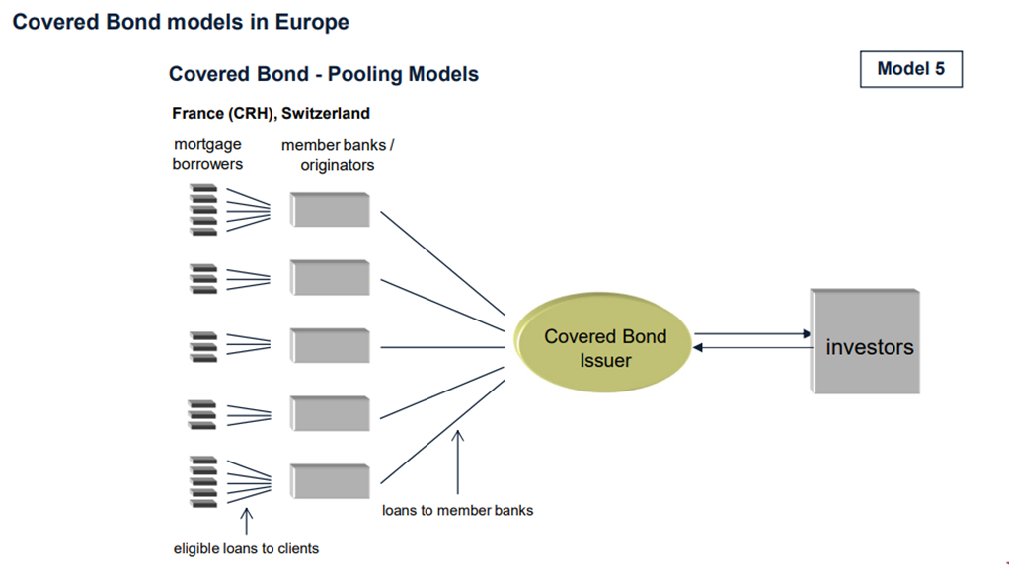
B. Specific Legislation on Covered Bonds - Europe
3. Up to date Covered Bond Law

Slide 57
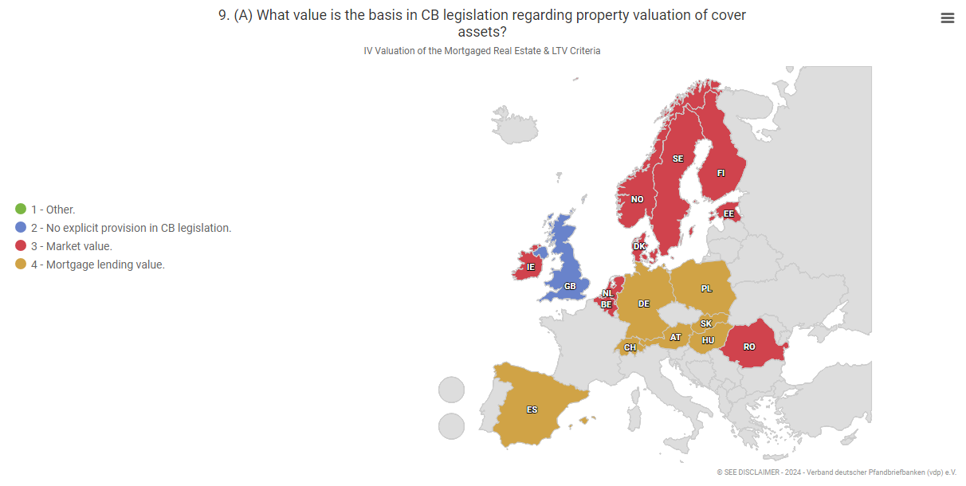
B. Specific Legislation on Covered Bonds - Europe
4. Valuation and LTV

Slide 58
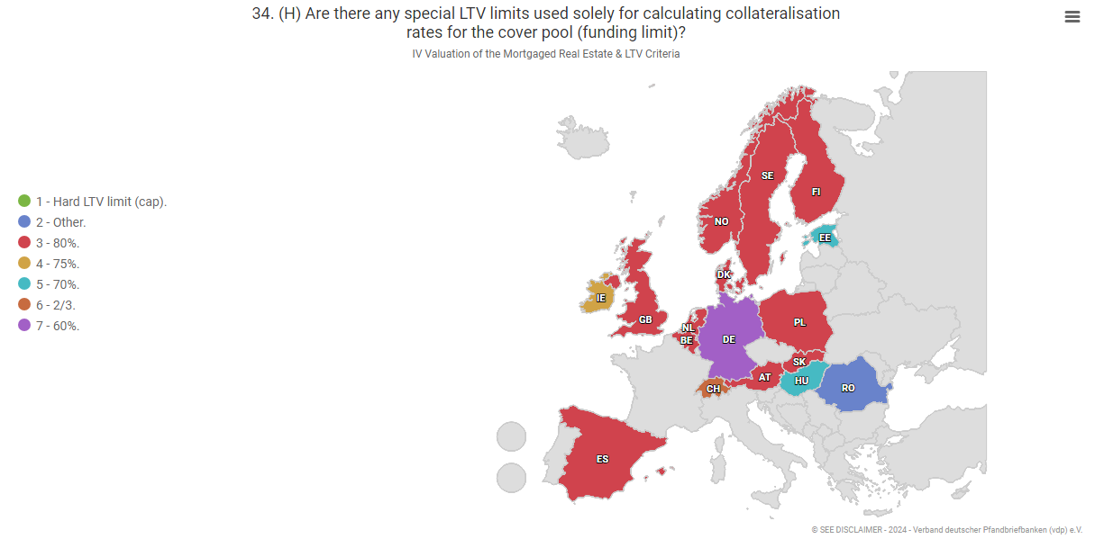
B. Specific Legislation on Covered Bonds - Europe
4. Valuation and LTV

Slide 59
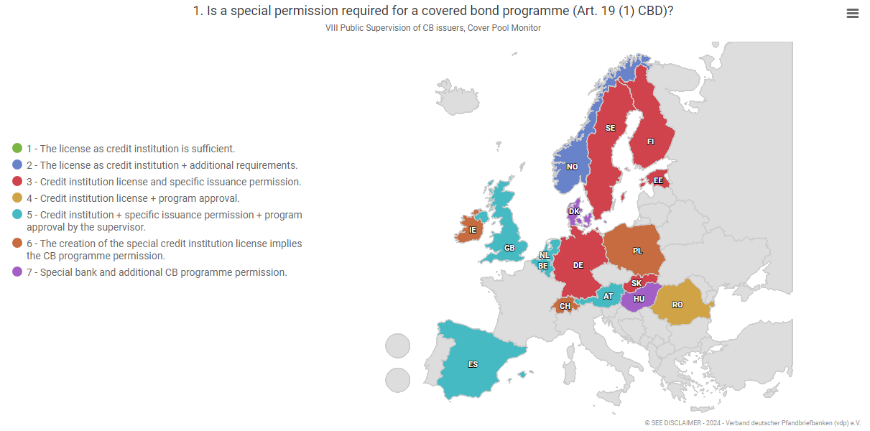
B. Specific Legislation on Covered Bonds - Europe
5. Independent and Specific Public Supervision

Slide 60
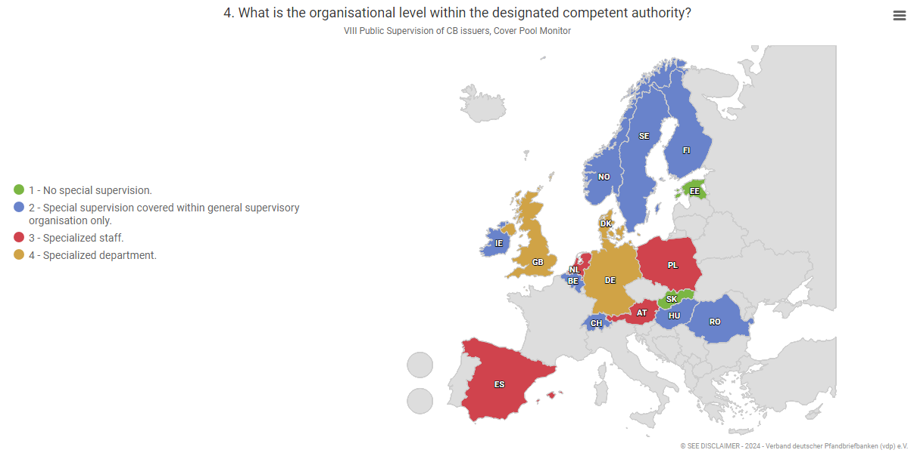
B. Specific Legislation on Covered Bonds - Europe
5. Independent and Specific Public Supervision

Slide 61
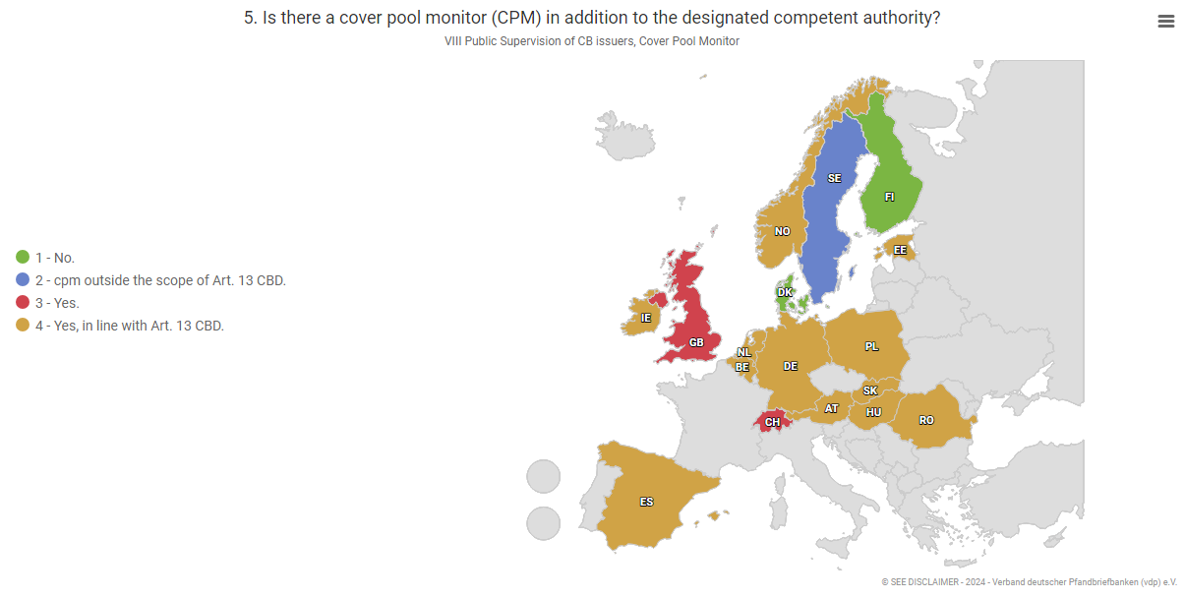
B. Specific Legislation on Covered Bonds - Europe
5. Independent and Specific Public Supervision

Slide 62
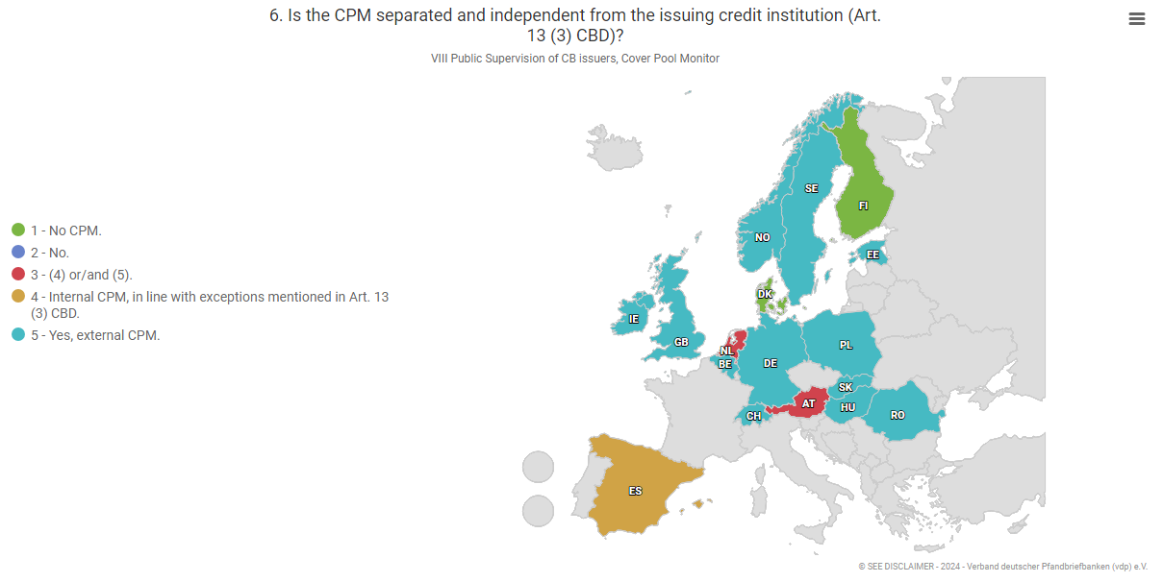
B. Specific Legislation on Covered Bonds - Europe
5. Independent and Specific Public Supervision

Slide 63
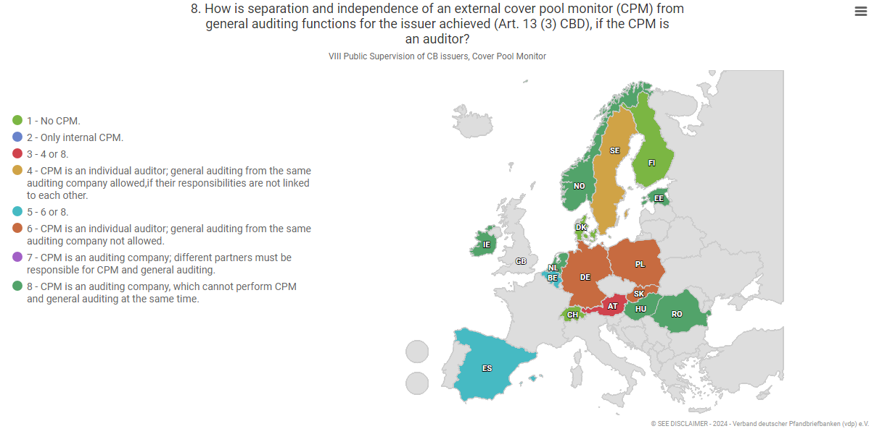
B. Specific Legislation on Covered Bonds - Europe
5. Independent and Specific Public Supervision

Slide 64
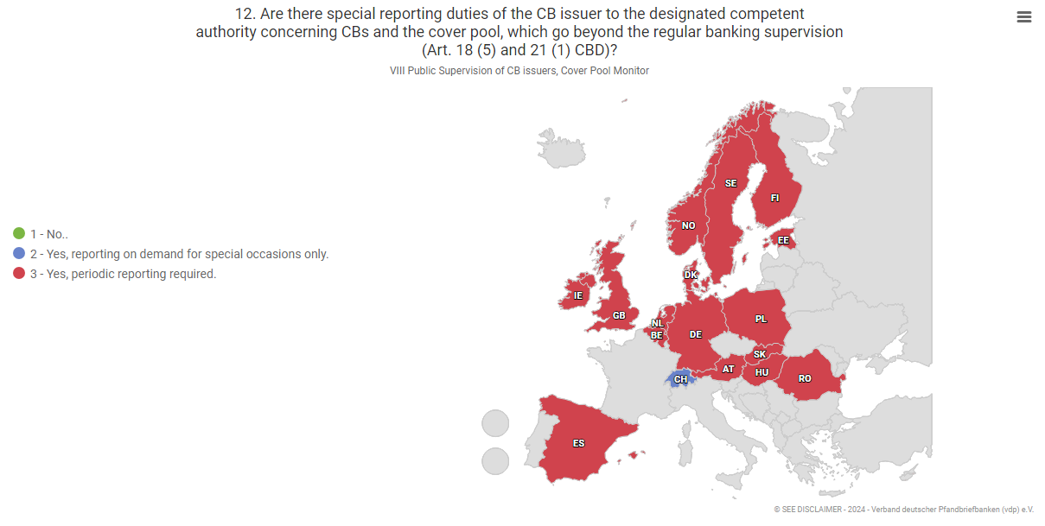
B. Specific Legislation on Covered Bonds - Europe
5. Independent and Specific Public Supervision

Slide 65
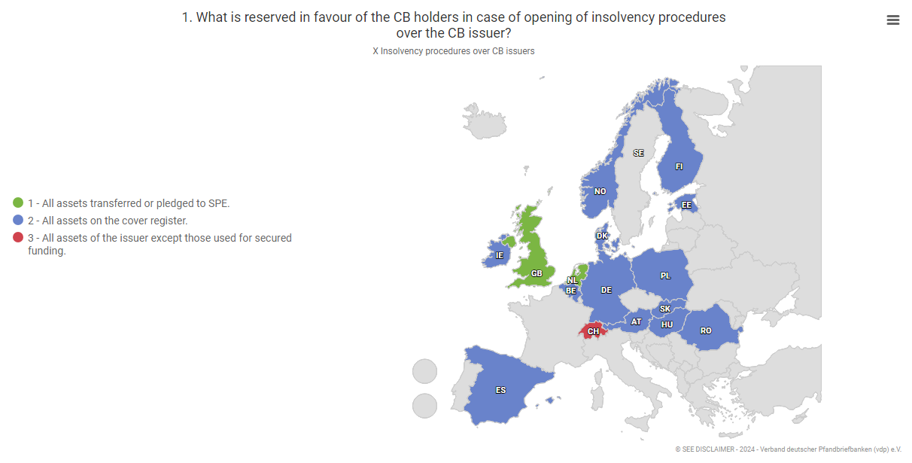
B. Specific Legislation on Covered Bonds - Europe
6. Insolvency Procedures over the CB Issuer

Slide 66
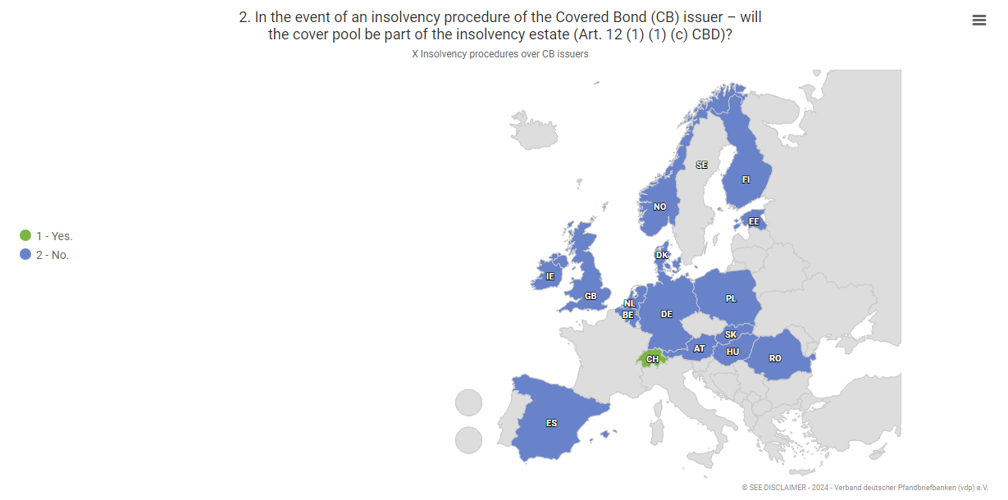
B. Specific Legislation on Covered Bonds - Europe
6. Insolvency Procedures over the CB Issuer

Slide 67
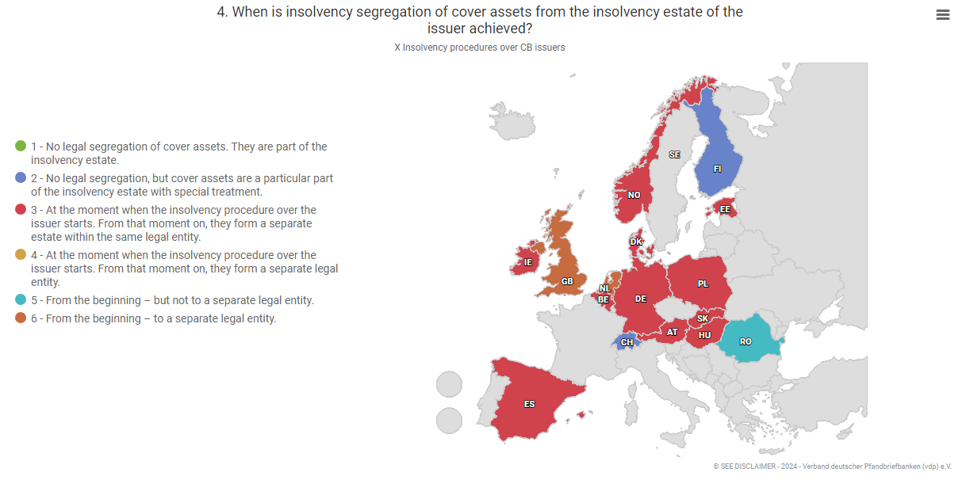
B. Specific Legislation on Covered Bonds - Europe
6. Insolvency Procedures over the CB Issuer

Slide 68
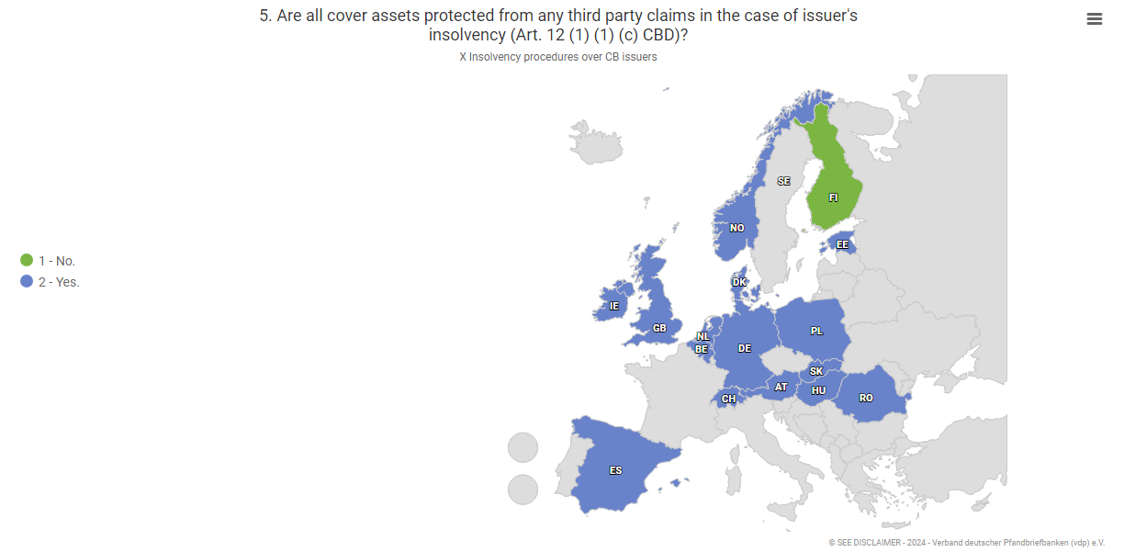
B. Specific Legislation on Covered Bonds - Europe
6. Insolvency Procedures over the CB Issuer

Slide 69
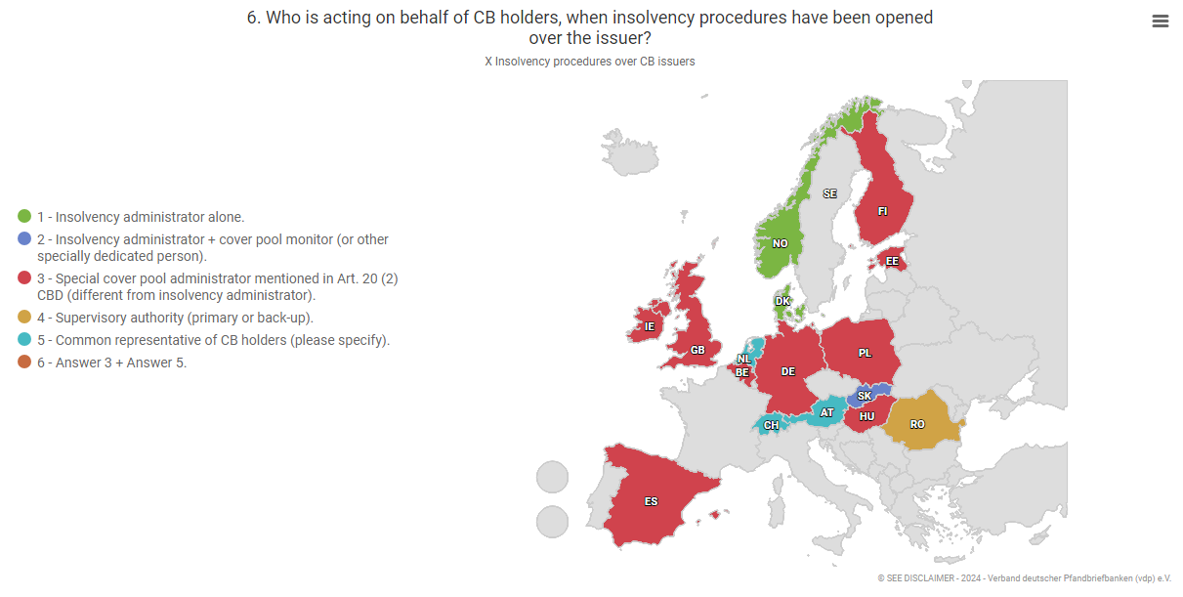
B. Specific Legislation on Covered Bonds - Europe
6. Insolvency Procedures over the CB Issuer

Slide 70
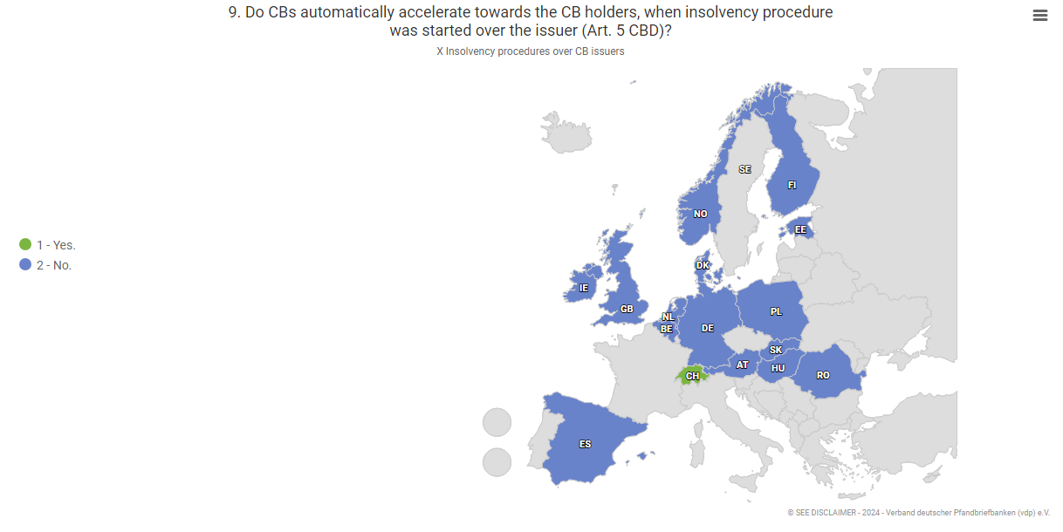
B. Specific Legislation on Covered Bonds - Europe
6. Insolvency Procedures over the CB Issuer

Slide 71
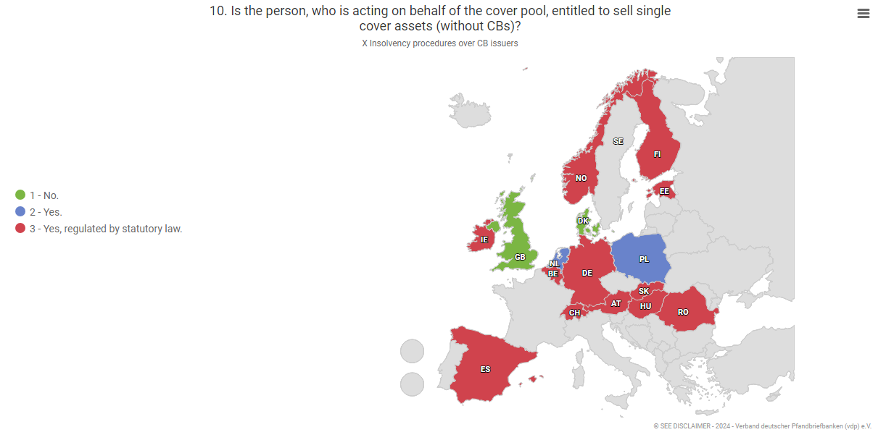
B. Specific Legislation on Covered Bonds - Europe
6. Insolvency Procedures over the CB Issuer

Slide 72

B. Specific Legislation on Covered Bonds - Europe
6. Insolvency Procedures over the CB Issuer

Slide 73

B. Specific Legislation on Covered Bonds - Europe
6. Insolvency Procedures over the CB Issuer

Slide 74
B. Specific Legislation on Covered Bonds - Europe
7. Investment Rules
Covered Bond Directive (Directive (EU) 2019/2162)
CBD lists key features of a Covered Bond
Lower risk-weighting for EEA Covered Bonds bought by EEA banks under the EU’s CRR
(Art. 129 Regulation (EU) No 575/2013)
Eligible as liquid assets under the EU LCR regulation
(Art. 10 (1)(f), (2); art. 11 (1)(c)(d); art. 12 (1)(e); art. 15 (2)(b)(c)(f); art. 17 (1)(b); art. 28 (3)(a)(b) Commission Delegated Regulation (EU) 2015/61)
Exemption from bail-in under EU’s BRRD
(Art. 44 (2) subsec 1(b); subsec 2; art. 76 (2); art. 79 Directive 2014/59/EU)
Privileged treatment of covered bonds under the EU large exposure rules
(Art. 387; 400 (2)(a) CRR) and Basel Committee on Banking Supervision (BCBS) rules (Rules 2023, 30.37 – 30.40)
Favourable treatment under Solvency II
(Art. 180; 187 Commission Delegated Regulation (EU) 2015/35)
Higher investment share for funds in UCITS Directive
(Art. 52 (4) Directive 2009/65/EC)
Favourable repo treatment at the European Central Bank (ECB) and other central banks
Art. 129 CRR defines the preferential risk weights and the eligible assets.

Slide 75
www.vdpcoveredbonds.com
The database for international comparison of the national law on Covered Bonds:

Slide 76
B. Specific Legislation on Covered Bonds (Brazil)
Secured Real Estate Bills
(Letras Imobiliárias Garantidas - LIGs)
The creation of registered, transferable and freely traded credit instruments,
(Law No. 13,097 of January 2015)
Central Banks’ public consultation of draft resolution:
(January thru April 2017)
Resolution CMN 4598/2017
Resolution CMN No.5,001/2022
Amending Resolution CMN No.5118/2024

Slide 77
B. Specific Legislation on Covered Bonds (Brazil)
Regulation:
Issuers: multiple banks, commercial banks, investment banks, credit, financing and investment companies, savings banks, mortgage companies, savings and loans associations, credit unions.
Issuance limits: 10%〰️ 30% of issuer’s total assets; compliance with Tier 1 capital requirements
Characteristics:
  single or program; comprehensive + registered Issuance Deed compulsory
  remuneration based on fixed or floating interest rate
  periodical payment of earnings and of principal
  adjustment based on a price index or an exchange variation
  weighted average term of at least 24 months
  early redemption/repurchase by issuers forbidden before 12 months
  early maturity only permitted in case of insolvency of asset portfolio

Slide 78
B. Specific Legislation on Covered Bonds (Brazil)
Fiduciary Regime on the Assets Portfolio:
  identification of the fiduciary agent (FA)
  obligations, responsibilities and fees
  events, conditions and method of removal or replacement of the FA
  management transition plan
Fiduciary Agent: represents the creditors in the taking of security and its foreclosure
Dynamic Assets Portfolio
  real estate mortgages – Real Estate Credit Notes (CCI) or Bank Credit Notes (CCB), representing their total value
  National Treasury Securities
  derivative instruments – specific account, segregated, for hedging purposes
  cash and cash equivalents

Slide 79
B. Specific Legislation on Covered Bonds (Brazil)
Eligibility of Real Estate Credits:
  fiduciary lien on immovable property (mortgage is accepted, but not used)
  performing and free of other liens (except those securing rights of CB holders)
  in the case of RE development (credit for production), segregated from developers assets (Article 31-A, Law 4591/1964)
  credit risk rated B or above
  insurance coverage at least for risks of death and permanent disability of the borrower; for physical damage to the real property; for builders’ civil liability
Max LTV (ratio between the updated par value of the transaction, comprising principal and ancillary expenses, and the appraisal value of the collateral)
  80% (residential properties)
  60% (nonresidential properties)
  verified every 3 years;

Slide 80
C. Reconstruction in Germany post 1945

Slide 81
C. Reconstruction in Germany post 1945
1. Public Guarantees for Housing Finance
100 %
80 %
Public Guarantee
Public-Sector Covered Bonds
60 %
Mortgage
Mortgage Covered Bonds

Slide 82
C. Reconstruction in Germany post 1945
2. Tax Privileges for Housing Covered Bonds 1952 - 1954
Covered Bond
Mortgage / Public Sector
Housing (90% social housing)
Tax exempt
Commercial / Other
Subject to taxation
Emergence of a
splited capital market

Slide 84
C. Funding for Real Estate Mortgages in Brazil

Slide 85

C. Funding for mortgages/real estate in Brazil
The introduction of CBs:
“for implementation of a long-term funding instrument for real estate financing in Brazil”.
Total: BRL 113.3 billion (Mar/24)
~ € 21 billion
3 issuers (private commercial banks):
Itaú – 52,3%
Bradesco – 33,2%
Santander – 14,5%
Investors: individuals (tax exemption)
Cover pools: RE mortgage portfolios constituted mainly from funding from savings deposits complemented by unsecured bonds

Slide 86
C. Funding for mortgages/real estate in Brazil
The issuance of Covered Bonds has not yet:
expanded the RE mortgage supply
significantly improved asset vs liability mismatch (average 2 years)
Recent amending of the regulation: the funds raised from the issuance of covered bonds are now part of the earmarked real estate finance system (65%):
    Savings and loans (SBPE)
    Unsecured RE bonds (LCI)

Slide 87

C. Unsecured RE Bonds vs Covered Bonds (Brazil)
Offers from Bradesco (June 13th 2024): CBs and unsecured RE bonds
LCI (unsecured RE bonds):
Liquidity: Shorter term
Risk:
  Solid issuers (rating)
  + FGC coverage*
Lower remuneration despite the absence of the dual recourse
Source: Ágora (https://www.agorainvestimentos.com.br/)
FGC: Credit Guarantee Fund, https://www.fgc.org.br/

Slide 88
Thank you!
Dr. Tim Lassen
Verband deutscher Pfandbriefbanken e.V.
Association of German Pfandbrief Banks
Georgenstraße 21
10117 Berlin
T +49 30 20915-520
F +49 30 20915-101
E lassen@pfandbrief.de
W www.pfandbrief.de
Dr. Claudia Magalhães Eloy
São Paulo, Brazil
T/Wapp +55 11 992816833
E claudia.m.eloy@gmail.com
LinkedIn: claudiamagalhaeseloy
co-founder: Blog do POCH

