Slide 1



The mortgage market between the real economy and financial markets:
an operational approach to the housing market
The EeMAP, EeDaPP, EeMMIP projects have received funding from the European Union’s Horizon 2020 research and innovation programme under grant agreement no. 746205, no. 784979 and no. 894117 respectively.

Slide 2





Bring Energy Efficiency to the EU buildings stock:
Banks can Play a Game Changing Role
In the EU 27 there are…
220
million dwellings
447
million people
more than 220 million dwellings were built
before 2001
Buildings account
for 40% of
EU energy use
€180 BN OF YEARLY INVESTMENTS IS NEEDED TO REACH EU TARGETS
A significant share of it must come from the private sector

Slide 3
The regulatory context: Energy Performance of Buildings Directive
The Energy Performance of Buildings Directive (EPBD) aims to achieve a highly energy-efficient and decarbonised building stock by 2050, create a stable environment for investment decisions and enable consumers and businesses to make more informed choices to save energy and money.
the gradual introduction of minimum energy performance standards for non-residential buildings to support the renovation of buildings with the lowest energy performance
national trajectories to reduce the average primary energy use of residential buildings
an enhanced standard for new buildings, including a more ambitious vision for buildings to be zero-emission
enhanced long-term renovation strategies, to be renamed national Building Renovation Plans
increased reliability, quality and digitalisation of Energy Performance Certificates with energy performance classes to be based on common criteria
a definition of deep renovation and the introduction of building renovation passports
ensuring new buildings are solar-ready (fit to host solar installations) where technically and economically feasible
a gradual phase-out of stand-alone boilers powered by fossil fuels, starting with the end of subsidies to such boilers from 1 January 2025
one-stop-shops for the energy renovations of buildings for home-owners, small and medium-sized enterprises and other stakeholders
the modernisation of buildings and their systems and better energy system integration (for heating, cooling, ventilation, charging of electric vehicles and renewable energy)

Slide 4
The regulatory context: Energy Performance of Buildings Directive
October 2022
Council agreed on its General Approach on the revision of the EPBD
7 December 2023
Co-legislators found a provisional agreement on the file
May/June 2024
OJ Publication
March/April 2024
Coreper approval on the agreement
June/July 2026
Final application. Due to the transposition period of 24 months, by then Member States will need to have put in place law to apply the EPBD
March 2023
Parliament reached its position on the EPBD revision
June/July 2024
Entry into force
12 March 2024
Parliament voted the provisional agreement at plenary level
H2
H1
H2
H1
H2
2025
H1
H2
2022
2023
2024
2026

Slide 5
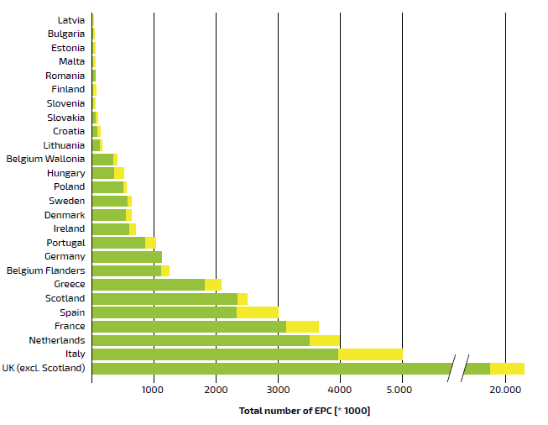
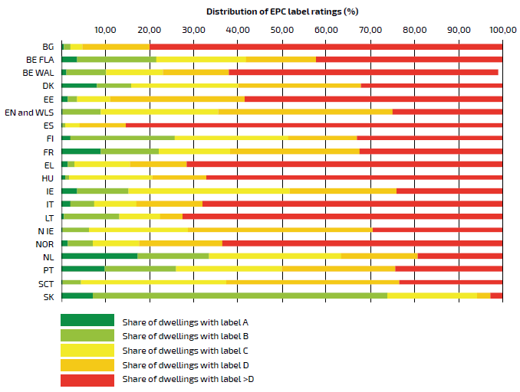
EPC overview in Europe
Number of EPC registered per country. Yellow bar indicates the latest additions 2016-2019)
Share of registered EPC ratings across EU, Norway and UK
12%
32%
16.8%
2.6%
11.9%
10.1%
50.2%
15.8%
76.6%
Source: Xtendo report on EPC (March 2020), Hypostat

Slide 6
House age structure in Italy and Europe

Slide 7
Most effective measures
Insulation
Roof, wall and floor insulations are three ways the heating retention of a building can be improved, making it one of the most impactful interventions.
Windows and doors
The quality of both the glazing and the joinery is key to determining energy performance. Completely replacing windows (glass and frames) will often be the second-best solution, in terms of energy efficiency.
Heating
A condensing boiler and heat pump are among the most used options. Other options include thermostat-controlled taps and an adjustable thermostat. These all bring improvements to the heating consumption of households.
Solar systems
In addition to the traditional solar panels, one can also opt for a solar water heater, which consists of solar panels on the roof and a storage tank for hot water. A solar water heater heats the domestic (sanitary) hot water.

Slide 8
EEMI Ecosystem
Banking/Lending
System
ESG Data
Data Provider
EEML
Consumers
SMEs

Slide 9
About EEMI
The Energy Efficient Mortgages (EEM) Initiative is a pan-European private bank financing mechanism that aims to stimulate and finance investment in energy-efficient buildings, energy saving renovations in order to secure a greener and more sustainable future for all.
Our stakeholders: seventy lending institutions, which represented 55% of mortgages outstanding in the European Union supported by fifty-two Supporting Organisations and by the Advisory Council.
EEMI develops the market through the establishment of national market hubs across Europe, our national hubs are active in Belgium, Germany, Hungary, Italy, the Netherlands, the Nordics, Spain and the UK (Scotland).

Slide 10
Why? – The Objectives
To maximise regulatory alignment with the main legal and policy developments such as the EU Taxonomy, Mortgage Credit Directive, CRR or equivalents at international level.
To establish the benchmark for Energy Efficient Mortgages (EEM) for a global audience (following the lead of the Covered Bond Label)
To provide more information on the portfolios of energy efficient loans as assets to be included in green covered bonds
To provide better evaluation of financial performance relative to inefficient alternatives
To improve the tracking of EEM performance
To allow easier access to energy efficiency financing, green bond markets, better tracking of EEM performance and to provide greater transparency regarding climate risks and portfolio resilience.
To adopt disclosure best practices (Harmonised Disclosure Template)
Regulatory alignment
Improve awareness of EE
Asset Resilience
Transparency

Slide 11
The Ecosystem Initiative
"Our initiative is laying the foundation for a European open source platform at the heart of an 'ECOSYSTEM' that can bring together a wide range of market actors, including lenders, investors, SMEs and public services. The EEMI is aligning strategies and actions through a new innovative market mechanism centred on a green 'hub' of products, services and data, delivered through a 'one-stop shop'. The ecosystem is the beating heart of the Energy Efficient Mortgage Initiative, which aims to stimulate consumer demand for buildings’ energy efficient renovations. The overall objective is to optimise the end-to-end customer journey and experience, implementing market interventions and partnerships that support delivery and thus, by maximising specific benefits for consumers, set the conditions for the whole supply chain to benefit."
More information are available on the Home Ecosystem website here.

Slide 12
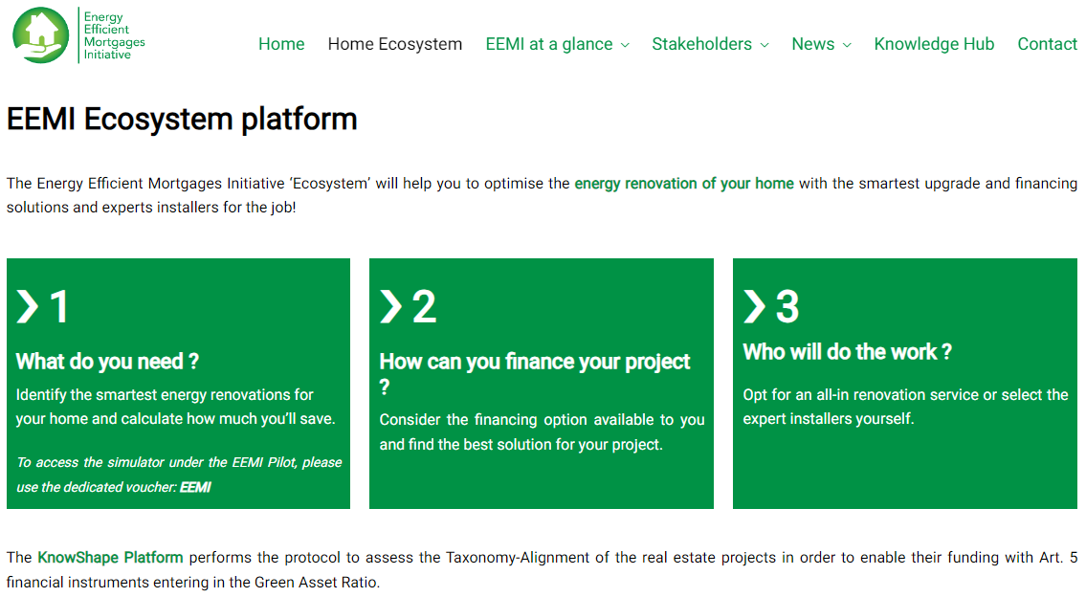
The Ecosystem homepage

Slide 13
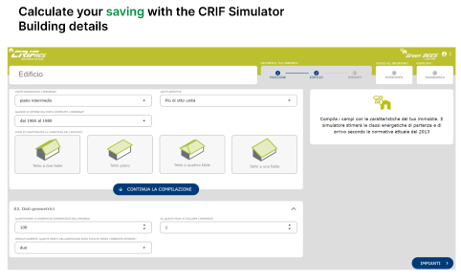
The Ecosystem’s simulator
With the Simulator (currently available for Italy and Sweden) an interested party can get an overview for their geolocalised dwelling of the improvement needed, budget indication, potential energy savings and CO2 reduction, an estimate on property value improvement and EPC evolution before and after the renovation works. Finally, there is also an indication of potential public support schemes available.
The output of the simulator is a document/link to share with the lending institution to get financing for the retrofitting project. The information provided will treated according to the consent of the interested party in line with GDPR.

Slide 14
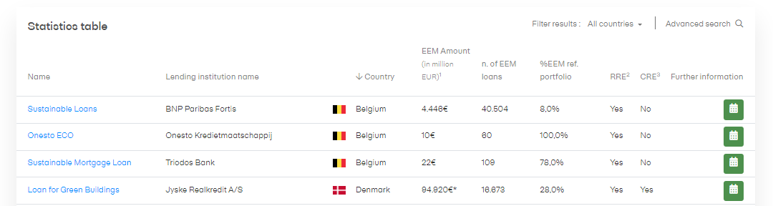
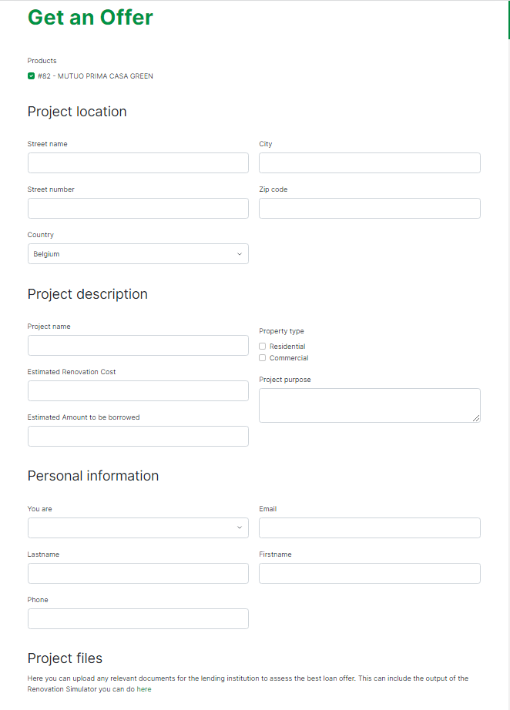
The Ecosystem’s financial partner finder
When looking for a potential financing solution the customer can browse through the EEM Label-compliant products and, if the lending institutions allow, she can directly request an initial offer by indicating information on the property location, and project description and by submitting any files useful to the lending institution to finalise an offer.

Slide 15
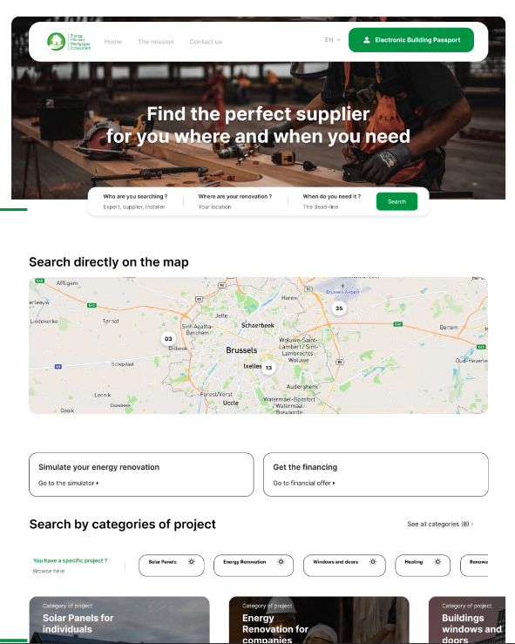
The Ecosystem’s marketplace
To maximise the effectiveness of the customer experience the Ecosystem offers various degrees of support according to the types of needs, the desired level of independence in managing the project and flexibility :
The local manager guides the client through the platform and supports the user in the choice of the best supplier and enterprise for his/her project for a more one-stop-shop experience
Direct choice of the enterprise through filters according to location, types of services and an internal rating system to provide a higher degree of flexibility of the customer in choosing the suppliers
Both local managers and suppliers can be contacted via an interactive platform

Slide 16
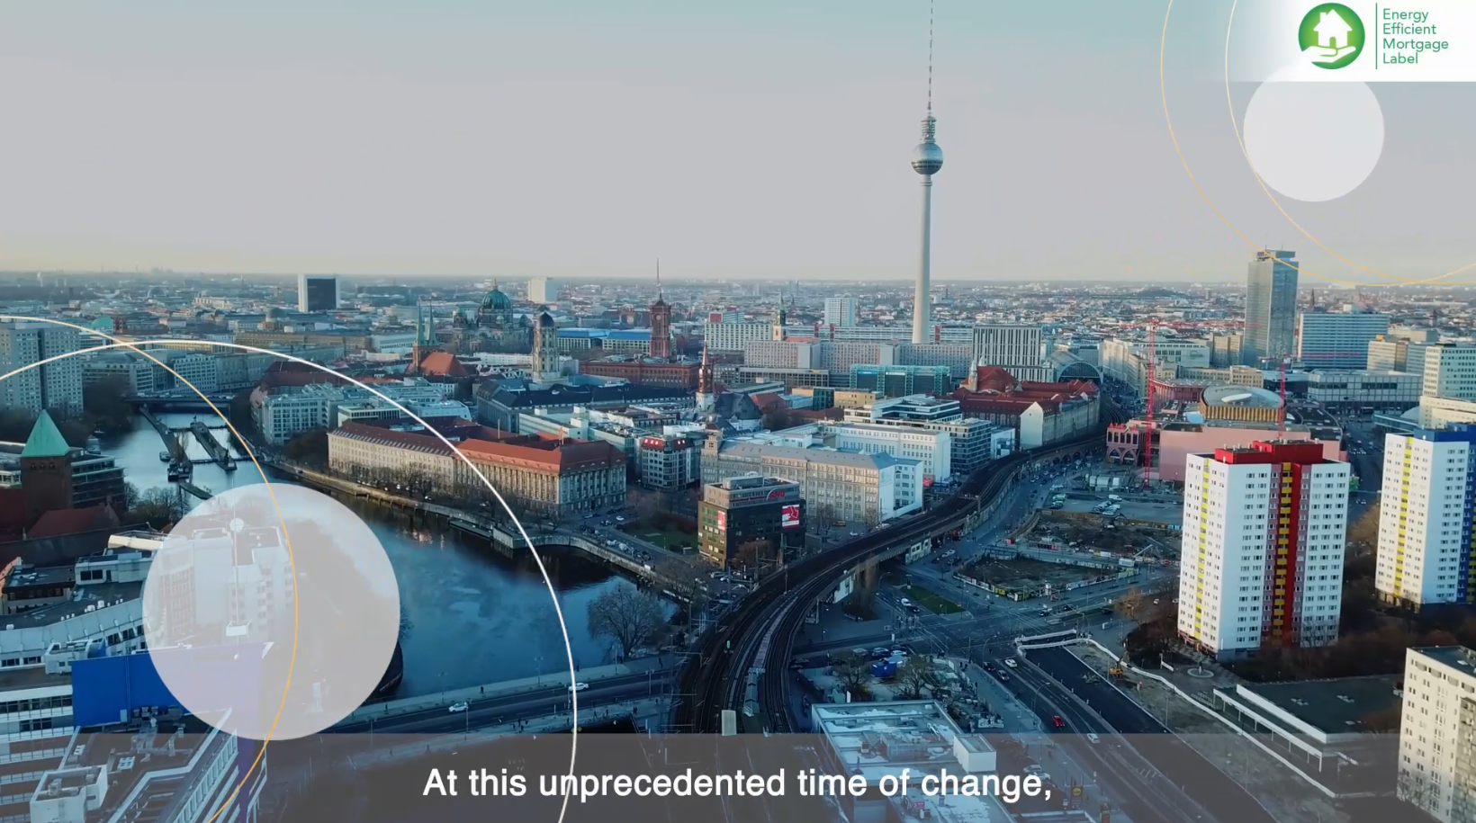
Our video: Funding the Hope for a Better Future
https://www.youtube.com/watch?v=jDUxdjvH0zo

Slide 17
Find out more about EEMI
Website:
https://energyefficientmortgages.eu/
Twitter:
https://twitter.com/emf_ecbc
Linkedin
https://be.linkedin.com/company/european-mortgage-federation

