Slide 1


Development of Mortgage lending
and Housing Saving Credit System
in Kyrgyz Republic
MFC “Elet-Capital” CJSC
September 2024

Slide 2

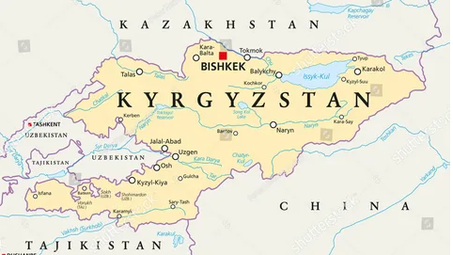




Population: 7,0 mln.
Kyrgyzstan (as for 2023)
GDP: $13.7 bln.
GDP per capita: $1 969
Territory: 199 951 sq.km
Mountains: more than 95%
Financial system
Banks - 23
MFIs - 121
Insurance - 17
HSCC - 0
Inflation: 7.3%
Emigrants: 651 000
Money transfers: $2,7 bln.
(20% of GDP)

Slide 3
Elet-Capital (2023)
Lending
Gross Loan portfolio
$40 mln.
4th place among 121 microfinance institutions
Active clients
27 487
Capacity
1HO
23 Branches
2 suboffices
Personnel
219
Financial position
Assets
$44 mln.
Equity
$7 mln.
PAR 30
1,20%
Loan officers
151
Net Profit
$1,5 mln.
Notes:
Вставить диаграмму по кредиторам

Slide 4




Activity
Strategy
Mission
Purpose
Vision
Improving housing affordability
improvement of housing conditions of citizens of the Kyrgyz Republic
creation of a sustainable housing finance system for citizens of the Kyrgyz Republic
Transformation into a financial institution for development in the housing sector

Slide 6
Mortgage disbursment channels
State Mortgage Company
Term of mortgage loan: 15-25 years
4%-8% interest rate
Mortgage of Banks
Term of mortgage loan: 5-12 years
>= 30% own contribution
Interest rate: 17-21%
Housing Saving Credit System Model
>= 50% own contribution
Interest rate: 7-12%
Term of mortgage loan: 6-15 years

Slide 8
Kyrgyzstan

Slide 9
Volume of housing construction annually
(million sq.m.)

Slide 13
Deposits of individuals in Kyrgyzstan 2018-2023 (mln. $)
Notes:
Вставить диаграмму по кредиторам

Slide 14
Estimated volume of migrants' deposits from the volume of international money transfers (mln. $)

Slide 15

Multiplicative effect
Improving financial literacy and encouraging the population to save
Accumulation of internal "long-term" financial resources and reduction of the dependence of the housing financing system on the republican budget
Involvement of a larger category of citizens in the housing program
Effect
Reduction of social tension of the population
Stimulation of the building materials market and the construction companies themselves
Creation of new jobs
Strengthening regional capacity, reducing internal migration
Stable development of mortgage market

Slide 16




Digital Ecosystem
1
2
3
CRM -
Customer Relationship Management System
Mobile app
Software
Remote Identification
Electronic digital signature (EDS)
Signing of contracts
Personal account
Partner Integration
Scoring
Internal Modules
Automation of all activities
- Digitalization of business processes and interaction with customers,
- Customer-oriented approach

Slide 17

Strengths
SWOT analysis
Weaknesses
Extensive branch network;
Established customer base;
Involvement of financial flows of labor migrants in the system of mortgage lending;
The company's experience in lending for 19 years;
Competence of the Board of Directors, the Management Board, and key employees
Good reputation with creditors
High cost of resources
Low level of capital adequacy;
Imperfection of prudential requirements on the part of the regulator;
Imperfect scoring system
Insufficient digitalization of processes;

Slide 18
SWOT analysis
Opportunities
Threats
Integration of successful experience of other countries, taking into account the characteristics of the country;
Access to long-term money;
No strong company involves in housing saving system and company can be one of the first such companies;
Territorial coverage of the country's citizens.
Harnessing the financial potential of migrants.
Instilling a culture of savings in the population.
Citizens' distrust of the system due to the new mortgage products;
Changes in the political and economic situation in the country, which will have an impact on the decline in incomes of the population and a drop in their solvency.
Inflation risks
Over-indebtedness of the population (parallel, consumer)

Slide 19

Thank you!

