Slide 1
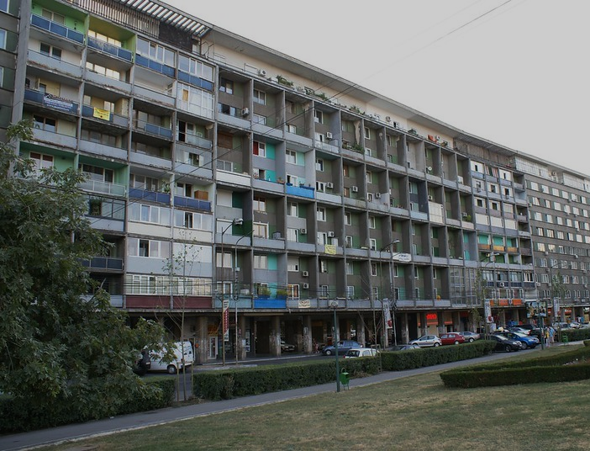

Urban disasters:
Confronting a new paradigm
Laura Grelet

Slide 2
80% of global population now lives in urban areas.
Urban areas are 3 times more likely to experience severe disaster impacts.

Slide 3
Approximately 55% of the global urban population is exposed to climate change risks, such as extreme weather events, heatwaves, and rising sea levels.

Slide 4
According to the National Flood Insurance Program (NFIP), about 30% of the U.S. population lives in areas with some level of flood risk.
Due to increased flooding from climate change, many properties are facing higher premiums (25% higher) or difficulty obtaining insurance.

Slide 5
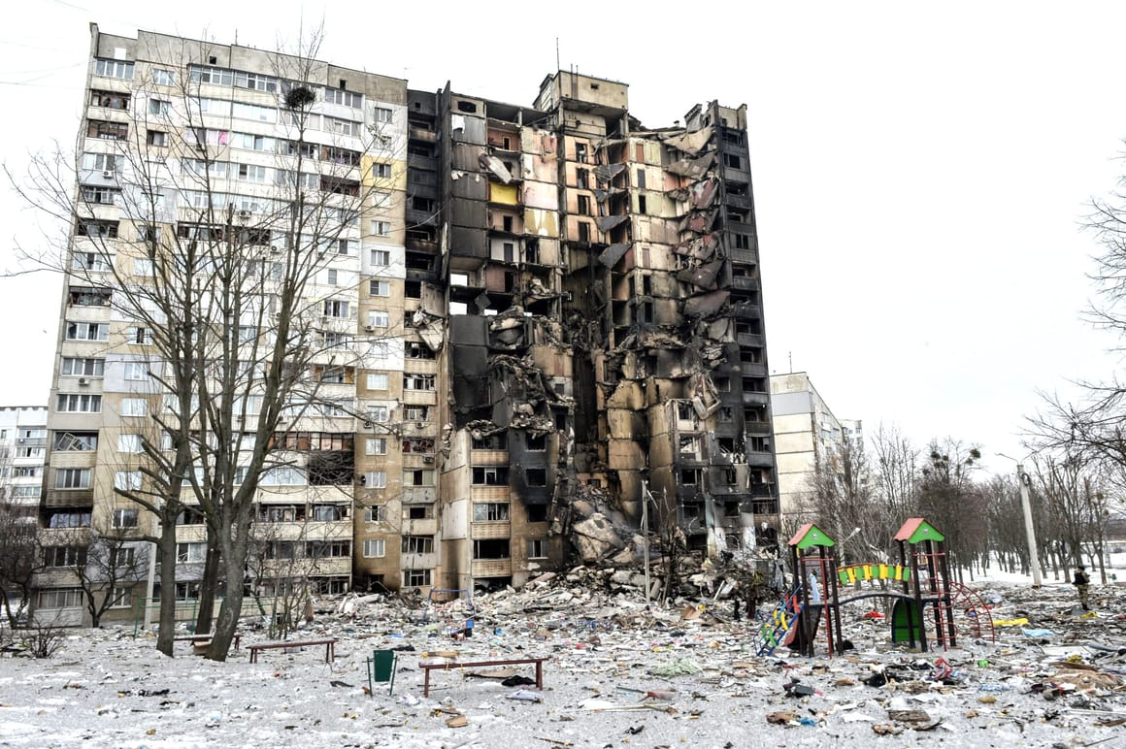
In Ukraine, over 30,000 residential buildings have been damaged or destroyed due to recent conflicts, highlighting the urgent need for practical repair solutions.

Slide 6
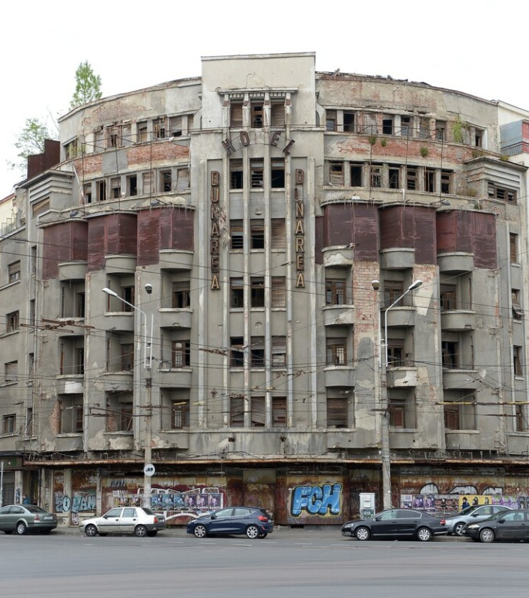

In Romania, exposure
to earthquake risk is among the highest in Europe.
Bucharest is the most vulnerable capital city on the continent and one of the top ten globally.
Notes:
Insert Indonesia photo from Kit

Slide 7
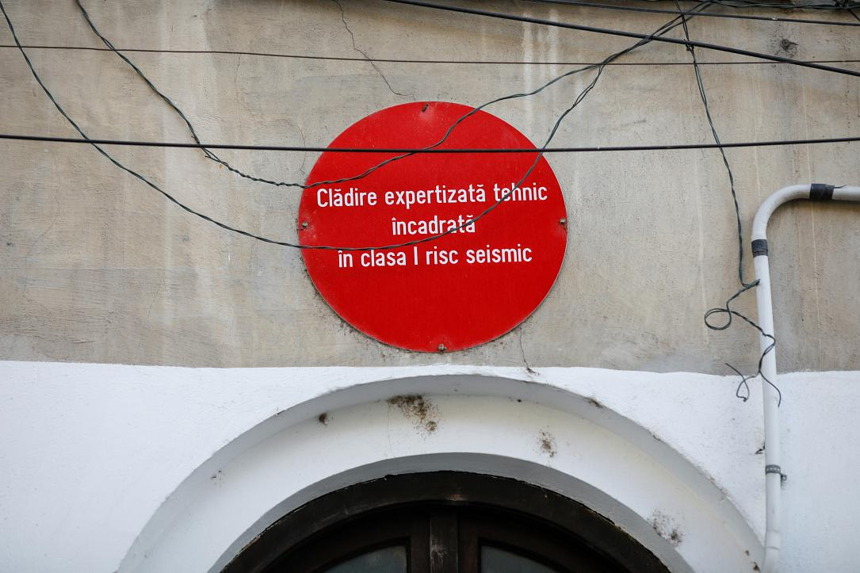
Bucharest has 370 buildings (6,480 apartments) classified as Class I seismic risks, with a high risk of collapse during an earthquake.

Slide 8
Challenges are exacerbated in developing countries:
  Cities are more vulnerable: higher risks due to poor infrastructure and informal settlements
  Cities have fewer resources
  Cities are growing faster

Slide 9
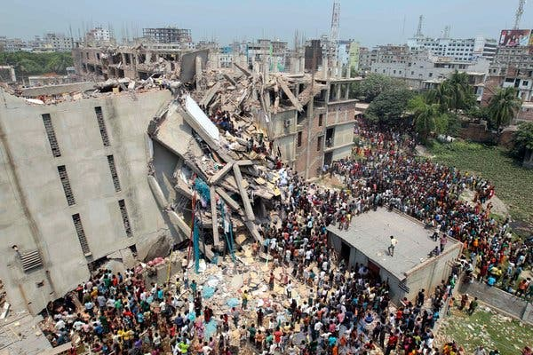
Collapse of a clothing factory building in Dhaka, 2013
In Dhaka, 900,000 buildings are at risk of collapse in the next earthquake

Slide 10
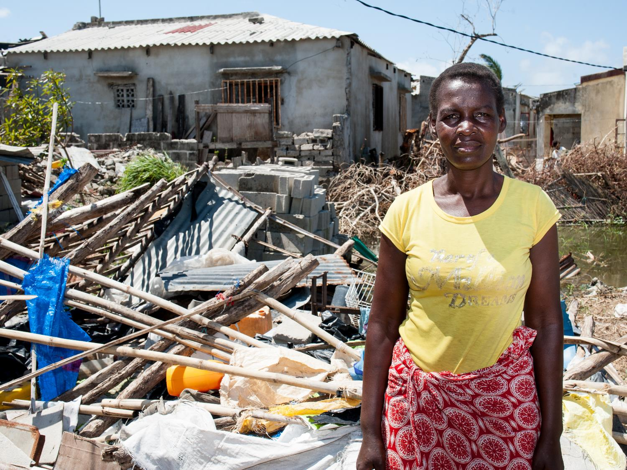

We need to build to last.
Notes:
Photo from Mozambique

Slide 11
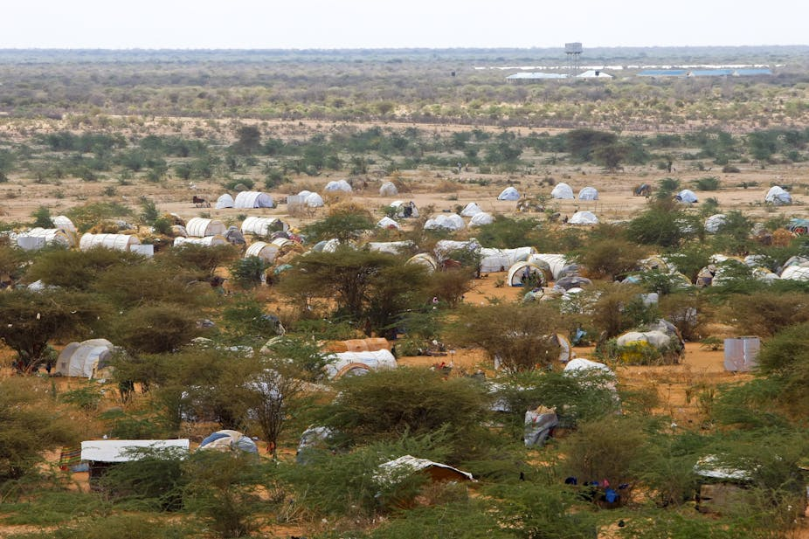
Humanitarian aid organizations have traditionally focused on rural and low-density areas, where their interventions have often centered around emergency relief, basic infrastructure, and community-level assistance.
Dagahaley – one of three camps that make up Kenya’s sprawling Dadaab refugee camp. Dai Kurokawa/EPA

Slide 12
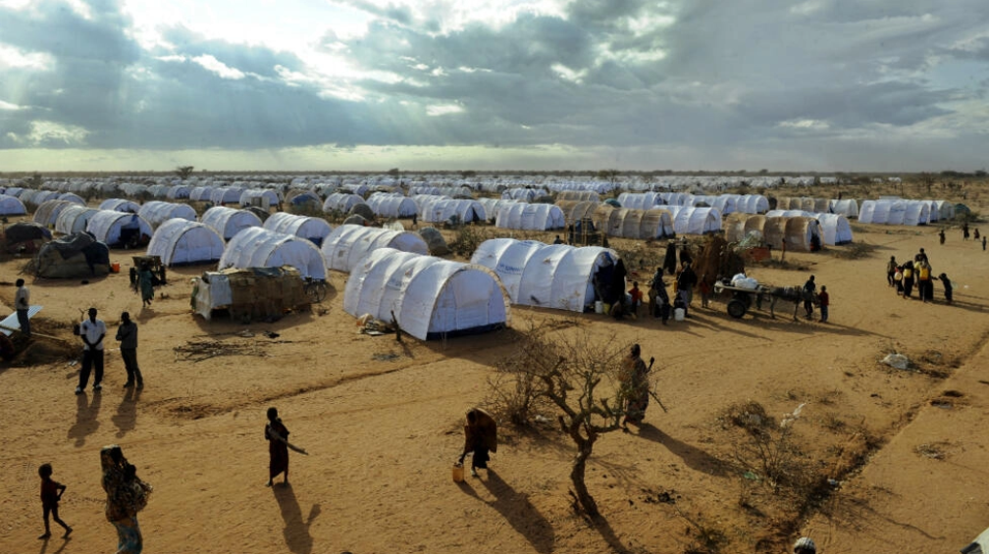
Refugee camps in the 1990s-2000s
Somali refugees settle in a new extension of the Ifo camp within the Dadaab humanitarian complex on July 31, 2011. — Tony Karumba, AFP

Slide 13
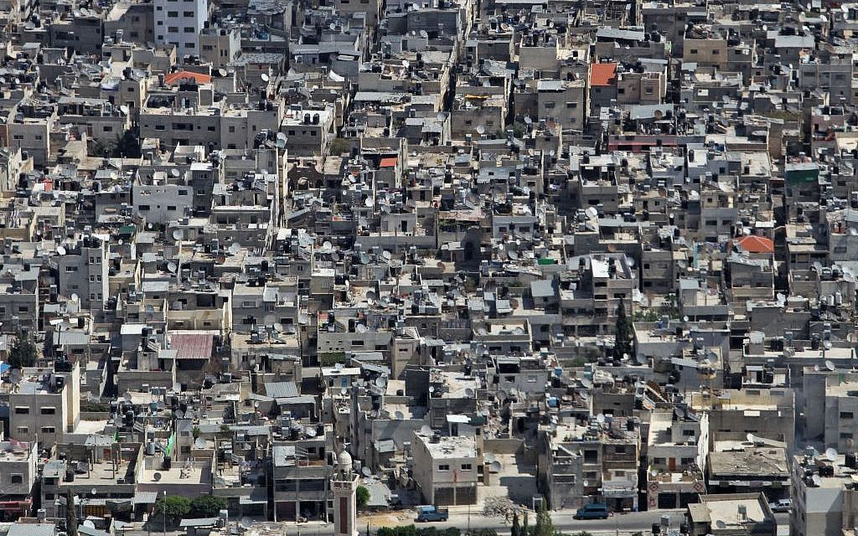
Refugee camps today
A view of the crowded Balata refugee camp in Nablus.
Balata is the largest refugee camp in the West Bank,
housing some 30 000 people — Nati Shohat/FLASH90

Slide 14
Transitioning to urban contexts - vertical residential developments and high population density (Ukraine, Gaza) – is a challenge for the humanitarian sector

Slide 15
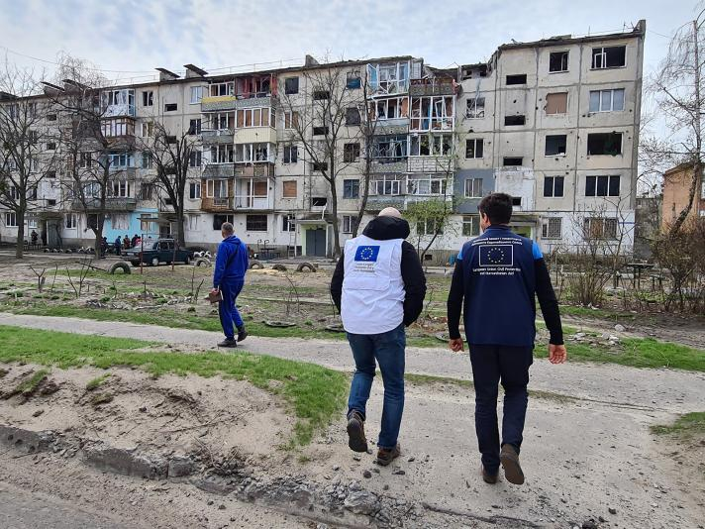
Because urban rebuilding is complex and expensive

Slide 16
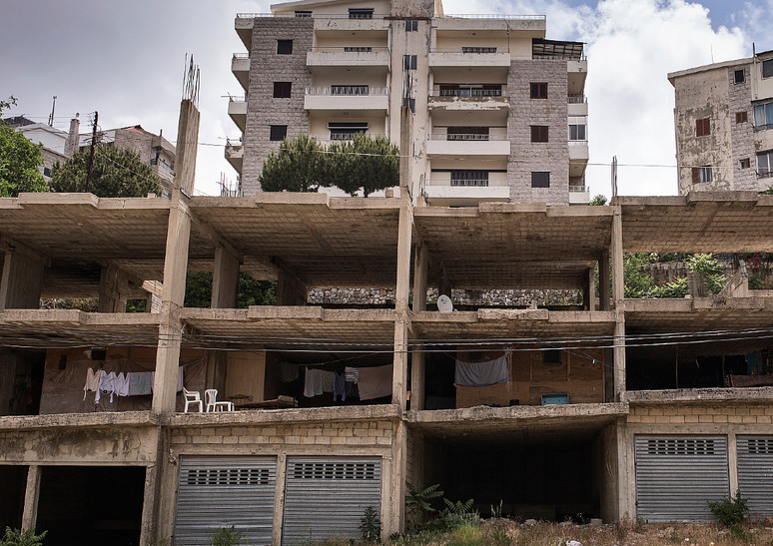
Humanitarian crisis
+
Financial crisis
+
Insurance crisis

Slide 17
Technical expertise, housing finance expertise and long-term funding is crucial for rebuilding urban housing.

Slide 18
Governments and financial institutions must play a central role in urban rebuilding and climate resilience.

Slide 19

How?
  Designing disaster reconstruction policies before disasters happen (currently, governments around the world spend 90% of their disaster budgets on emergency relief, but only 4% on prevention and preparedness):
    Creation of dedicated funds and financial mechanisms for reconstruction
    Retrofitting: increasing housing resilience lowers the cost of housing (e.g. lower insurance premiums)

Slide 20
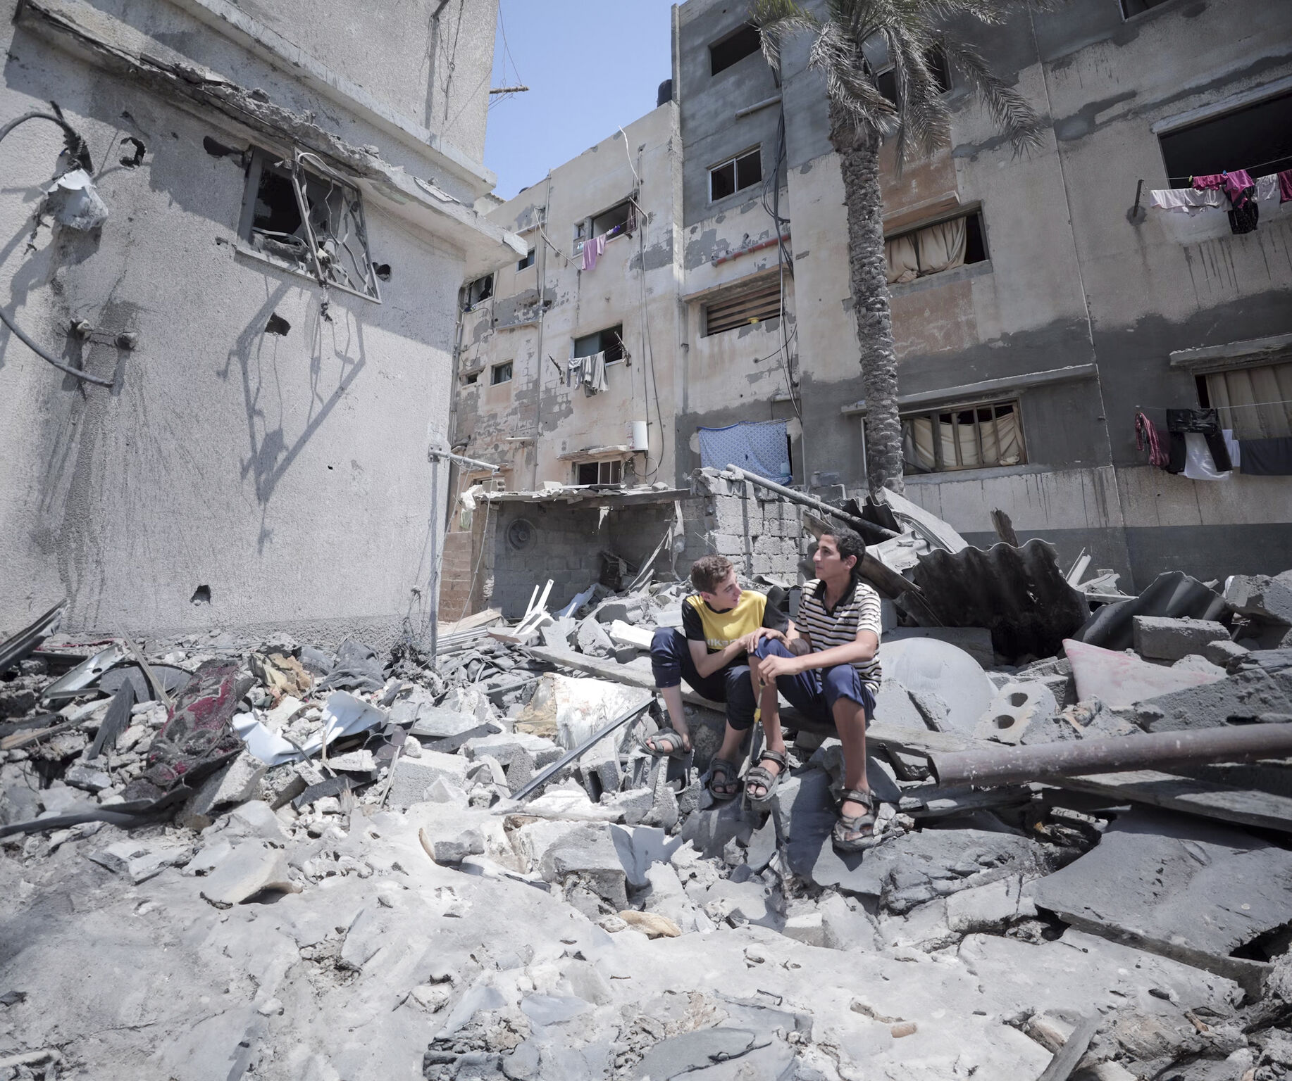
  Starting with quick, simple repairs to provide immediate housing solutions and prevent urban camps.

Slide 21
Miyamoto focuses on quick, effective repairs to critical building parts like roofs and walls.
Starting with these simple fixes is often more practical than jumping straight to full reconstruction

Slide 22
How?
  Preparing the financial sector for disasters:
    Banks must develop robust mitigation plans to :
      Assess climate risks of the properties they underwrite
      Ensure proper construction standards
      Safeguard mortgage portfolios against catastrophic events

Slide 23
Conclusion
  Humanitarian, international development and private sectors must work together to be effective.

Slide 24


