Slide 1



REIT
  Migration and Housing Finance
  The Mexico and USA
  Financing for Migrants
Septiembre 2024

Slide 2

Dr Jorge Yarza
Jorge Yarza, PhD, MBA, MSc
Advisory Services Leading Partner Real Estate Advisory Services & Investment Transactions
+52 5541806260 jyarza@deloittemx.com
Previous experience
Macro-project participation:
President of REIT International (real estate investment trust).
President of the Interamerican Union of Finance (UNIAPRAVI). He has been vice president of the National Construction Industry Chamber (CMIC) and housing (CANADEVI), permanent member of the National Housing Council .
Managing Director of Softec (consulting Real Estate)
He coordinated the integration of the 2000-2012 Government Housing Plans for the Presidents Vicente Fox and Felipe Calderon.
He was partner and Executive Director of Hipotecaria Su Casita, responsible for its commercial revenues, surpassing goals, maintaining leadership in market share and placement of the Mortgage.
Director of Technology and Organizational Development of Hipotecaria Su Casita, responsible for strategic planning, operations, quality, organization, and technology . He founded Instituto Su Casita.
Jorge has obtained a PhD, MBA, MSc Engineering and a BSc Ind Eng
He is a Visiting Professor at IPADE and Universidad Anahuac
Consulting services for Strategic Plan for Real Estate, Mortgage and Urban Development in Mexico
Advisory for the Development of the Strategic Plan for the Urban Developments related with The FONATUR Tren MAYA
Consulting and conceptualization The Strategic Plan for Medical Tourism in Mexico
Financial Feasibility and market studies for Housing, Industrial and Commercial Real estate for more than 300 projects
Jorge holds a PhD in Engineering from Manchester University (UMIST), UK. He joined Deloitte in June 2015 becoming Real Estate Advisory Services & Investment Banking Leading partner. He has been a director, entrepreneur and advisor to leaders in real estate development and mortgage banking companies. He has served as a consultant to domestic and foreign government agencies and international institutions with over 30 years of experience.
He retired from Deloitte to form an Investment fund, REIT International
© 2018 Galaz, Yamazaki, Ruiz Urquiza, S.C.

Slide 3

Overview
Migration
USA and Mexico
The structure of Families and Segmentation
Inmigrants Insertion and Evolution
Financing across borders

Slide 4
How we approached the analysis:Top Down Scheme
Global Migration
Trends and Condition
Pacific
CANAMEX
USMCA
Chicago-Quebec
Economic and Social development
Geopolitics
Eastern Seaboard
Global Context
California
Nevada
Arizona
Utah
Colorado
Kansas
Tennessee
North Carolina
New Mexico
Oklahoma
Arkansas
South Carolina
Baja California
Texas
Mississippi
Alabama
Georgia
Migration between the USA and Mexico
Sonora
Chihuahua
Coahuila
Louisiana
Florida
Nuevo León
Tamaulipas
Sun Belt
Mexico and USA Migration
Household structures and Segmentation
Household Segmentation
Bajo NSE
(E,D)
Hasta $5,876
Medio NSE
(D+, C-,C)
$5,877 a $30,431
Alto NSE
(C+, A/B)
Mayor a $30,432
1.9
4.0
3.5
Formal
4.4
8.8
Mixto
1.7
Informal
1.5
3
1.2
Segmentation of the Households
Migrant needs, expectation and Lyfe cycle
Specific options and Solutions for Mexican inmigrants
Solutions for Specific Segments of Mexican Migrants
Solution by segment and market
Financial institutios development
Cross border financing
Final Remarks
Bajo NSE
(E,D)
Hasta $5,876
Medio NSE
(D+, C-,C)
$5,877 a $30,431
Alto NSE
(C+, A/B)
Mayor a $30,432
1.9
4.0
3.5
9.4
Formal
4
5
4.4
8.8
7
Mixto
2
3
6
1.7
14.9
3
1
3
Informal
1.5
1.2
5.7
7.8
15.8
6.4

Slide 5

Global Migration a few facts and questions
Migration is a highly complex phenomena and affects people and societies in many ways. There is the challenge to inform the general public about the realities of migration to combat widely held misconceptions.
To start the discussion there are a few basic concepts:
How many migrants are there?
What are their main characteristics?
How do migrants contribute to host and origin societies?
How does the role of immigrants evolve over time?
These and other basic questions must be answered to plan migration, to leverage the opportunities of migration, and to address its challenges and opportunities.
Compared to the global population, the number of international migrants remains relatively small. In 2013, international migrants comprised about 3.2% of the world population, the estimate for 2023 is around 3.6%.
Some 292 million international migrants are living in the world today.
To this figure we must add those migrants that have obtained their permanent residence or the citizenship.
Source OECD

Slide 6

Global Migration a few facts and questions
The process and locations where migration happens in a more intense way are, from the recipient countries: the United States of America hosted the largest number of international migrants (20% of the global total), followed by the Russian Federation, Germany, Saudi Arabia, the United Kingdom, France, the United Arab Emirates, Canada, Australia and Spain. Inmigration rates to OECD countries were on the increase in the las decade, notably in Europe and America
From the emigration side half of migrants into the OECD come from 10 countries. Mexico topped the list, followed by China, the United Kingdom, India, Poland, Germany , Philippines, Romania, Morocco and Vietnam.
Therefore, the most sizeble exchange of migration in the world is between the United States and Mexico.
The migration process and the characteristics of the people who emigrate cover the whole spectrum of socioeconomic groups.
The number of tertiary educated immigrants in the OECD increased by 70% in the past decade to reach 27 million. Emigration rates of the highly-skilled, exceeded total emigration rates for most countries of origin. In some cases creating a brain drain to those origin counties.
Migration also considers the retiring families from the USA, UK, Germany, to countries where they can gain affordability and quality of life.
Some analysts consider that to understand the influence in the host societies (countries) we should consider first and second generation of migrant descendants.
The estimated population of Mexican Americans considering Inmigrants, first, second and third generation in USA is over 30 million people
.
Source OECD UN BBVA

Slide 7



The three counties have over 183 million people in their productive age
Population in Mexico, USA and Canada
325.8
million people
36.7
million people
129.2
million people
Productive age
11%
67%
8%
¿Work structure and formal jobs?
The vast majority of Jobs are forma
Mexico has expanded its industrial base in automotive, manufacturing , agribusiness, IT,tourism in the las three decades
The labor cost structure of the country provides a competitive advantage for the region
Increasingly educated and skilled population
The job structure is a combination of formal employment and mixed economy
Large country that retains and attracts cultural heritage
Highly structured production and supply chains
Aging population
Retiring population
Demand for young skilled labour
Energy and infrastructures in major cities
The high investment in technology, value chain, employment make the USA an atractive country
The USA requires inmigration for the economy expansion
Highest expenditure level in the continent

Slide 8
Where are the major links and relationships
The Mexico USA relationship expands from commerce, business, education, culture and security agendas. It is systemic.
Main Regions with Inmigration and Emigration
Pacific
CANAMEX
Since the TLC (NAFTA) the foreign investments in cities like Monterrey, Saltillo, Ciudad de México, Tijuana, Ciudad Juárez y Querétaro have grown fivefold in 30 years
The Deparment of Commerce registered 90 million of containers that get through land last year
Every year the estimated number of inmigrants from Mexico to the USA about 650,000 persons per year, more tan 80% through formal processes
The characteristics and socioeconomic segments of the inmigrants cover the whole spectrum of the Mexican population.
The estimated population of Mexican Americans in USA is over 30 million people
USMCA
Chicago-Quebec
Eastern Seaboard
California
Nevada
Utah
Colorado
Kansas
Arizona
New Mexico
Arkansas
Tennessee
North Carolina
Oklahoma
Mississippi
Georgia
South Carolina
Baja California
Alabama
Sonora
Texas
Louisiana
Chihuahua
Florida
Coahuila
Nuevo León
Tamaulipas
Sun Belt

Slide 9
Households in Mexico
The following graph helps to explain the segmentation of the Mexican households.
The Graph considers the different levels of income and the way these households earn their income.
Bajo NSE
(E,D)
LOW
Medio NSE
(D+, C-,C)
MIDDLE
Alto NSE
(C+, A/B)
HIGH
The graph was developed by the autor in 2000 and refined with the team at Deloitte
The graph considers in the xx¨axis the level of household income
The vertical yy¨axis considers the level of formality in the working activities of the families, the accesability to financial services and social security availability
The graph is divided in 9 areas or quadrants for simplicity.
The Quadrants in the upper and right side are those segments with more affluent and wealtier families.
In the opposite corner we can identify the households in poverty
The coverage of the Mexican financial an Mortgage system is shaded with blue.
The áreas for expansion and opportunities are shaded in yellow
The arrows depict the upward social movility
4.0
1.9
3.5
9.4
Formal
8.8
4.4
1.7
14.9
Mixed
3
Present Coverage
1.5
1.2
Potential Markets
5.7
Informal
Social Movility
Millones de Familias
7.8
15.8
6.4
Fuente: Elaboración propia con datos de la AMAI, Softec, GEA y Deloitte

Slide 10
Mexican Families Their Characteristics and Motives to Emigrate
The needs and expectations that drive the migration process are different acconding to the social and economic situation, age, expectations and links with other families that already live in the USA
At the basis of the matrix, we can identify migrants that are in the poverty line and are willing to risk a lot to emigrate.
The other quadrants have different motivators. There are formal inmigrants with more resources and education. These segments constitute more than 80% of the inmigrants to the USA.
Bajo NSE
(E,D)
Hasta $5,876
Medio NSE
(D+, C-,C)
$5,877 a $30,431
Alto NSE
(C+, A/B)
Mayor a $30,432
Bajo NSE
(E,D)
Hasta $5,876
Medio NSE
(D+, C-,C)
$5,877 a $30,431
Alto NSE
(C+, A/B)
Mayor a $30,432
5.6
5.1
2.6
4.0
3.5
13.2
1.9
Increase in their standard of Living
9.4
Formal
Formal
12.3
8.8
5.9
4.4
Better Opportunities
2.5
1.7
20.7
14.9
Mixto
Mixto
Poverty Line
4.2
1.5
3
1.2
2.0
1.9
5.7
8.1
Informal
Informal
7.8
15.8
6.4
10.5
22.1
9.4
30 Millones de Familias 2018 *
42 Millones de Familias 2035*
* En proceso de Actualización
Fuente: Elaboración propia con datos de la AMAI, Softec, GEA y Deloitte

Slide 11
Going to America

Slide 12
Using a similar approach used with the Mexican families segmentation, a simplified versión of the USA is depicted bellow
USA Household segmentation
Ingreso familiar bajo
<25 mil USD / año
Ingreso familiar medio*
25-60 mil USD/ año
Ingreso familiar alto
>60 mil USD / año
Formality in Job and Social security
They seek for local and have a strong american culture
Many do not have a passport
They live with the challange making means met ends
Public schools (primary and high school)
Seeking the American Dream
Local roots but more informed
Educated, some have attended college
Some have traveled
Aspirational in the future
Highly educated
Well Informed
Well off and with ambitions
Have traveled abroad
Insured and Covered
Formal
Mercado
que
queremos desarrollar
They seek for local and have a strong american culture
No Passport
Family run businesses
Local information and opinions
Limited Social security
2
Local Solutions
Informed and educated
Aspirational
Indipendent od Family business
Looking for the american dream
Highly educated
Family business
Traveled and informed
Bicultural
Limited Coverage of Medical care and Pensions
Limited
1
Local if American
Deep roots in culture if foreign
If foreign anchored in their background
Chalanges in Education and Medical Services
Inmigration situation iffy
Local in their conceptualización of their lifes
Educated to a basic level
Risk of Medicare, social Security and education
Tradicional views
No passport
Inmigration challanges and in the process of stability
Flexible ways to ear income
Business oriented
Resourceful and sometimes iffy
Some acces to medical services
Bicultural
Informal
Source United States Census Bureau’s Annual ASEC survey, median income in2017 was 58.8 mil USD

Slide 13
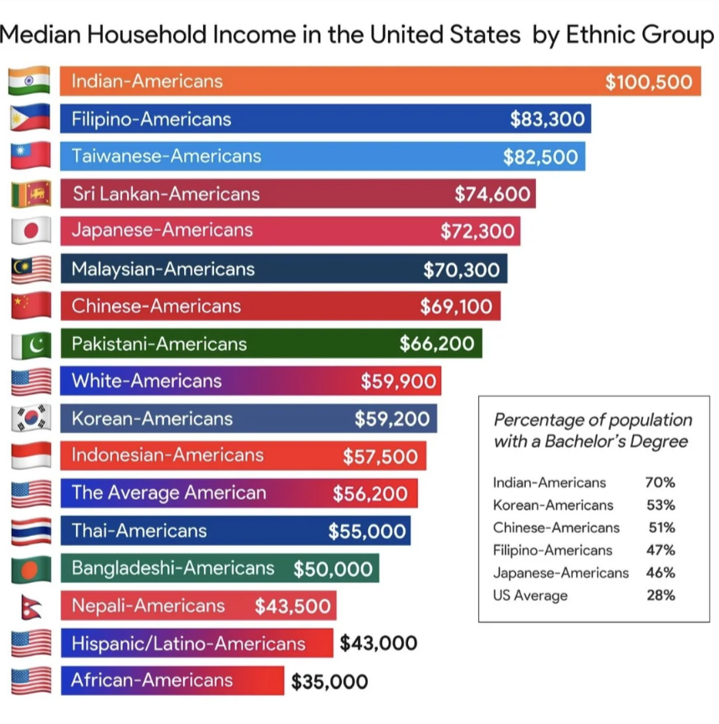



Households Life Cycle
Households and families evolve over time. They are not static and the main challange is to identify and provide solutions for them in each pase of their life..
High
Multiple Options
Second Home
6
Upward moving
5
Income
First Home
Rent/buy
4
TIME
10 to15 years
Meddle
Getting stablished
3
5 to15 years
Rent
2
3 to 8 years
1
2-5 years
Low
1-3 years
Young adult
Newly weds, DINKids
Family Home with children
High value House and Consolidation
Retirement
Household evolution in their life cycle

Slide 14

Policies for Inmigrants: Transitory vs Structural
1
In the case of the inmigrants in the situation of the poverty line, the families may need to have a transitional and limmited support.
The major challenge is how they fit in the conditions of the same quadrant as the Americans, in that quadrant in order to avoid injustice and confrontation.
A few things that need to be considered
Inmigration status (??)
Poverty aid by the authorities
Formality in Labour, how they can be integrated in the process
Financial needs
  Money transfers
  Bank Accounts
  Credit History
Rent vs Buy option
Subsidies
Transfering Money Orders and Buying in Mexico
Motivation
Flexibility
Adaptation
Risk profile

Slide 15
Solutions for Inmigrants who are established in the USA
2
In the case of the inmigrants in the situation of middle income, formal or mixed economic activities, access to certain support schemes, these households may need to have a better Access to the financial system and support to develop their capacities.
The major challenge is how they develop their full potential
A few things that need to be considered
Affinity and links with their relatives in Mexico. They have a strong sense of support and solidarity
Formality in Labour, how they can be fully integrated in the process
Financial needs
  Money transfers and Remittances
  Bank Accounts
  Credit History
  Business credit
  Better financial conditions (rates and costs)
In the USA their major concern is the best option between Rent vs Buy options
They seek financial institucions where they can have a better fit and confidence with thei Mexican american condition.
Two of their KEY financial Transfering Money Orders (remittances) and Buying properties in Mexico for them or their relatives

Slide 16


The Journey Home

Slide 17
Emigration : Solutions by Segment
The housing solution for each segment is different and it is dynamic, it follows the needs of the household in its evolution.
1
First Solution Poverty line: Shelter or subsidised housing
Cross border financing
2
Entry level housing Rent or Buy with subsidies
Bajo NSE
(E,D)
Hasta $5,876
Medio NSE
(D+, C-,C)
$5,877 a $30,431
Alto NSE
(C+, A/B)
Mayor a $30,432
3
Saving and Loan (S&L) Shemes
Both in USA & Mexico
1.9
4.0
3.5
3
5
9.4
Formal
Saving and Loan , mortgage institución Market conditions
4
4
8.8
7
4.4
3
1.7
6
14.9
5
Saving and Loan , mortgage institución Market conditions
Mixto
2
3
1
3
6
Saving and Loan Shemes for Properties in Mexico (ie Property trusts)
1.5
1.2
5.7
Informal
7.8
15.8
6.4
7
Saving and Loan and Mortgages Shemes for Properties in Mexico
30 Millones de Familias 2018
Fuente: Elaboración propia con datos de la AMAI, Softec, GEA y Deloitte

Slide 18

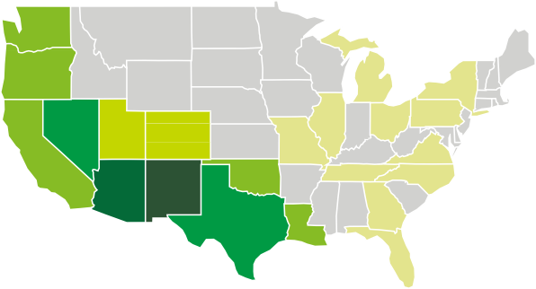


Cross border Mortgages Mexico & USA
Tu Opción México
BBVA
2
Mexican families with the need for a formal house in Mexico. (title, permits, survey) Brokerage Options for the Property
3
Mortgage in Mexico
Credit contracts in USA and Mexico
Specialised Funding
Coupled credit and Insurance
Regulation Mexican and USA
1
Mexican american families with disposable income to buy a property in Mexico
Mortgage Advisory
USA instution tha provides the joint origination process
Certification as Brokers (Real Estate & financial)
6
3
Origination of the motgage,
Specialized chanels to analyse coupling borrowers, appraisals, notary,
Personal information
Coordinating the relationship between the USA and Mexican financial institution
Special funding schemes
7
4
USA instution origination processs
Consular documents and certifications
5
Signing the Documents and formalizing the Mortgage and credit (USA)
Comunication
Regulatory processes
5
Signing the Documents and formalizing the Mortgage and credit (USA)
Comunication
Regulatory processes
Remittances
6
Payments in the USA and money transfers into the Mexican Institution
6
Payments in the USA and money transfers into the Mexican Institution
Registrration of payments follow up
Cancellation when fully paid

Slide 19



Saving and Loan and the Bausparkassen
The solutions for households who are in the middle income and mixed economy who require specialised financial services, can opt for Saving and Loan schemes.
One of the options for the mortgage and saving schemes is the Bausparkasse model.
The saving and loans helps to develop conditions to have access to financial products for mexican migrants, particularly those in the mixed economy. There are several financial products that contribute towards that end:
  Saving accounts
  Credit history through banking customer relationships
  Savings with purpose (housing , bausparkasse)
  Specialised and personalised attention
  Financial options for cofinancing and coupling clients
  Possibility to apply for cross border financial options to buy in Mexico
  CRM data to identify opportunities to develop long term relationship between mixed economy clients and the financial institutions
Households with mixed sources of income
Loan
Resources to complement loan
Saving period
(5-6 years)
=
Mutual society savings and capital formation
Strat
Préstamo:
Capital + interés en tasa fija (2% más alta que en el préstamo)
Final
Households in the mixed economy
Ahorro:
Tasa de interés fija como bono
Loan recovery
=
Origination
Administration
Recobery
Fuente: http://www.bausparkassen.de/index.php?id=102

Slide 20

Final Remarks

Slide 21
Market Opportunities and Perspectives of Health Tourism in Mexico
To reach the markets and migrant segment, we have been working suggesting a portfolio with 7 initiatives.
Initiatives selected according segments and opportunities
Result of the analysis and the results obtained from the suggestions and pilot schemes
1 | Development of a campaign that positions the opportunities to buy and Finance homes in Mexico, highlighting its factors of competitiveness in costs, times, warmth in attention and experience
2 | Creation of processes and specialised attention to inmigrants with programs promote the financial inclusión through saving and loan programs in the USA
3 | Synergies and strategic alliances with other financial institutions specialised in mortgages in Mexico and Remmitances in the USA to be able to make a more efficient and less expensive the process of tranfering resources in the cross border schemes and allowing greater flexibility and mobility of rhouseholds
4 | Synergies and strategic alliances with real estate brockers to facilitate and expedite house transactions with information and counseling
5 | Strategies for the low income inmigrants and their productive insertion in the community, looking for solutions that improve their access to housing, either in rent or buy options
6 | Elaboration of a deep analysis on specific market niches of inmigrants of all the market segments that could be attacted to specialised attention for housing solutions in the USA and Mexico
7 | Generate a mechanism of facilitation, information and profiling for possible USA emigrants interested in retiring in Mexico
33

Slide 22

Solutions: Three key Conditions
Septiembre 2023

Slide 23









Retos en la Bancarización
Para los próximos 20 años, México tiene el reto de generar procesos para ampliar la base de bancarización tato en el modelo tradicional (relacional) como con esquemas nuevos digitales y disrruptivos. Esto implicará revisiones regulatorias, nuevos modelos de negocios en toda la cadena de valor, mayor fondeo de recursos, y adecuaciones al marco legal.
Maturity model of financial inclusion
Financial Inclusion: Percentage of people (15+) who have an account in a financial institution
Developing
Consolidated
Mature
Poorest 40% (% ages 15+): 25%
Richest 60% (% ages 15+): 42%
No account because financial institutions are too far away (% age 15+): 21%
Used the internet to pay bills or to buy something online in the past year (% age 15+): 13%
Brazil
World
USA
Japan
Mexico
Colombia
Germany
Chile
UK
Uruguay
Peru
40%
70%
90%
Source Deloitte

Slide 24
Life Cycle Market Opportunities for Households
Lifestyle
<18 years Youth travel | 18 – 20 years Youth travel and Spring Breakers | 21-35 years International trips | 35 –50 years Family trips | 51 – 65 years Family trips | >65 years Long stay travel
Family trips with children’s attractions and family accommodations Beach destinations, theme parks, themed cruises | Travel with friends Looking for experience, ecotourism Low cost lodging and services | Families are formed Travel with friends and/or partner Plannng starts for family expansion First jobs (Income rising) Sports and physical activities | Tuition payments Family vacations Entrepreneur possibilities Sports and recreational activities | Children grow, study in university and start working Families look for yearly trips, holiday homes Tuition payment end, first mortgage You need a house closer to entertainment and health centers Preparation for retirement - possibility of a business | Higher health spending Search for increased life quality Long-term trips with greater spending potential
Tourism solutions
Beach destinations or with attractions for children Theme parks Theme cruises | Beach destinations Ecotourism destinations Theme parks Theme cruises | Honeymoon International travel Beach destinations with integrated services Cruises Wellness retreats Coaching retreats Yoga and Mindfulness destinations Training | International travel Beach destinations with integrated services Cruises Wellness retreats Coaching retreats Yoga and Mindfulness destinations Training | International travel Beach destinations with integrated services Cruises Wellness retreats Coaching retreats Yoga and Mindfulness destinations Trips in search of retirement destination (second home) | Cruises Wellness trip Change of residence or long stay residences in retirement Second home purchase for retirement
The search for a long stay home for retirement, or some residence for older adults, begins well before the age of retirement, around 50 years of age.
Income curve
Target Market
26

Slide 25





Desarrollo y evolución del sector
1990
2000
2010
2020
2030
% del PIB (Avance)
Introducción
Infancia
Crecimiento
Movilidad
Madurez
Estrategia
Mercado Inmobiliario
Producción
Mercado Hipotecario
Fondeo
Desarrollo Urbano
Impacto Económico
J Yarza, IUHF International Conference Viena, 2015

