Slide 1
Housing vulnerable groups in Finland
Teija Ojankoski, CEO
IUHF World Congress, Berlin 18.9.2024

Slide 2


Home for all – Y-Säätiö’s rental flats
Group
19 006 flats
Y-Homes
Rental flats for groups with special needs.
7 543 flats.
M2-Kodit
Rental flats based on ARA-conditions,
11 463 flats.
Targeted for impoverished & low income individuals with urgent housing needs

Slide 3
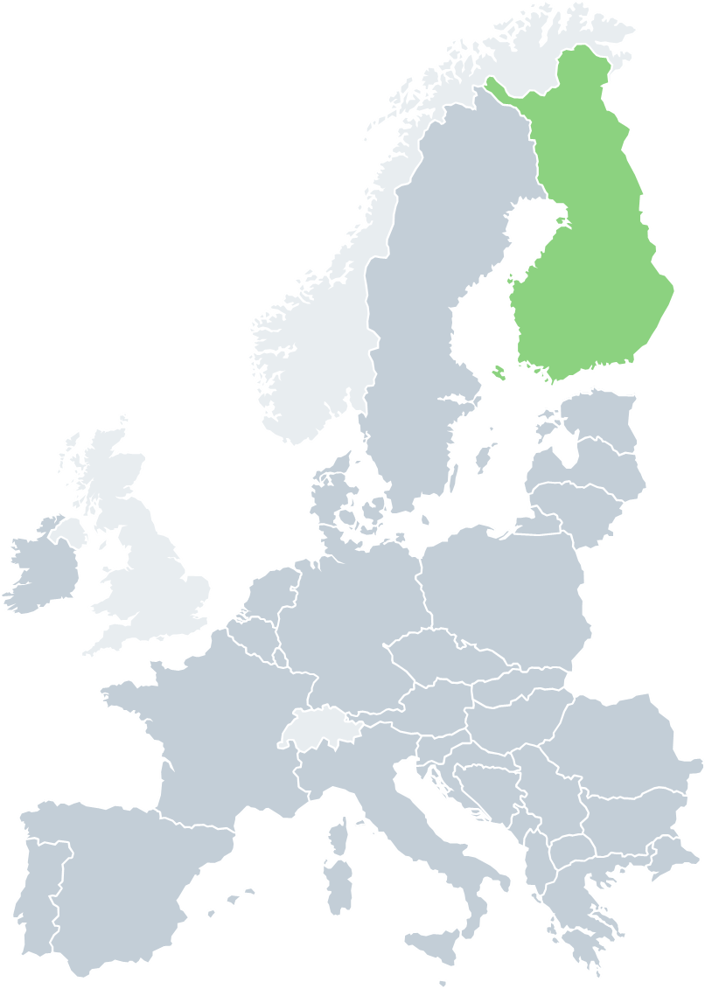
Homelessness in Europe
Finland is the only EU country
With a long-term reduction in homelessness
That has ended homelessness due to income poverty
Pop. 5,5 M
Helsinki
Source: FEANTSA
Notes:
Tilanne Euroopassa on todella huolestuttava. Suomi on ainoa EU-maa, jossa asunnottomuus laskee.
Tuemme muita maita antamalla kouluttamalla ja jakamalla tietoa asunto ensin-mallista. Housing First Europe Hub on Y-Säätiön ja eurooppalaisten asunnottomuusjärjestöjen verkoston FEANTSAn koordinoima pysyvä oppimisalusta asunnottomuustyön uudistamiseksi Euroopassa.

Slide 4
Homelessness in Finland 1987-2023

Slide 5
Homelessness has decreased in Finland
1985: 20 000 homeless
2023: 3 429 homeless
-83%
Notes:
Tähän muutokset visuaalisemmin. Asunnottomuutta on tilastoitu vuodesta 1985 lähtien. 25 vuodessa asunnottomuus on laskenut Suomessa roimasti.
- 65-70 of the homeless people are living with friends or relatives = sofa surfers

Slide 6

Systemic Change
Emergency response
Emergency response
Prevention
Housing & Support
Finland moved from this…
Emergency response
…to this
Prevention
Housing & Support

Slide 7
National Homelessness Programmes
2008-2011
PAAVO 1
2012-2015
PAAVO 2
2016-2019
AUNE
2020-2023 PROGRAMME
2024-2027 PROGRAMME
Housing First –principle was introduced: no shelters, but homes with own rental agreements. 2 143 new flats in total.
3 523 flats for people experiencing homelessness. Professionals and experts by experience were hired.
Programme concentrated on preventing homelessness and special groups. Expertise by experience has become established as a part of homelessness work.
The Cooperation programme aims to halve homelessness by the end of 2023.
The programme emphasizes the responsibility of the municipalities.
Ending long term homelessness by 2027.

Slide 8

Critical elements of ending homelessness
On a society level
Affordable social housing
(structural prevention) (Now 13 % of total housing stock)
General housing benefit
Implementation of Housing First
  Wide partnership
  Concrete quantitative goals

Slide 9

Critical elements of ending homelessness
On an individual level
Housing First as a mainstream policy
Permanent housing solutions
Alternative housing solutions and tailor-made support
Sillanpirtti 2, Helsinki

Slide 10

Subsidized housing in Finland
The Housing Finance and Development Centre of Finland
Implements subsidized housing policy in Finland, since 1949
Distribute government grants, subsidies and guarantees
Guides and monitors the use of ARA housing stock

Slide 11
Funding for subsidized housing
Loans
interest rate subsidy loans for new apartment construction, renovation, and procurement
guarantee loans for rental housing construction and housing company renovations
Grants
investment subsidies for special groups, repair grants, infrastructure grants, etc.
The funds are provided by the Housing Fund of Finland and government budget
Grants
352 million €
Loans
2,3 billion
€
8600 new apartments
2023

Slide 12
Subsidized housing stock is regulated by Ara
ARA rents are based on cost recovery principle
Tenant selection is based on need for housing
13% of all housing stock is under Ara regulations
400 000 state subsidized apartments:
250 000 rental apartments
100 000 rental apartments for special groups (elderly, students etc.)
50 000 right of occupancy dwellings
13 %

Slide 13


An example, Y-Säätiö Building Affordable Rental Houses with 90 apartments
80-95% loan from bank 16 M€
5-20 % own capital 2 M€
+ 18 M€
Interest subsidy from state
Rent*
~ 850 €/month
~ 17 €/m2
* Includes energycosts

Slide 14

How can a homeless person pay for rent and services?
Persons pay their rent themselves
Money comes from (options):
Unemployment benefit
Retirement income
Basic social security assistance
Supplementary assistance
Housing benefit
Paying services
Wellbeing Service Counties pay
all the social- and healthcare expenses

Slide 15

With Housing First Helsinki has more or less ended street homelessness
Safer and more pleasant city for everyone
The local community
Visitors &
tourists
Businesses &
investments

Slide 16

Ending homelessness is a cost-effective and profitable use of public finances
Economic benefits on various government functions
Safer Society Pays Off
Law enforcement, court appearances, incarcerations, nights in prison
Minimizing the Negative Effects of Homelessness
Unemployment, physical and mental health, instability etc.
Better Access to Services Saves Resources
Emergency services

Slide 17
Teija Ojankoski
CEO, Ph.D
teija.Ojankoski@ysaatio.fi

