Slide 1
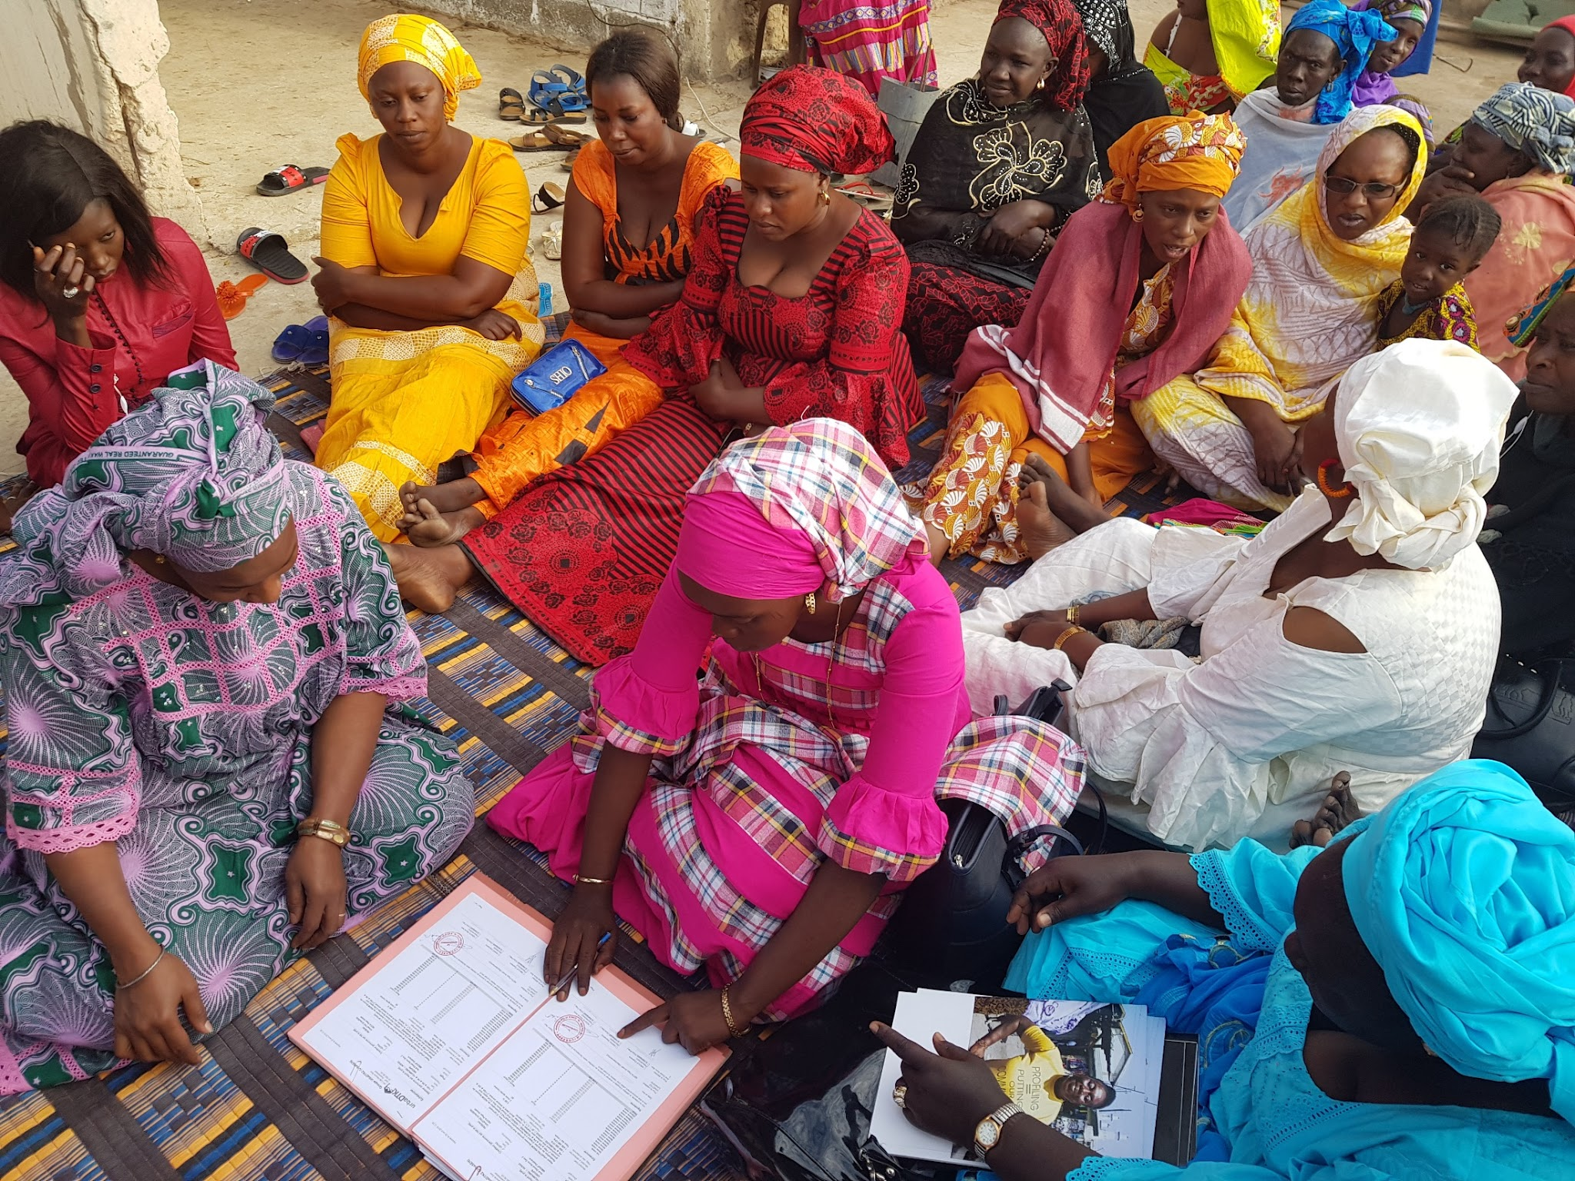

Saving systems for housing for vulnerable women in Senegal
IUHF Congress, Berlin - 09/18/2024

Slide 2

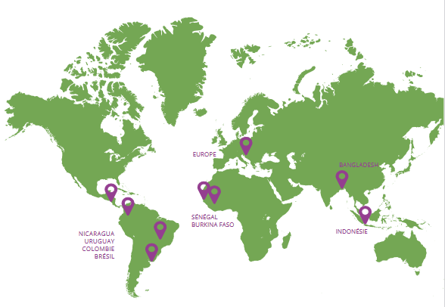



Franco-Swiss association committed to sustainable cities by and for their inhabitants
International cooperation and peer-to-peer exchanges of experiences.
Technical support to projects.
Promotion of financing tools and mechanisms for community-led housing solutions.

Slide 3
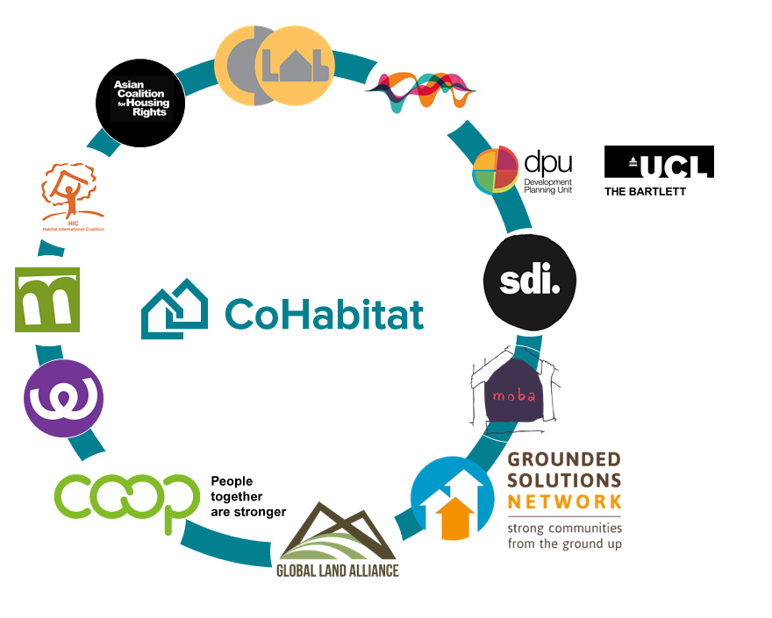

urbaMonde leads CoHabitat network,
a network of organizations promoting collaborative housing around the world

Slide 4
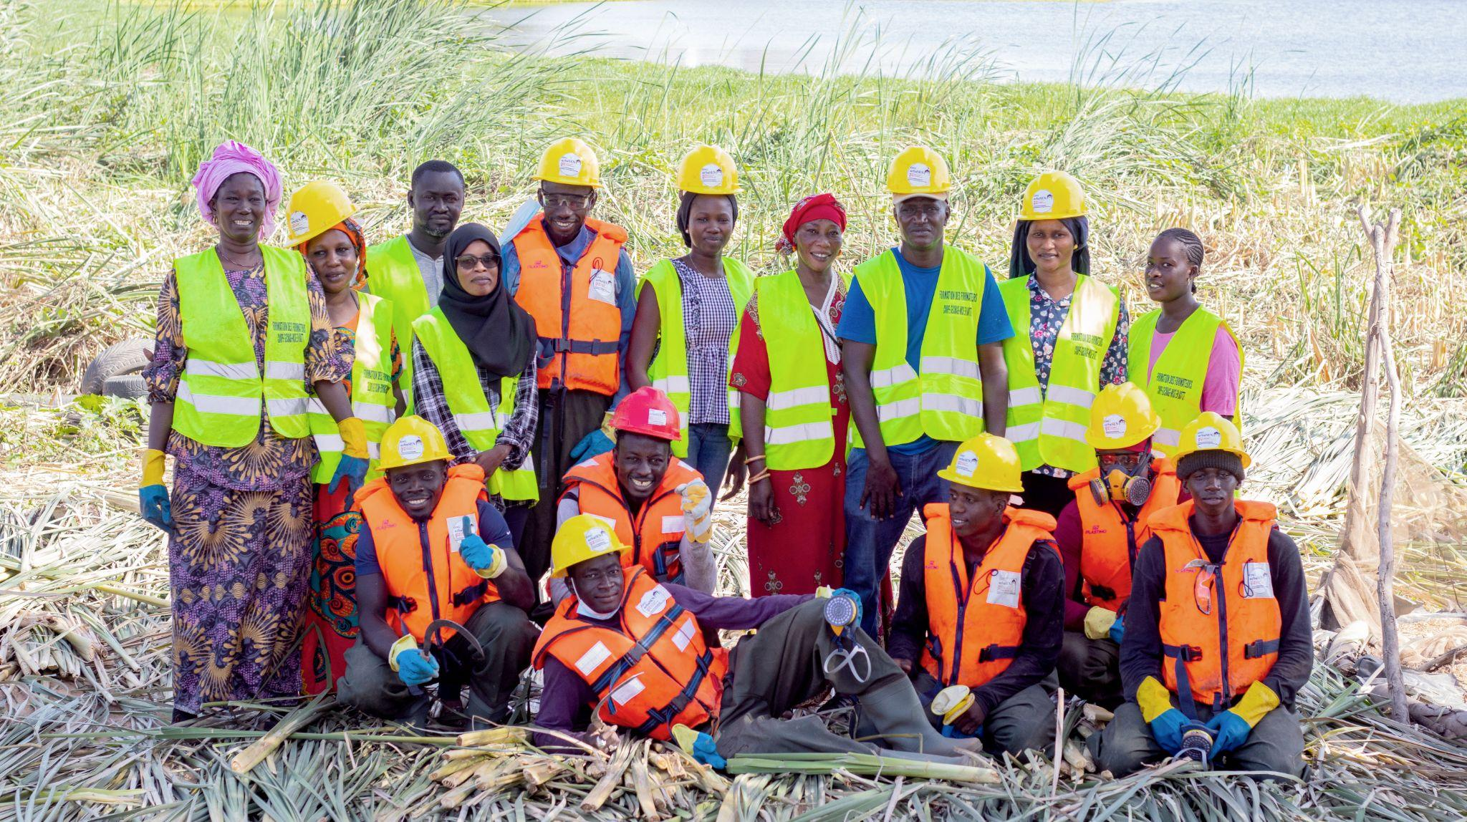

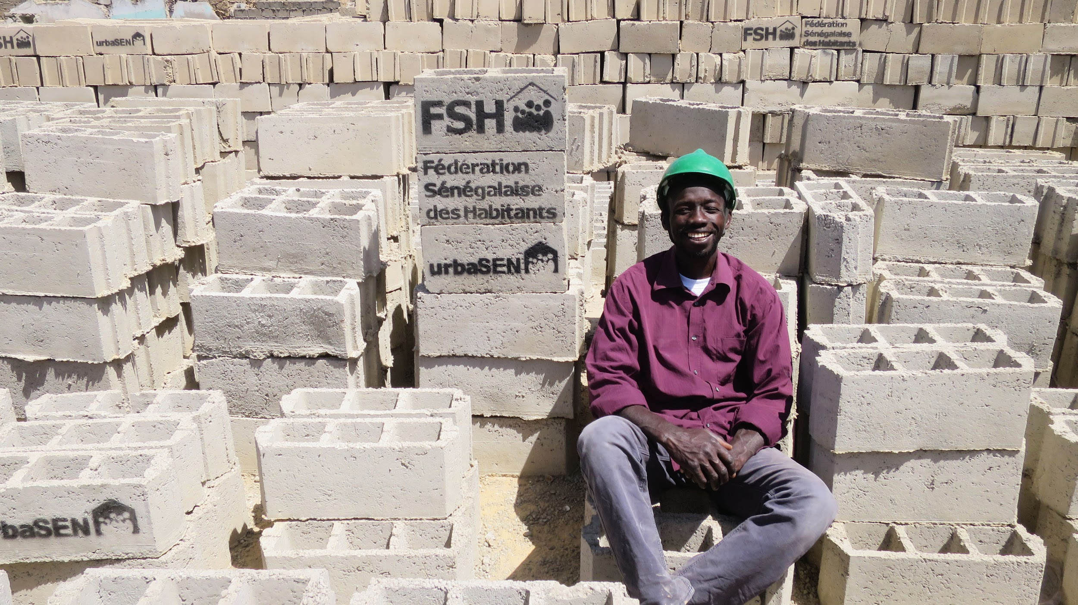
Senegalese NGO created in 2009
20 urban and community development professionals
A credo: residents at the heart of urban development
and neighborhood management
Ongoing dialogue with FSH and the authorities

Slide 5

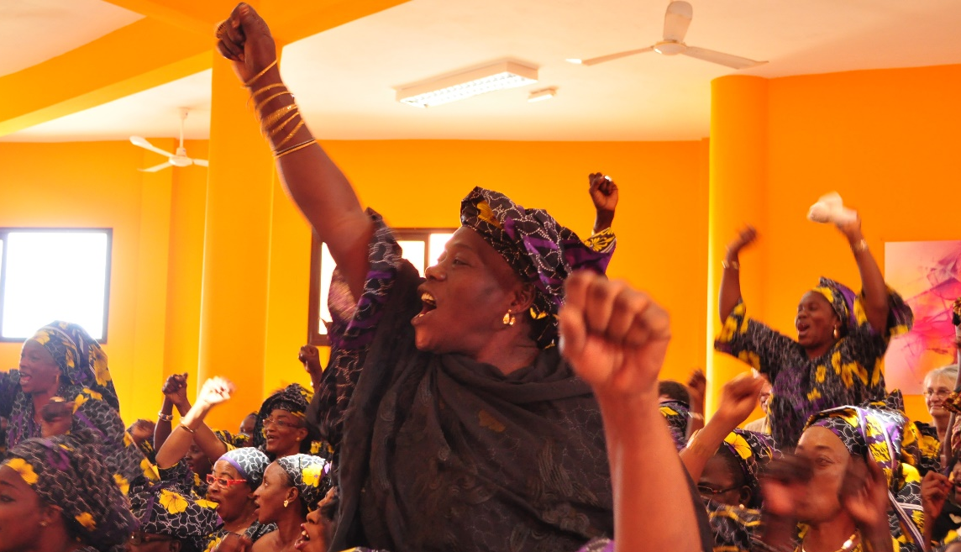
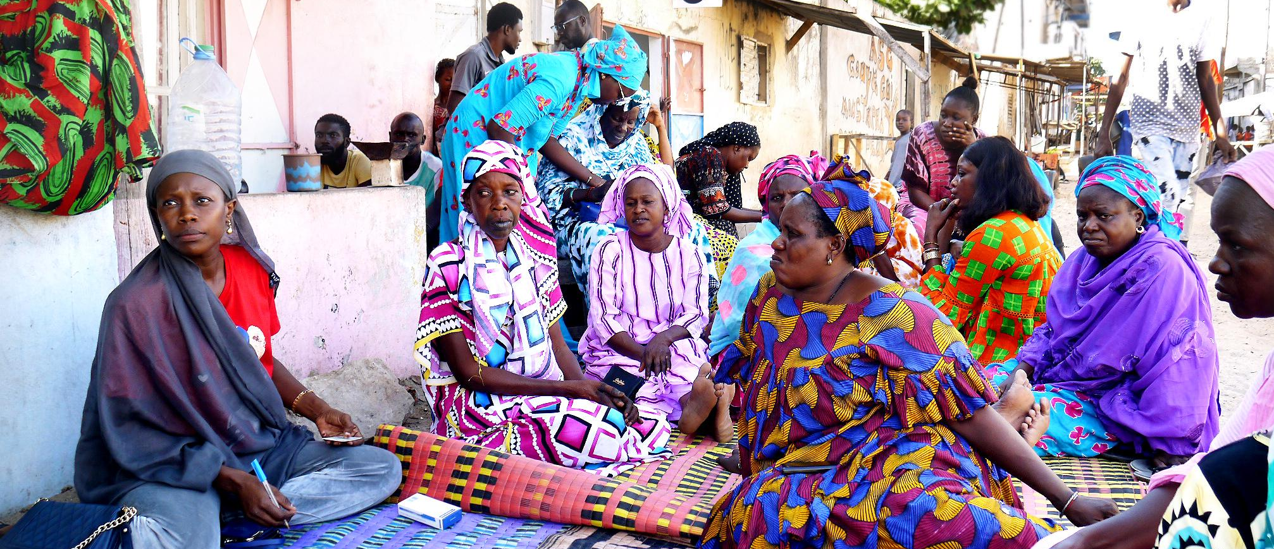
Senegalese Federation of Inhabitants
Created in 2014
Nearly 17’000 members,
96% women
672 saving groups
1 revolving fund
Over 800 craftsmen trained,
contributing to the implementation of projects

Slide 6

Community savings,
a tool for housing finance and urban projects

Slide 7
The FSH revolving fund, a tool for housing finance and urban projects
FSH's revolving fund, launched in 2014
as a tool for residents to pool their savings and
improve their living conditions in the context of floodings.
Total value: 335 million XOF (€ 511’000/USD 567’000)
(150M members savings + 167M endowments from international donors + 3M interests + 15M private donations)
Total loans granted: nearly 1 billion XOF (€ 1.5/USD 1.7 million)
83% global reimbursement rate

Slide 8
The FSH revolving fund principles
Solidarity: group jointly liable for the loan(s) allocated to its member(s). Solidarity and sense of belonging of the groups to a federation that represents their common interest is the only ‘guarantee’ of repayment.
Sustainability: the revolving fund is intended as a sustainable mechanism that encourages residents to take ownership and responsibility for improving their homes.
Accessibility: with its low interest rate (5%) and access conditions, the FSH fund is dedicated to members who are excluded from the conventional banking system.
Self-management: decisions are made by the FSH.

Slide 9
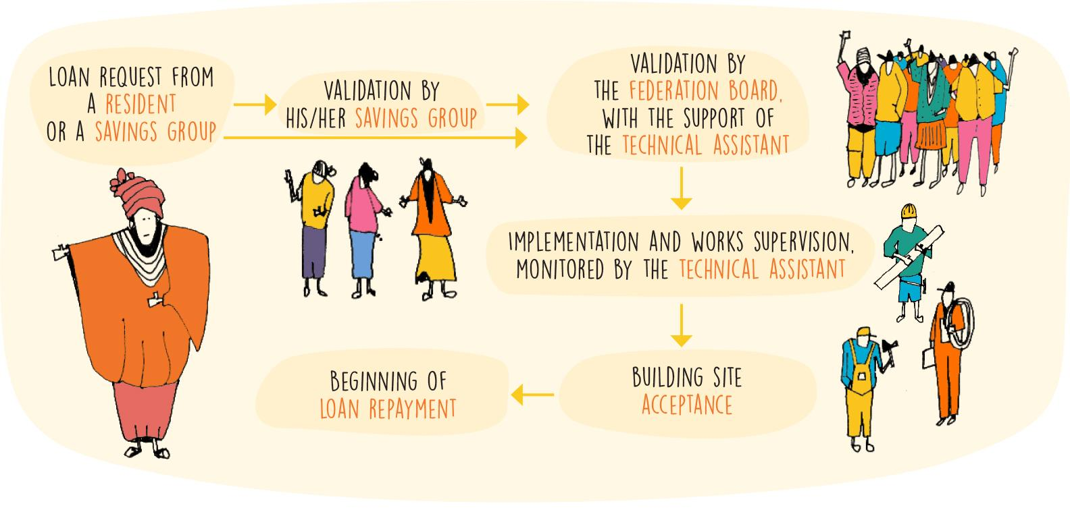
Loan process through the revolving fund
The repayment begins after the end of constructions, over 20 months with a one-month grace period.

Slide 10
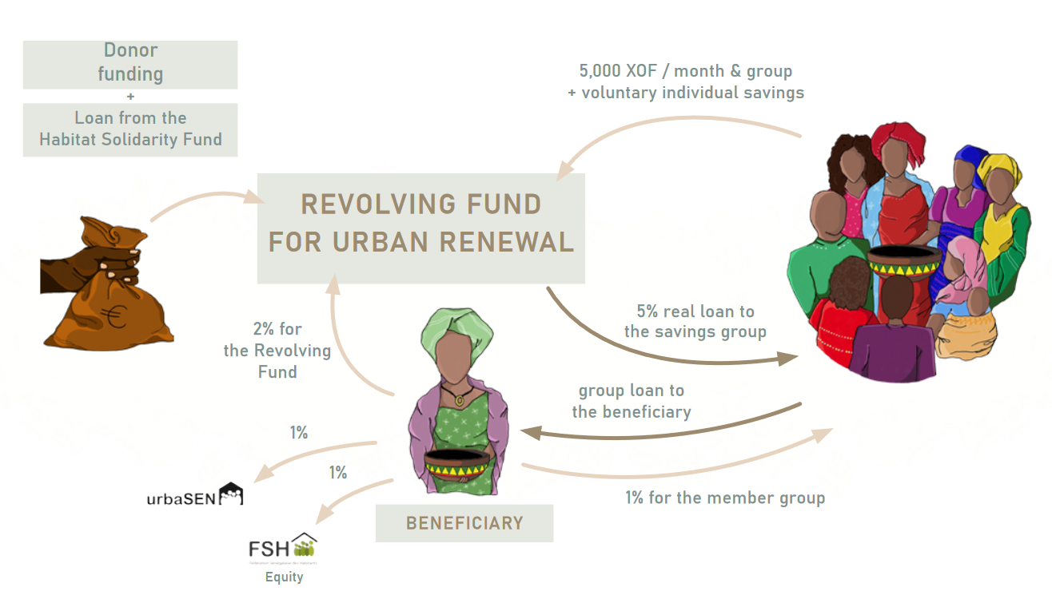
Loan conditions

Slide 11
Rules of the FSH revolving fund
Maximum loan = 1 million XOF (€ 1’525 / USD 1’700)
5% interest per loan, to support the system :
  1% for the borrower’s group
  1% for the Federation
  1% for urbaSEN (technical assistance)
  2% for the revolving fund itself
Collective responsibility of each loan : if the borrower defaults on repayment, the savings group has to repay (otherwise, nobody can borrow money again).
Each savings group has to contribute 5’000 XOF/month to expand the fund.

Slide 12
Access conditions to the revolving fund
Be a member of a savings group affiliated to FSH
The borrower must be authorised to carry out work on the plot where he/she lived.
The borrower’s group must be up to date with its payments:
  Membership fee (10’000 XOF / €15)
  Federal savings (5’000 XOF/ €7.5 group/month)
  Repayments of loans already granted to the group.

Slide 13
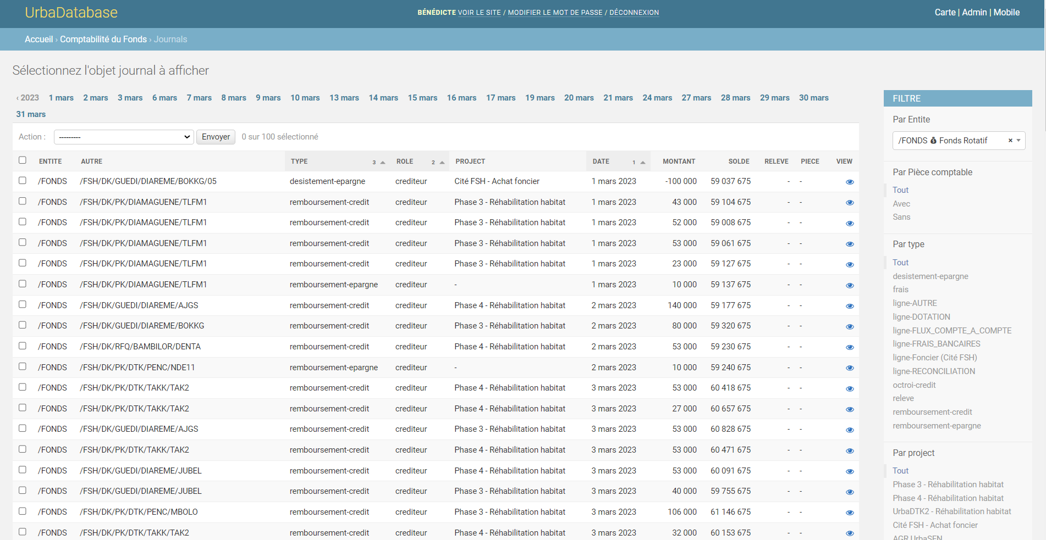
UrbaDataBase, a tailor-made digital monitoring tool

Slide 14
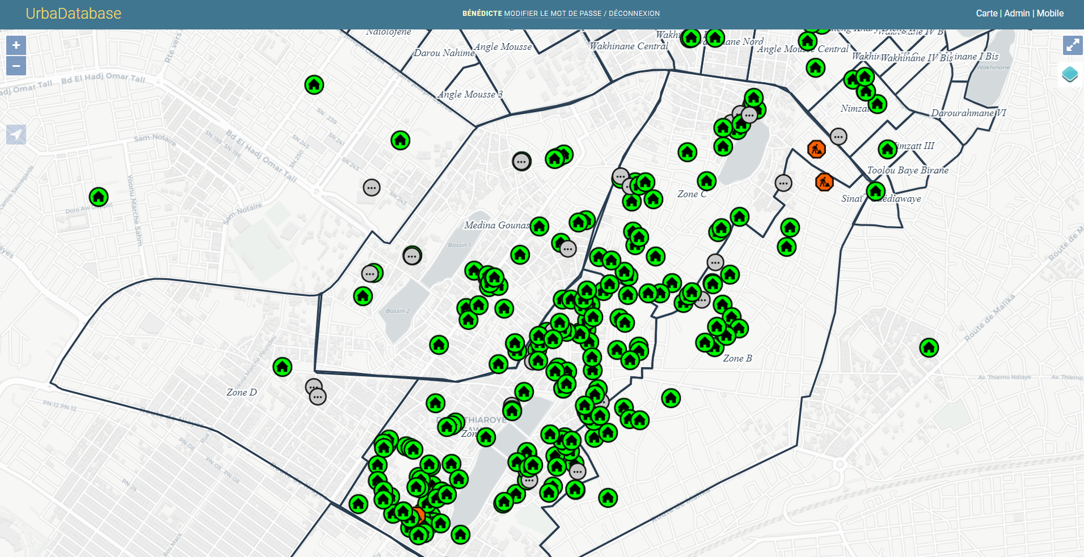
UrbaDataBase, a tailor-made digital monitoring tool

Slide 15
Performance indicators of the revolving fund
Indicators for 1 project | Million XOF | USD
Endowment by donor | 59 | 99’340
Total amount loaned / renovation works done | 136 | 229’256
Total repayments | 116 | 195’000
Sum of late repayments | 19 | 31’926
Reimbursement rate | 86%
X 2,3
X 2,25
> Thanks to its rotating principle, the revolving fund has a multiplier effect of the sums injected into it.
> Interesting for donors: endowment to the fund is an alternative to the grants’ logic - greater money impact.

Slide 16
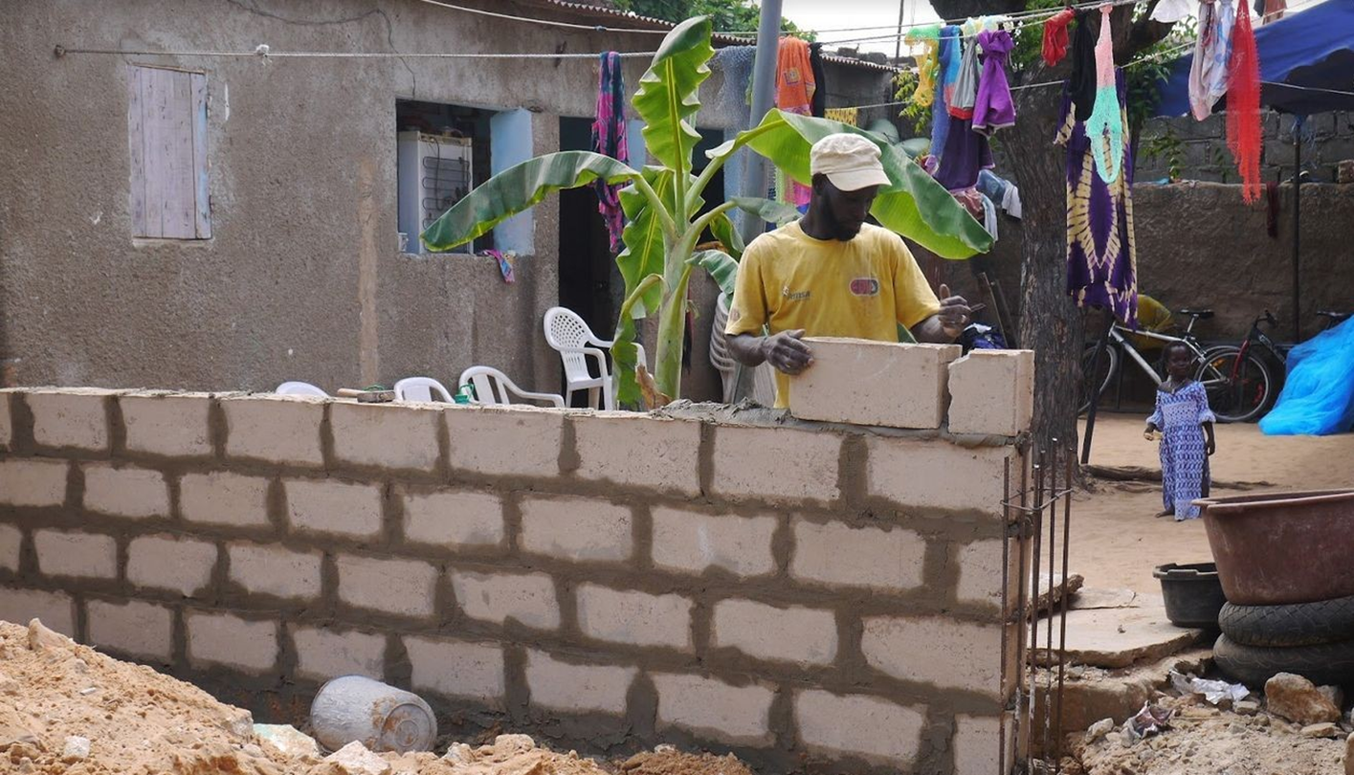
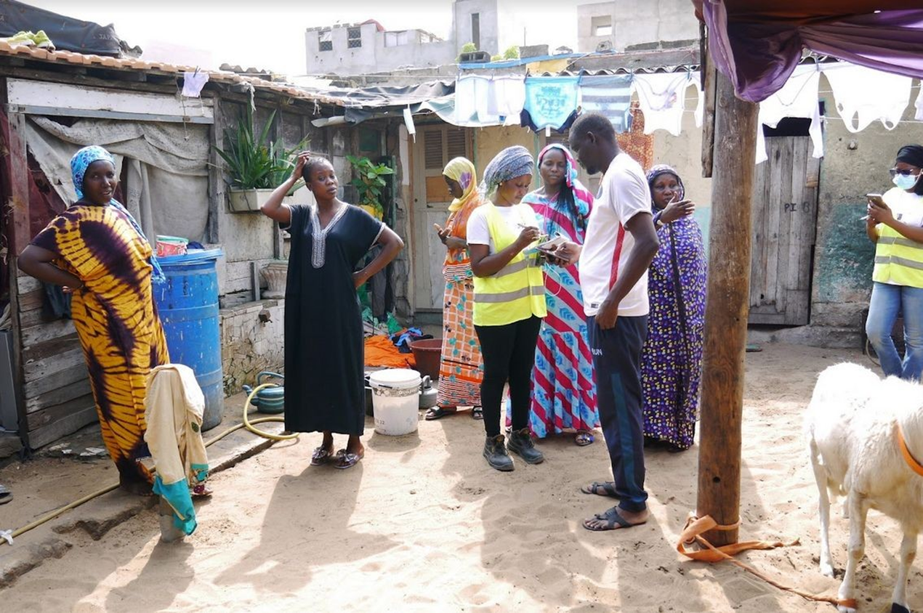
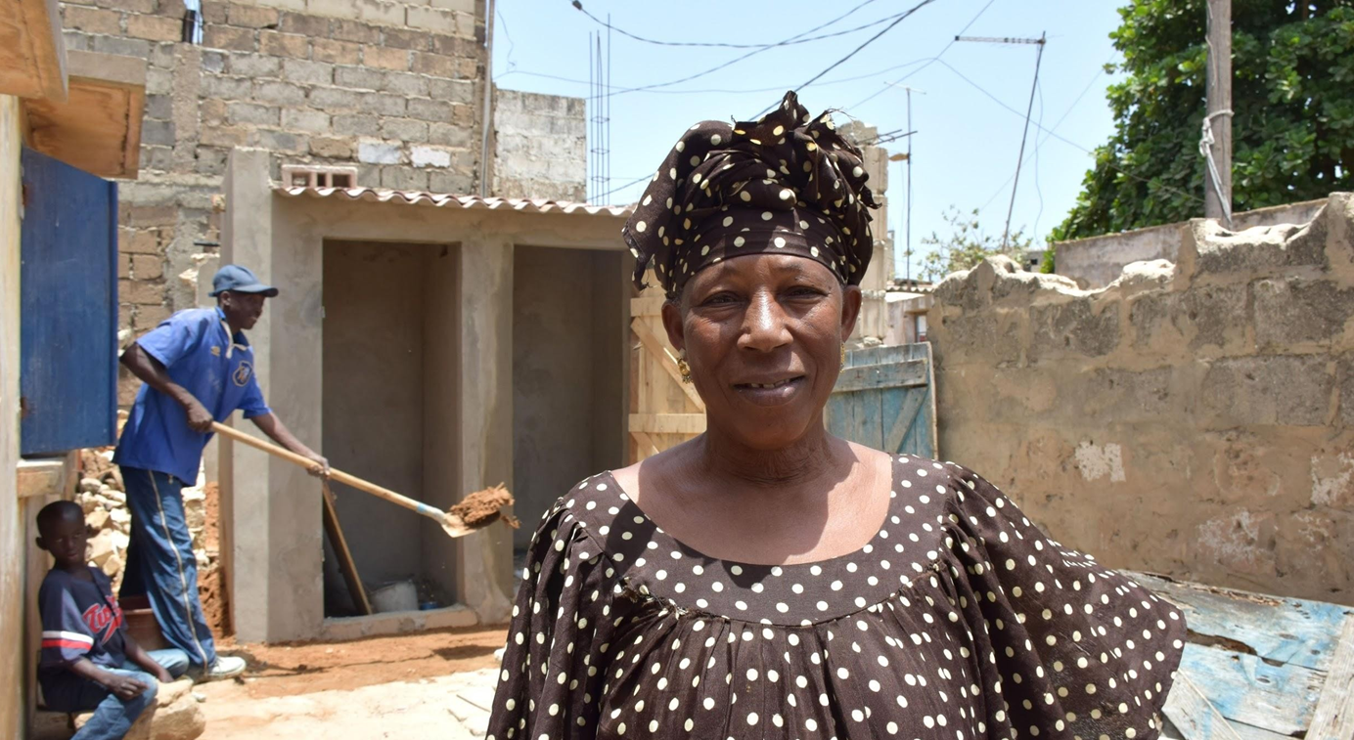
Community savings, a tool for individual housing rights
1’022 housing units renovated by households since 2014
Monitoring of works by urbaSEN’s technical team

Slide 17
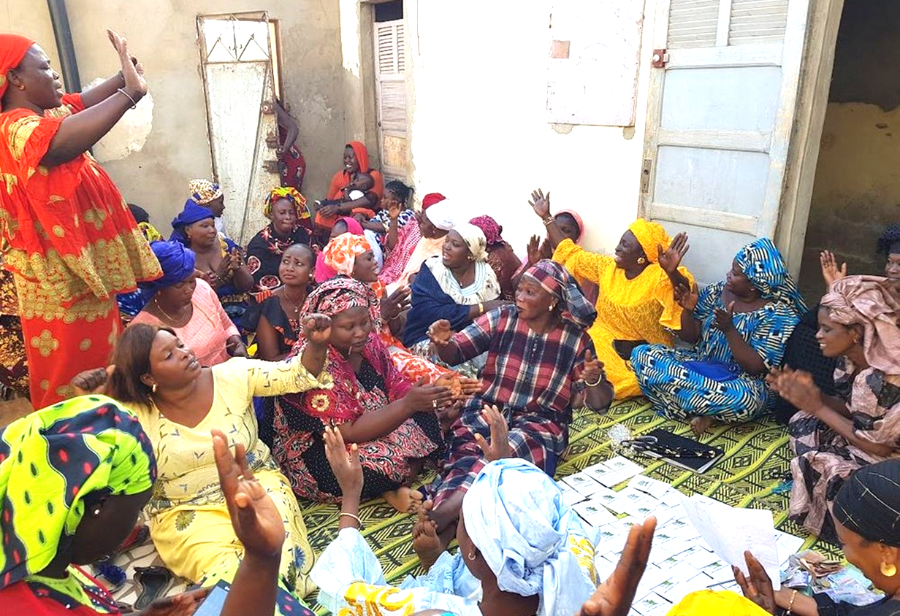
Community savings, a tool for collective empowerment
Collective savings give financial power to the Federation members.
Empowerment dynamic also fuelled by sensitization, training, data collection (“Information is power”)

Slide 18
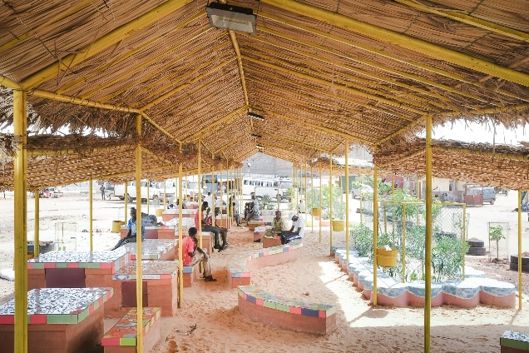
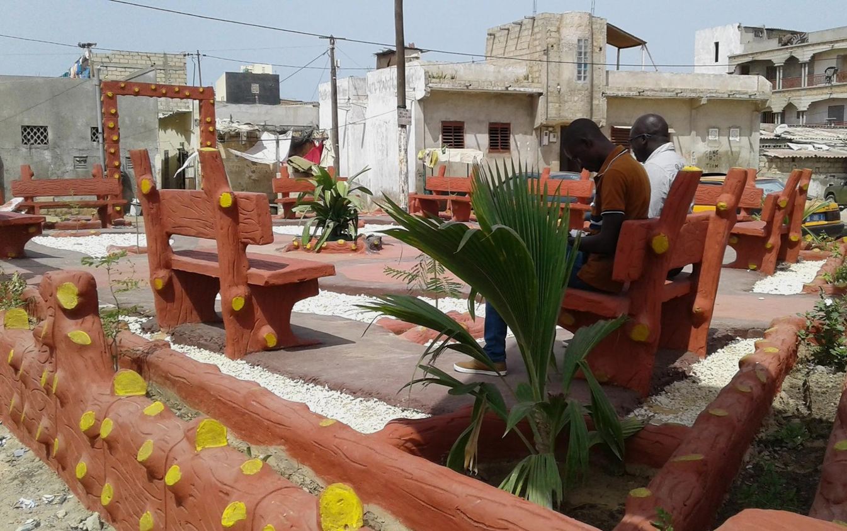
Community savings, a tool for participative urban projects
Thanks to the revolving fund, residents can cofinance collective projects: neighborhood improvements, public spaces, drainage infrastructures.
> Financial power legitimates the place of residents (especially women) in public life and local decision making processes.
> Base for co-design and co-production in local projects:
local authorities, residents and technical teams work together to
identify and solve local issues.

Slide 19
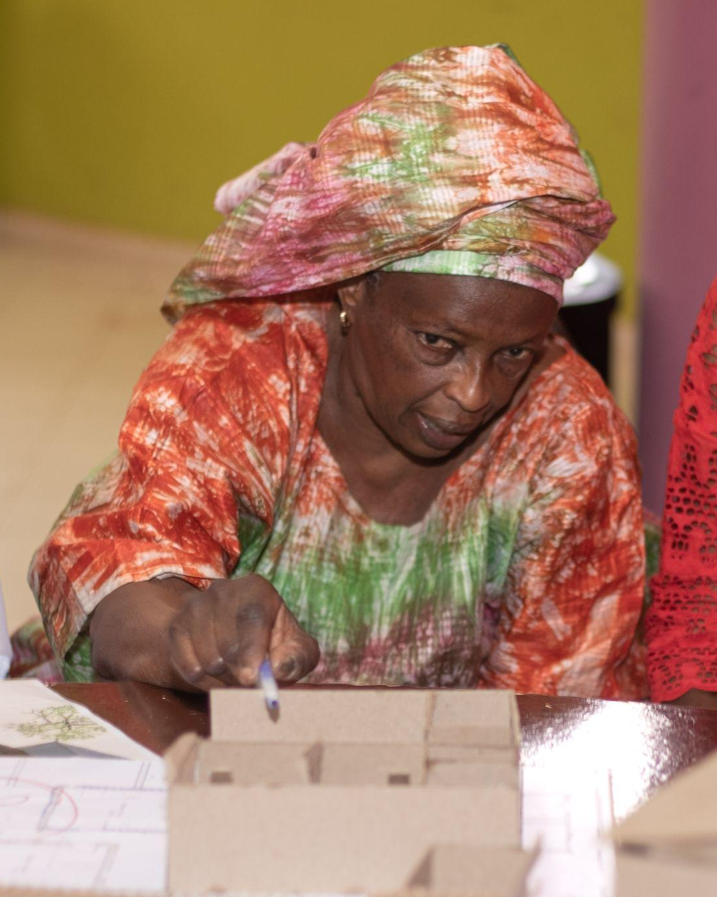
From renovation to affordable housing production
for vulnerable women :
the Cité FSH project

Slide 20
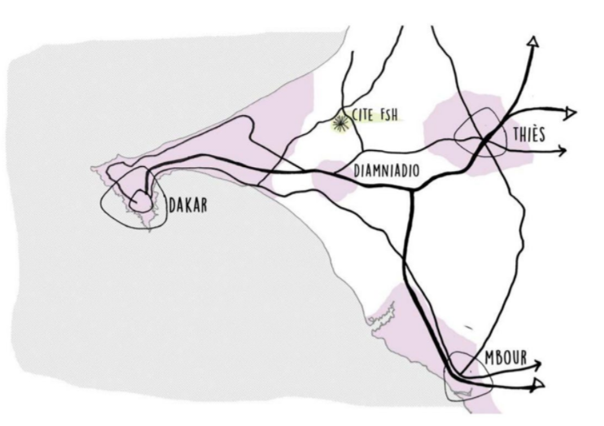
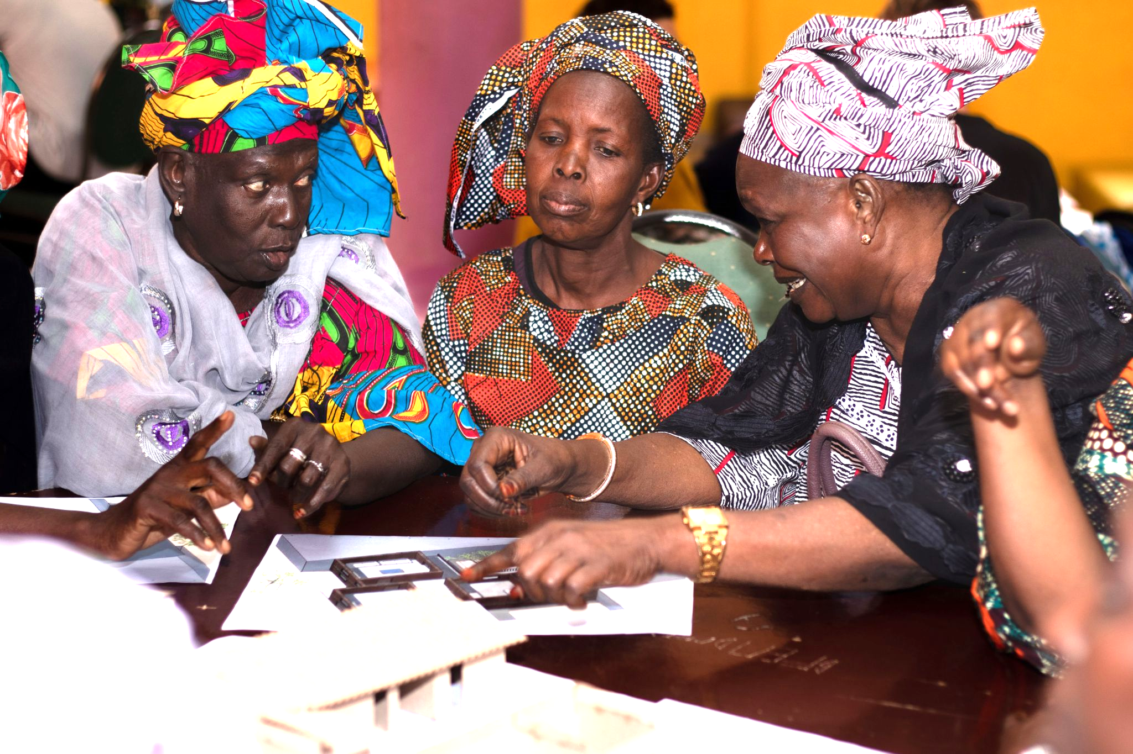
Homeownership for low-income households
2015 : Demand from women deprived of home ownership.
2018 : Beginning of specific savings
2020 : land acquisition and cooperative FSH founded to carry out the construction
Since 2021 : codesign workshops with beneficiaries, technical, legal and financial set-up of the project
Lobbying Senegalese government to recognise the project as part its social housing programme

Slide 21
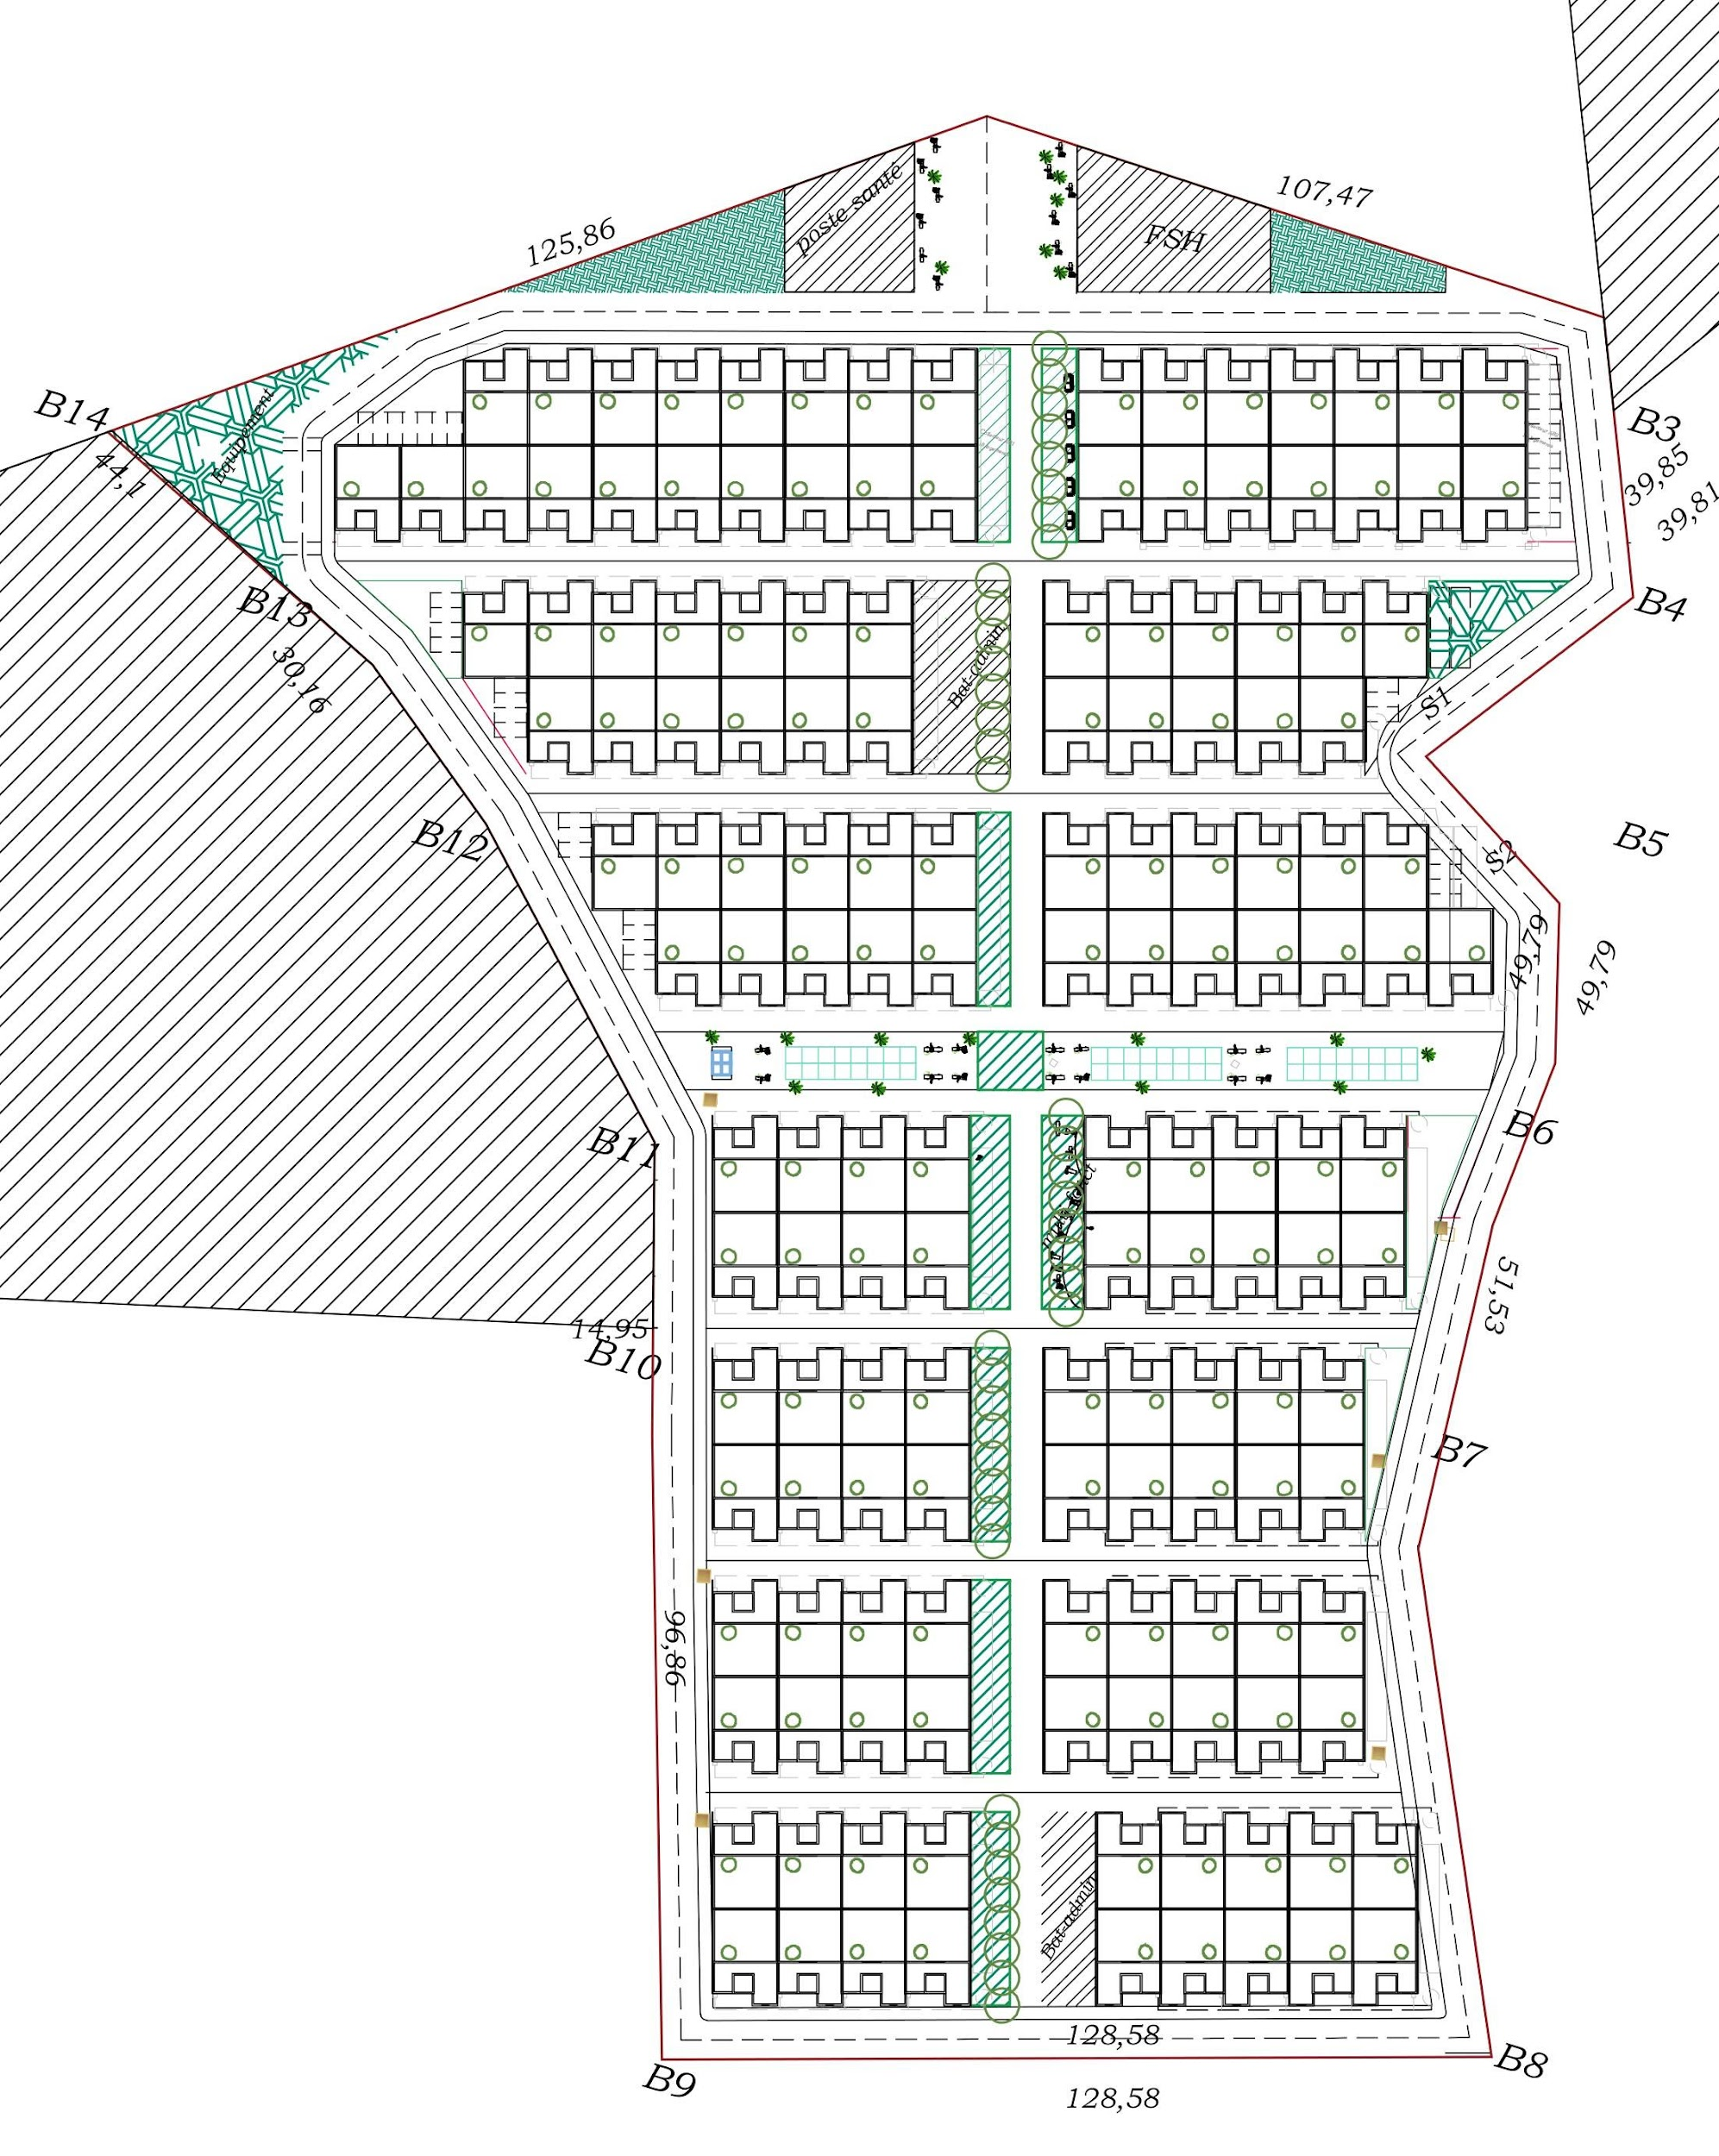
Development plan of the eco-district
150 plots of 150 m² each
Generous walking public
spaces, minimum space
for cars
Public facilities addressing
local needs (health center,
market, community center)
Green public and private
spaces, landscape design.
Eco-district principles:
sustainable materials,
bioclimatic design, universal accessibility
(French écoQuartier label)
Medical center
Maison FSH
Community hall
Green public space
Green public space
Public facility
Market
Central green public space
Public facility

Slide 22
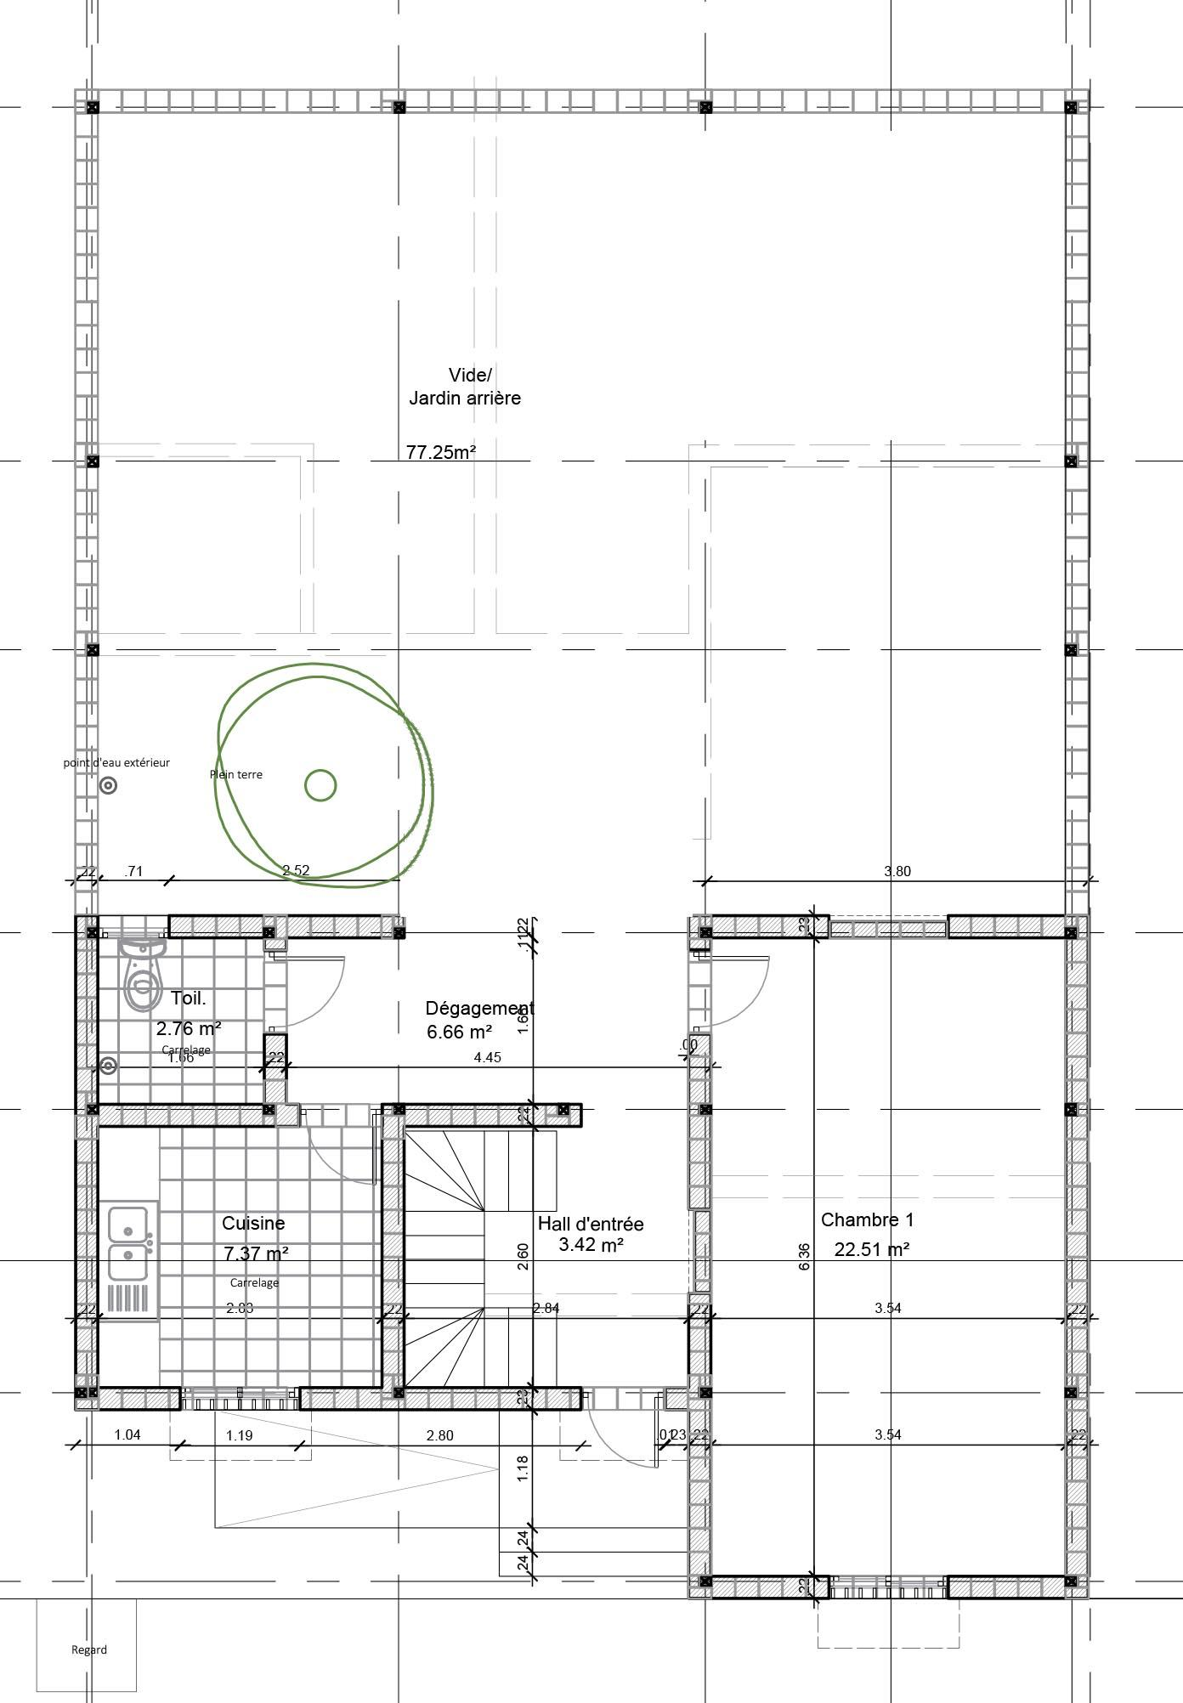
Architectural design
Affordability: a simple but qualitative model - XOF 13 million/house incl. serviced land (€ 20’000/USD 22’000).
Bioclimatic design: orientation and ventilation, local bio-sourced
materials.
Incremental design: evolutive house that can
be extended to suit the needs and resources of households over time.
Backyard
Tree in each backyard
Water point in the backyard
Divisible room
Staircase to terrace
Large kitchen space

Slide 23
Financing plan - a necessary combination of funds
Resources to be combined
Costs
Savings gathered by each household
Individual loan from the FSH revolving fund: monthly repayment capacity estimated at 50 to 80’000 XOF
Support from the Senegalese state covering of the servicing costs.
Grants from donors, private and CSR donations.
Collective bank loan to the FSH cooperative (amount depending on other contributions)
Cost of one house estimated at 13 million XOF (€20’000/USD22’000)
2.1 billion XOF for the whole project (incl. public services and spaces)
(€ 3.2M/USD 3.5M)

Slide 24
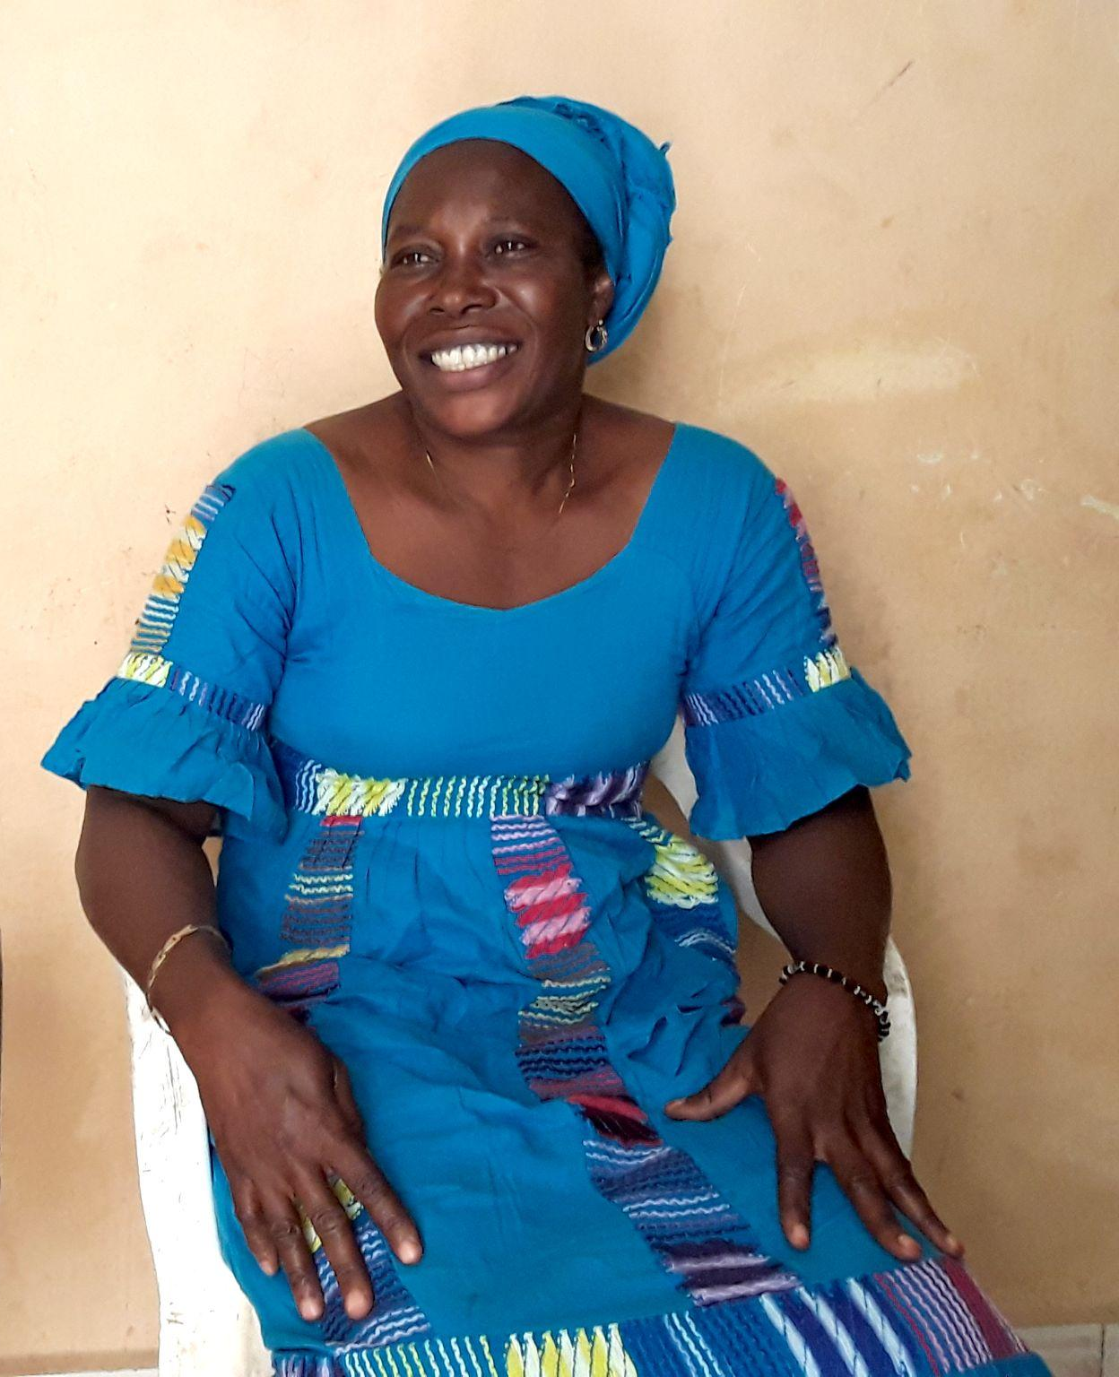
What we need now to operationalize the project
Financing:
  Endowments to the revolving fund
  Bank loan at accessible conditions
  International and CSR donors
Expertise: to reinforce urbaSEN’s engineering skills (financial model, production of materials, building process).
Support from government and public agencies for technical support and assistance with administrative procedures.
Technical partners to disseminate the model and share best practices.

Slide 25


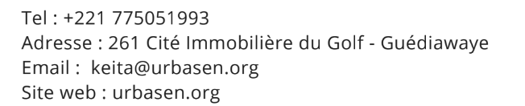


Further information...
Detailed brochure on the Cité FSH project
Study on affordable housing carried out by urbaMonde for CAHF

Slide 26
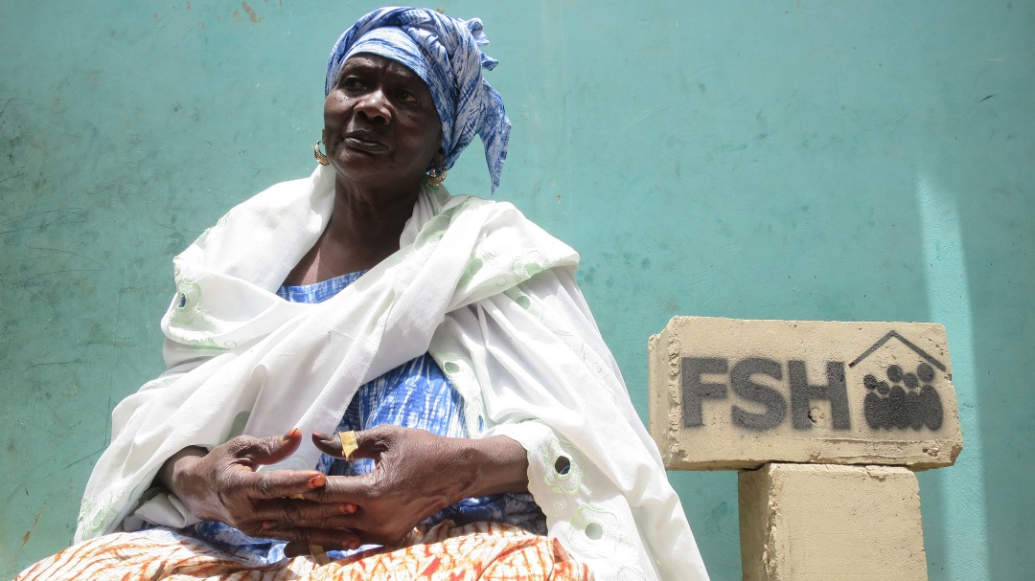
THANK YOU

