Slide 1

Economic and Mortgage Market Outlook
Prepared for the International Union for Housing Finance 32nd World Congress
Session 1: Regional Developments in Housing Finance and the Economy
September 18, 2024
Presented by:
Eddie Seiler, Ph.D.

Slide 2
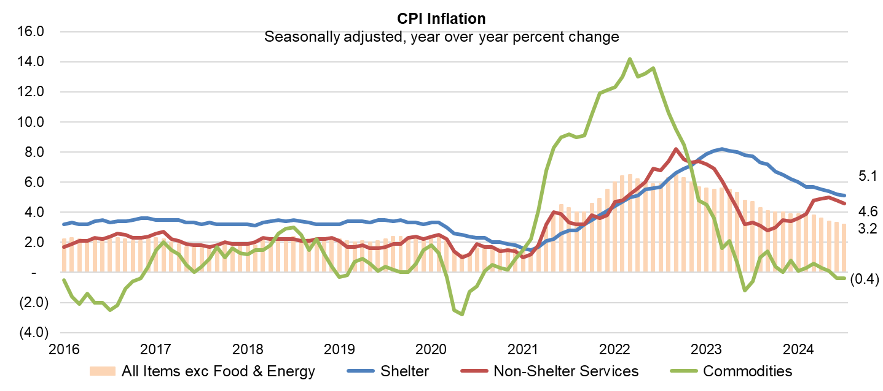
U.S. Inflation Continuing to Come Down Steadily to Fed’s 2% Target
Source: Bureau of Labor Statistics - Consumer Price Index (CPI)

Slide 3
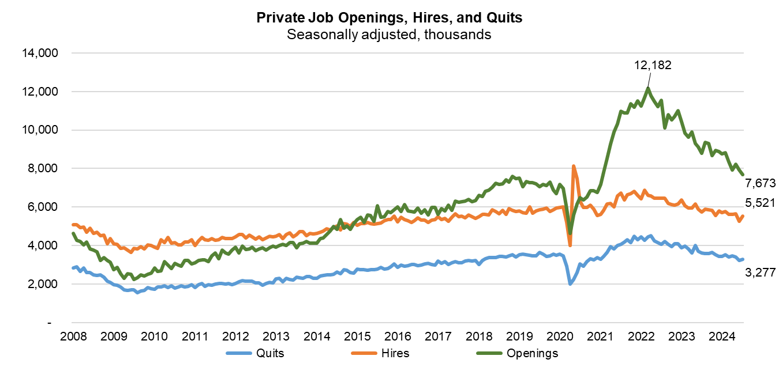
U.S. Job Market Cooling
Source: Bureau of Labor Statistics

Slide 4
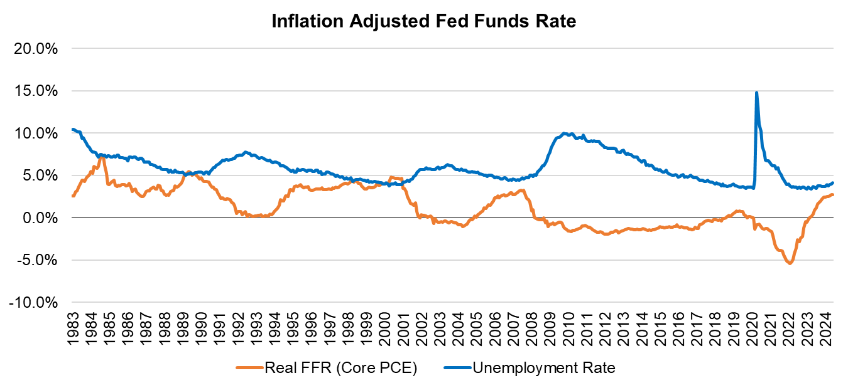
Turning Point for the U.S. Funds Rate?
Source: Bureau of Economic Analysis, Bureau of Labor Statistics, Federal Reserve Board

Slide 5
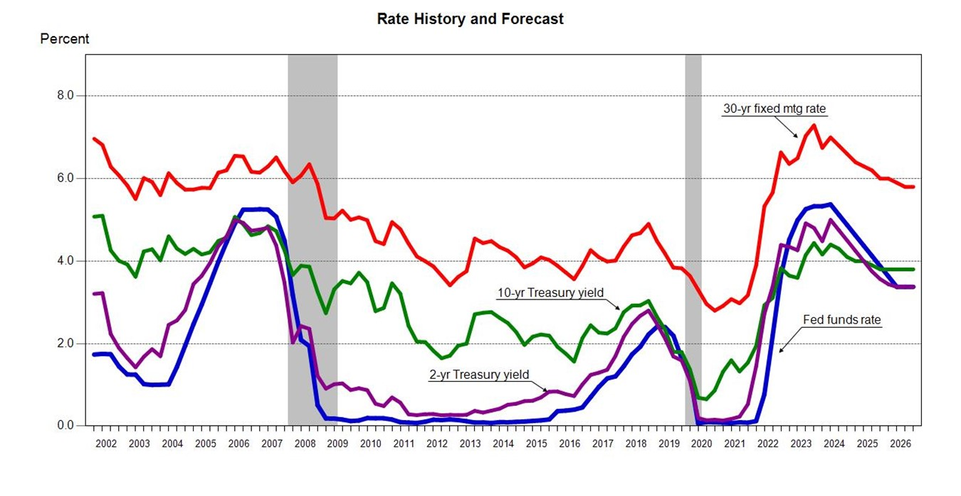
Fed Funds Rate: Expect Two Cuts This Year
Source: Federal Reserve Board, Freddie Mac, MBA Forecast

Slide 6
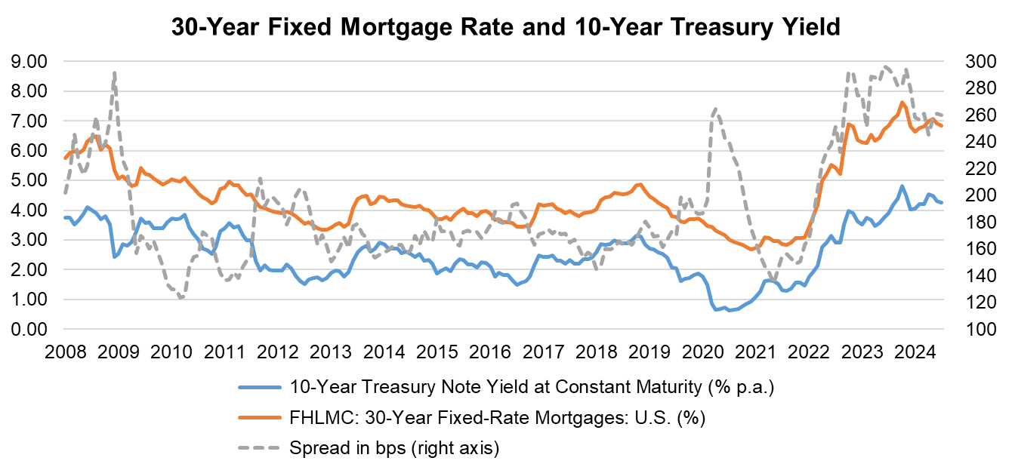
Spreads in U.S. Narrower But Still Wider Than Historical Averages
Source: Federal Reserve Board, Freddie Mac

Slide 7
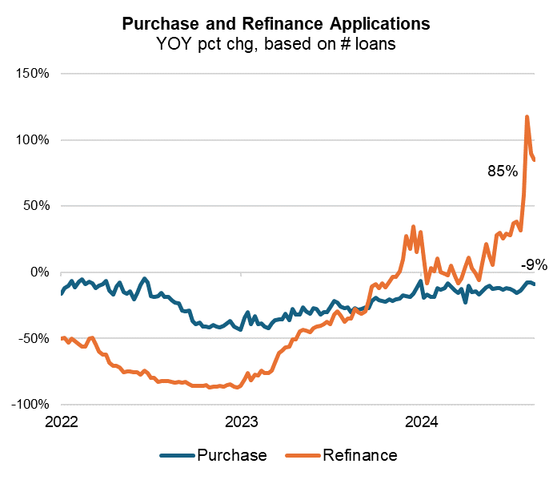
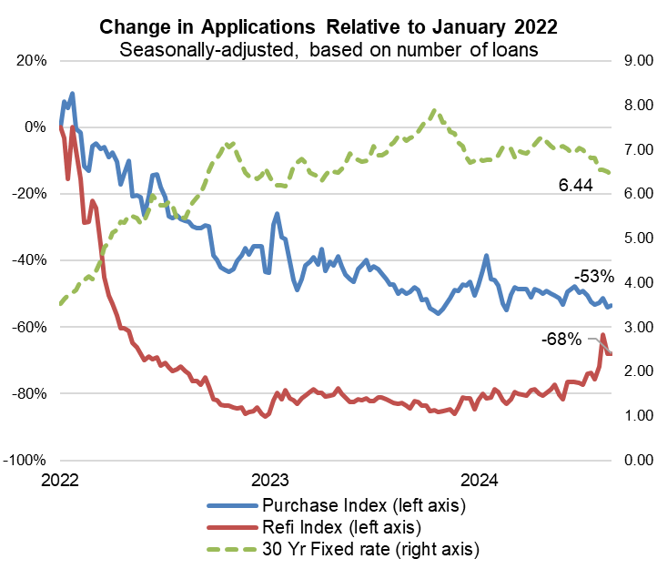
U.S. Refinance Applications Have Picked Up
Source: MBA Weekly Applications Survey

Slide 8
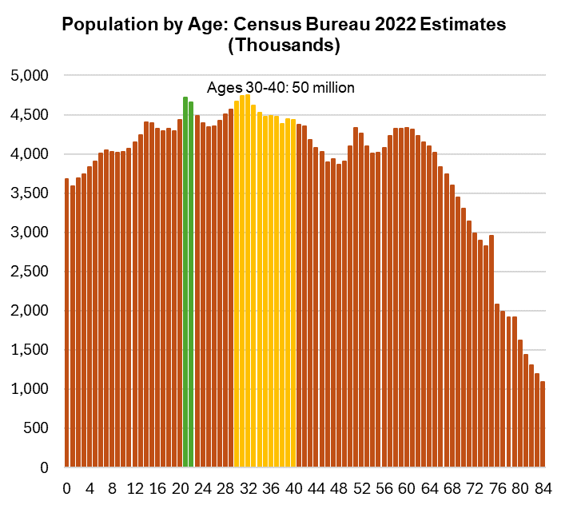
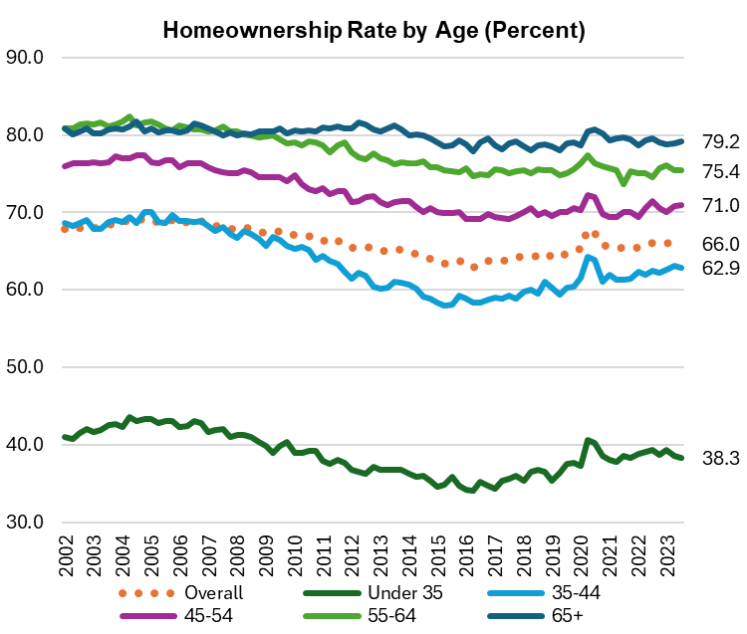
Demographic Support for Home Purchases in the United States
Source: Census Bureau

Slide 9
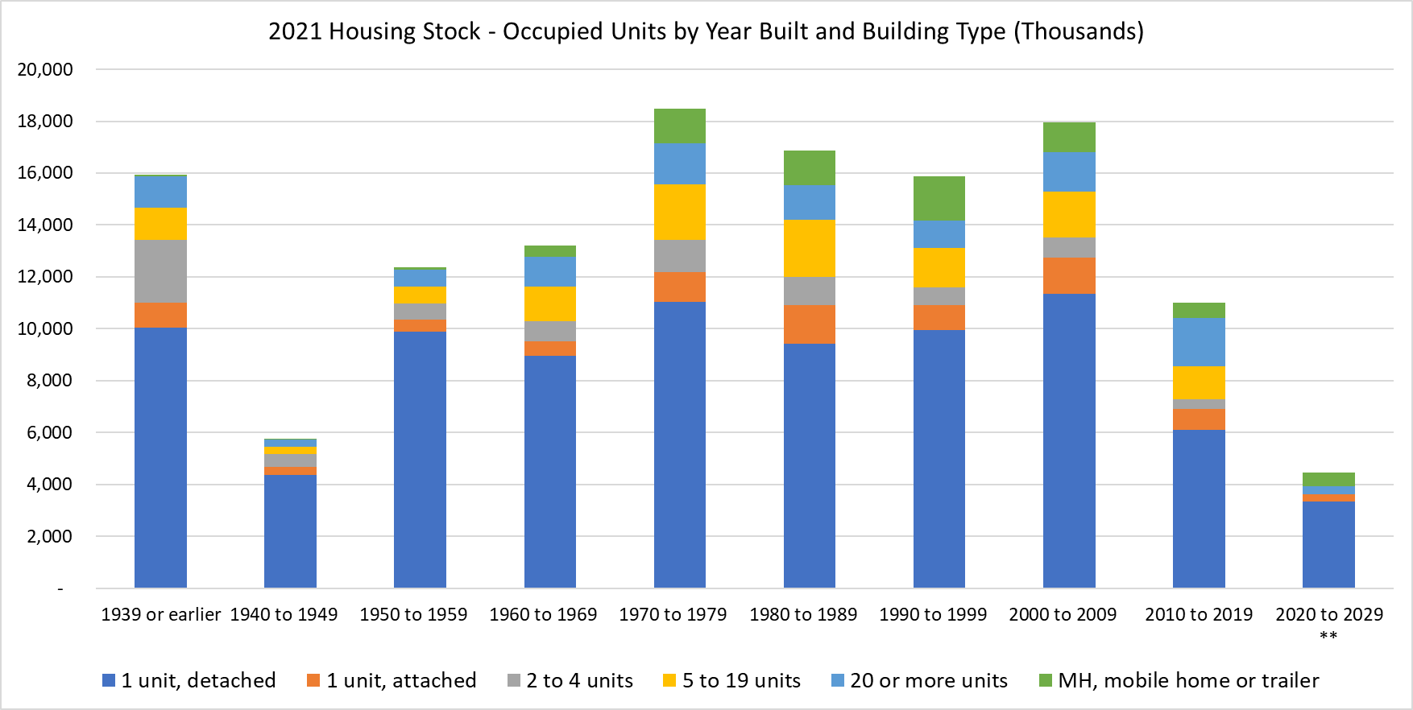
Structural Undersupply of Housing in U.S.
Source: Census Bureau, Department of Housing and Urban Development

Slide 10
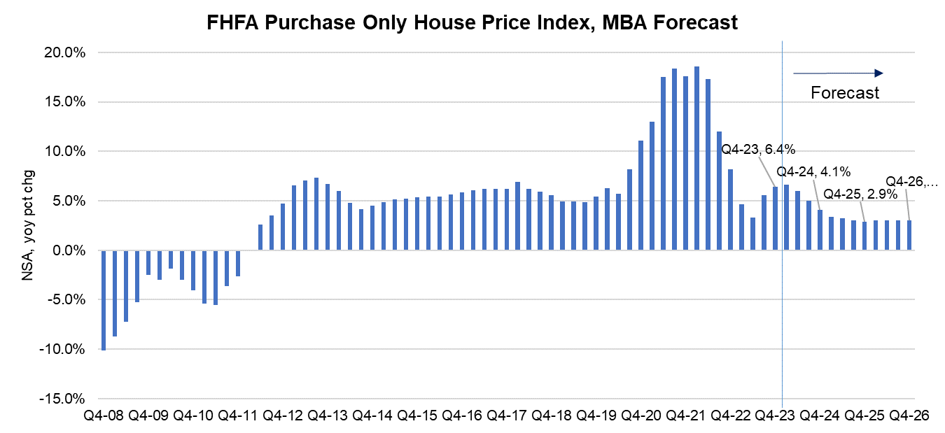
U.S. National House Price Appreciation Moderating But Expected To Remain Positive
Sources: Federal Housing Finance Agency, MBA Forecast

Slide 11
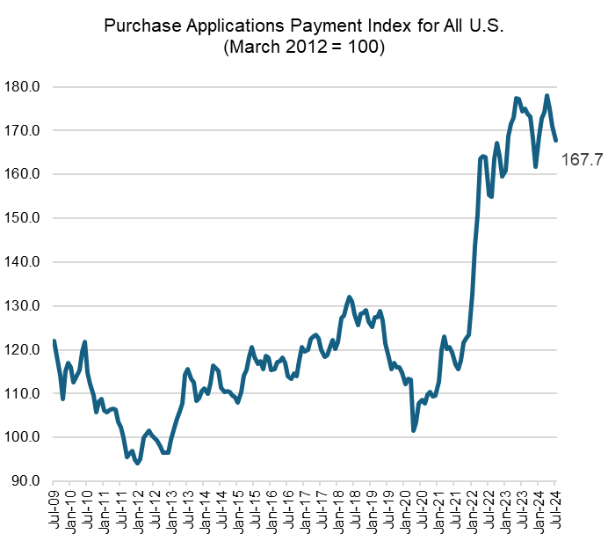
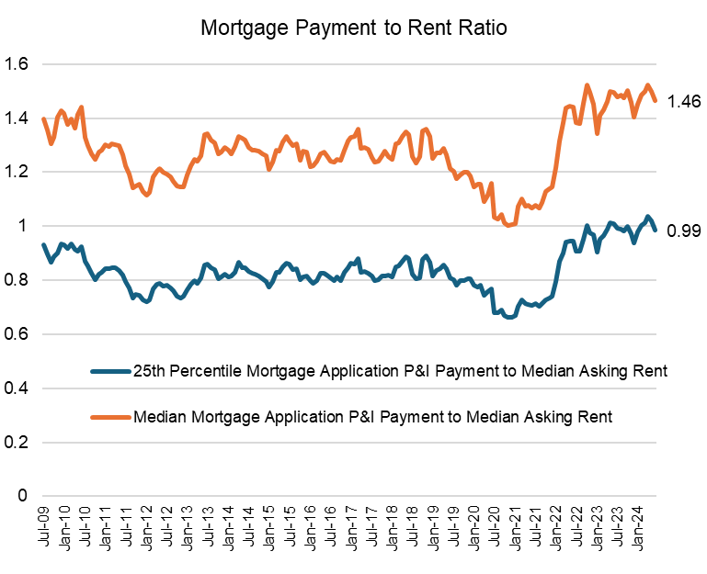
Affordability Conditions Have Worsened
Sources: MBA Weekly Applications Survey, Bureau of Labor Statistics, Census

Slide 12
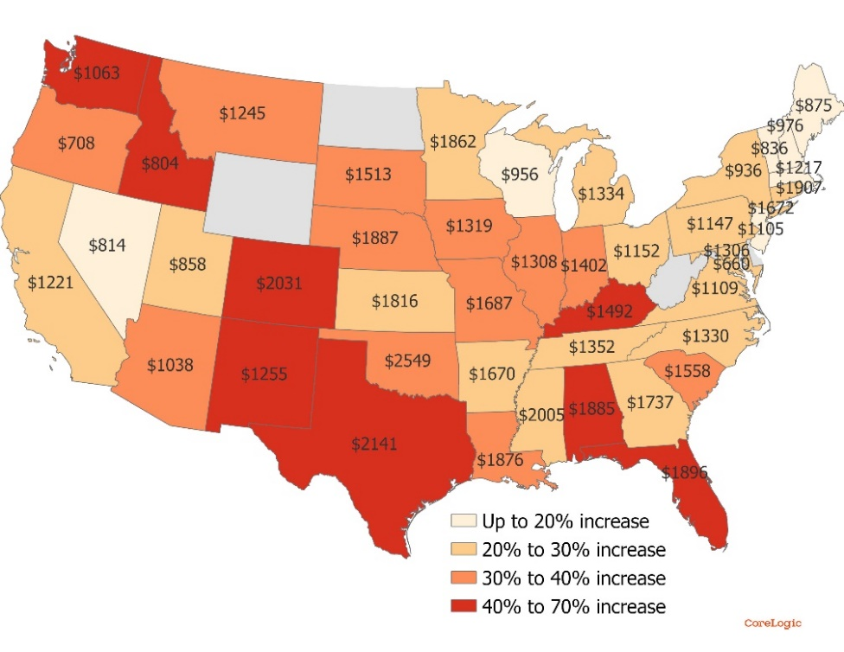
Rising Property Insurance Impacts Affordability for Owners (Especially Those With Fixed or Low Income)
Average Insurance Premium
Homeowner Insurance Premium and change from 2021
2021 to 2023 average increase: 35%
Top 5 states with highest increases:
  Florida 68%
  New Mexico 47%
  Idaho 46%
  Colorado 46%
  Texas 46%
Source: CoreLogic, National Association of Insurance Commissioners - https://content.naic.org/sites/default/files/publication-msr-pb-property-casualty.pdf ;
https://www.policygenius.com/
12
Notes:
Also mention this
https://www.spglobal.com/marketintelligence/en/news-insights/latest-news-headlines/us-homeowners-insurance-rates-jump-by-double-digits-in-2023-80057804

Slide 13
Contact Information and MBA Resources
Edward Seiler, Ph.D.
Executive Director, Research Institute for Housing America
(202) 557-2739; eseiler@mba.org
MBA Research: www.mba.org/research
Research Institute of Housing America (RIHA): www.housingamerica.org
MBA Forecasts and Commentary: https://www.mba.org/news-and-research/forecasts-and-commentary
Chart of the Week: https://www.mba.org/news-and-research/research-and-economics/chart-of-the-week
MBA Member-Only Research Portal: https://www.mba.org/news-and-research/research-and-economics/single-family-research/single-family-research-for-mba-members-only
13

