Slide 1

Housing Finance in Latin America and the Caribbean (LAC)
E-mail: uniapravi@uniapravi.org
Website: www.uniapravi.org

Slide 2

Economic Context
LAC reached a GDP of US$7.09 trillion
It represents only 6.7% of the Global GDP
Source: World Bank
Notes:
Millions=Millones en español
Billion=miles de millones en español
Trillion=Billones en español

Slide 3
GDP growth rates are varied in each country. The average for the region was 2.15% in 2023
According to World Bank projections:
1.6% in 2024
2.7% in 2025
2.6% in 2026,
Although a slow post-pandemic recovery is shown: "These figures are the lowest compared to all other regions of the world, and are insufficient to promote prosperity."
Source: World Bank

Slide 4
GDP per capita, which is also diverse in the countries of the region, varies between US$ 2,500 and US$ 22,550.
In 2023, the average in the region reaches US$ 10,681.73 with a growth rate of 1.41%.
In 2022, the average in the region reaches US$ 9,618.71 with a growth rate of 3.31%
Source: World Bank

Slide 5
The LAC region maintains high levels of inflation and unemployment.
In 2022, the average inflation for the region reached 7.8% and unemployment at 6.9%
In 2023, an improvement is shown, and the average inflation for the region reached 4.6% and unemployment at 6.2%
Source: World Bank
*Inflation Not available for Argentina and Venezuela

Slide 6
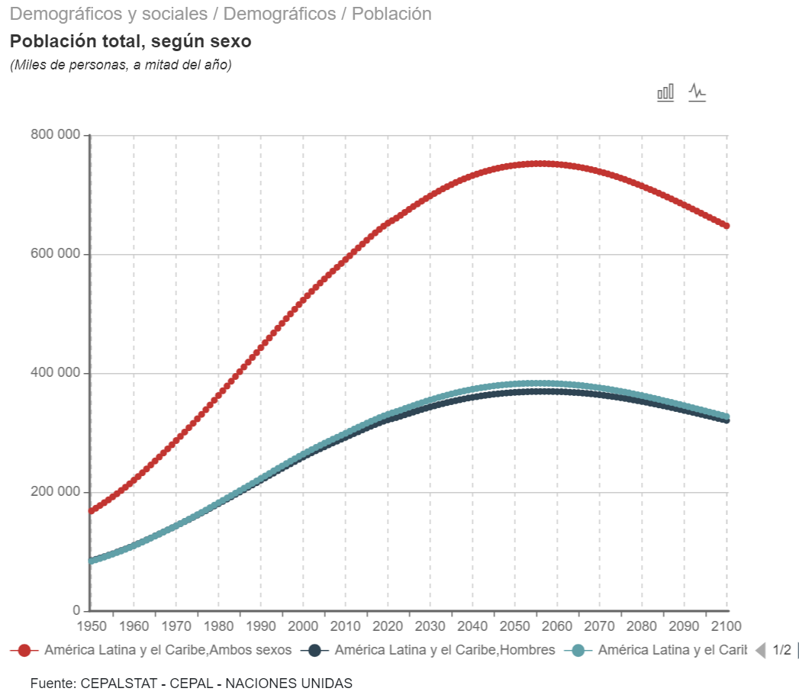
LAC Population
Total LAC population: 664 million inhabitants
From 2050 onwards, the growth trend changes
The urban population is growing steadily, as of 2023:
82% live in urban areas
18% in rural areas
Source: World Bank

Slide 7
New homes, new demand for housing:
By 2030, the formation of new households would be 9.6 million
By 2040 there will be 19.7 million
By 2050 there will be 24.8 million
Source: ECLAC
*Average household size 3.5 people, ECLAC, 2022

Slide 8
Housing deficit
Total Housing Deficit in LAC reaches 69.5 Million Homes
54.2% is urban and 45.8% rural
Sources: National Statistics Institutes, Ministries and Secretariats of Housing, Trade Unions, Housing and Construction Sector Foundations

Slide 9
Quantitative Deficit: 22%
Number of new homes required.
15.1 Million homes
Qualitative deficit 78%
Housing with poor housing quality and lack of basic services
54.4 Million Homes
Sources: National Statistics Institutes, Ministries and Secretariats of Housing, Trade Unions, Housing and Construction Sector Foundations

Slide 10
Home credit portfolio
The portfolio balance shows an increasing trend in the last 10 years
As of 2023, the Mortgage Portfolio Balance for housing amounts to US$ 613.5 trillion
Source: Prepared by Uniapravi, with data from Central Banks, Superintendencies of Banks and Financial Institutions, National Commission of Banks and Authorities of the Banking and Financial Sector of Latin American Countries

Slide 11
The evolution of the housing loan portfolio as a percentage of GDP showed an increasing pre-pandemic trend, then decreased, and in some countries it has not yet recovered to previous levels
Source: Prepared by Uniapravi, with data from Central Banks, Superintendencies of Banks and Financial Institutions, National Commission of Banks and Authorities of the Banking and Financial Sector of Latin American Countries

Slide 12
On average, the balance of the housing loan portfolio represents 8.63% of GDP for LAC, very low compared to other regions of the world.
Chile and Panama stand out, which are close to 30%
"There is great potential to increase mortgage deepening in the Region."
Source: Prepared by Uniapravi, with data from Central Banks, Superintendencies of Banks and Financial Institutions, National Commission of Banks and Authorities of the Banking and Financial Sector of Latin American Countries

Slide 13
In general, LAC shows low levels of delinquency.
As of 2023, it is between 0.5% and up to 3.8%, which indicates a healthy portfolio.
Source: Prepared by Uniapravi, with data from Central Banks, Superintendencies of Banks and Financial Institutions, National Commission of Banks and Authorities of the Banking and Financial Sector of Latin American Countries

Slide 14
Interest rates on housing loans granted by commercial banks range from 5% to 16%.
They tend to be lower in countries where indexed units apply, such as Argentina, Chile and Uruguay
/1 UVA Loans /2 Banks Only /3 Banks only, 2020-2022 information /4 Private Banks Only /5 UI and USD Loans /6 Includes special programs, information from 2016 - 2019
Source: Prepared by Uniapravi, with data from Central Banks, Superintendencies of Banks and Financial Institutions, National Commission of Banks and Authorities of the Banking and Financial Sector of Latin American Countries

Slide 15

Investment required
0.39 trillion USD
3.09 trillion USD
5.37 Trillion USD
1.89 trillion USD
Current quantitative deficit:
54.4 million homes
New Homes by 2050:
24.8 million homes
Current Qualitative Deficit:
15.1 million homes
  It is estimated that about US$ 5.37 tillion will be required to meet the current housing deficit and the new demand of the next 25 years

Slide 16
Highlights
Context show slow economic recovery, high levels of inflation and unemployment, great diversity of progress in the countries of the region.
The growth of the urban population is growing faster than the rural sector. But from 2050 there would be a demographic decrease
Housing financing has grown in recent years, credit portfolios are healthy, however the deepening of housing credit (8.63% of GDP) is still very low in the Region. There is great potential to increase housing financing.
The housing deficit (69.5 million homes) is more representative in the urban sector (54%) and the Qualitative Deficit (78%) mainly due to the production of informal housing or without technical assistance or risk areas.
Given the high qualitative deficit, in recent years countries such as Brazil, Colombia, and Mexico have been implementing self-construction/self-production programs for housing with technical assistance. Likewise, civil organizations, multilateral banks and development organizations have been promoting this issue in several countries of the region.

Slide 17
Highlights
To face the current housing deficits and demographic changes, it is necessary to:
Promote innovation in housing financing products to attend the acquisition of new housing, as well as improvement, mainly in lower-income sectors and the informal economy that are not served by traditional banks.
Take advantage of innovation and technological tools, in the design of products as well as in the strengthening of financial institutions, multiple banks, cooperatives, mutual savings and loans, among others.
Continue to promote financing programs with a gender and sustainable housing approach, taking advantage of the financial instruments and capital markets of sustainable financing and multilateral banks.
The articulation of the public, private, multilateral and civil society sectors is essential to generate synergies and implement joint actions to promote the development of housing financing and sustainable cities in Latin American and Caribbean countries.

